Slide 1

2020 Outlook
Presented By:
Your Name
Company
Notes:
Welcome to our 2020 Outlook workshop.

Slide 2
Tonight’s Agenda
Equity Market Update
Planning Strategies
Q&A
All examples provided are hypothetical and meant for illustrative purposes only. State income tax laws can be different from Federal income tax laws depending on your state. Be sure to take this into account before making any decisions. Individual situations will vary so please consult a tax advisor to address your specific situation.
Notes:
Today’s agenda is straightforward.
First, we will share a review of equity markets.
Then we will discuss some wide-ranging planning strategies you can consider.
We will then conclude with a questions & answer session.

Slide 3

Five Key Areas of Financial Planning
Preservation Planning
Retirement Planning
Tax Planning
Estate Planning
Investment Planning
Notes:
Before we begin, it is always important to review the five key areas of financial planning.
They are:
Preservation Planning,
Retirement Planning,
Tax Planning,
Estate Planning, and
Investment Planning
As a comprehensive financial planning practice, we try to always consider the impact of any recommendation we make on not just one, but all of these areas for our clients.

Slide 4


2019 Was a Healthy Year for Investors
Equity Market Review
Notes:
2019 was a healthy year for investors!

Slide 5
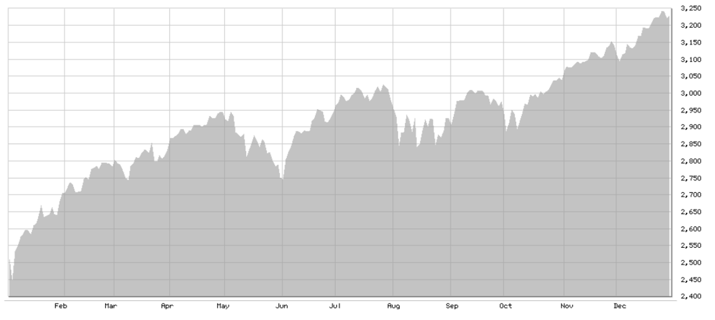
Markets do not move in a straight line!
Equity Market Review
S&P 500
1/1/2019 – 12/31/2019
Source: BigCharts.com
Notes:
As I said, 2019 was a good year for equities. As this chart shows, the S&P 500 moved up strong over the 12-month timeframe.
In fact, from October 8th through November 30th, the S&P 500 climbed +8.6% without a single down day worse than -0.50%. Then after 2 down days to start December, on December 3rd it headed toward an exceptional year close.
However, as this chart shows, even a great year for equities did not move in a straight line.
Source: Barron’s, bigcharts.com

Slide 6
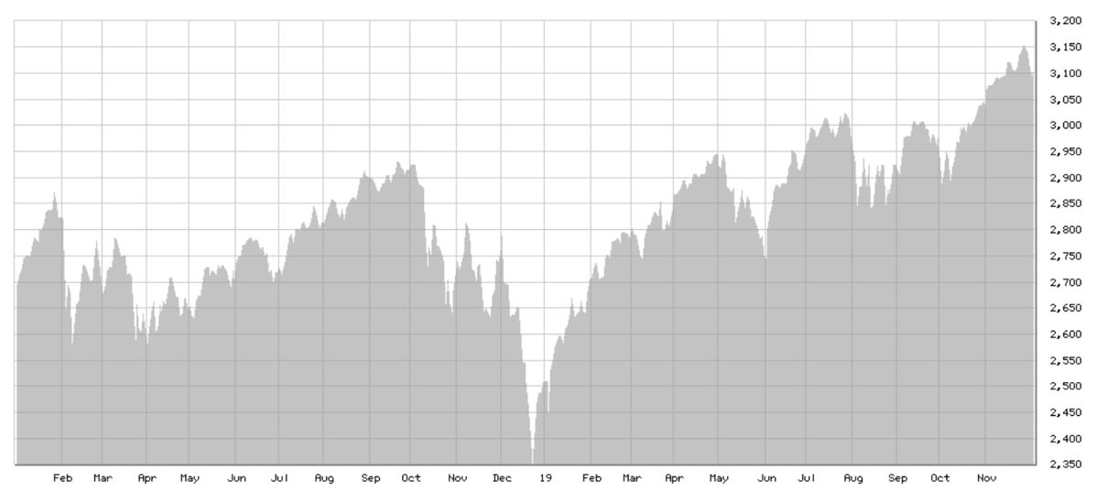
Equity Market Review
January 2019
2-year chart
S&P 500
1/1/2018 – 12/31/2019
Source: BigCharts.com
Notes:
A two-year chart is even more telling that equity markets can be quite volatile.
Notice the last quarter of 2018 was not a good one for returns, but over the two-year time period investors did well.
Source: bigcharts.com

Slide 7
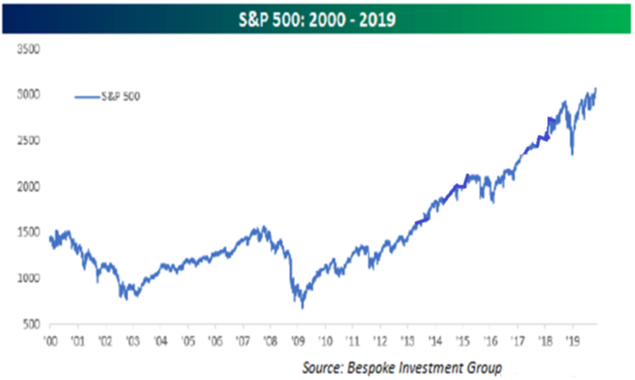
2010’s Were a Good Decade for Investors
Equity Market Review
Notes:
Looking back even further, the 2010’s was a good decade for equity investors.
As this chart shares, after a rough decade of 2000 to 2010, the past decade was a very healthy one for investors.
One challenge for investors in the equity market currently is the fact it appears to be at very high levels.
This is decent for those already invested, but it also presents questions about where the market is headed.
Source: https://seekingalpha.com/article/4310001-investing-all-time-highs-in-equity-market

Slide 8
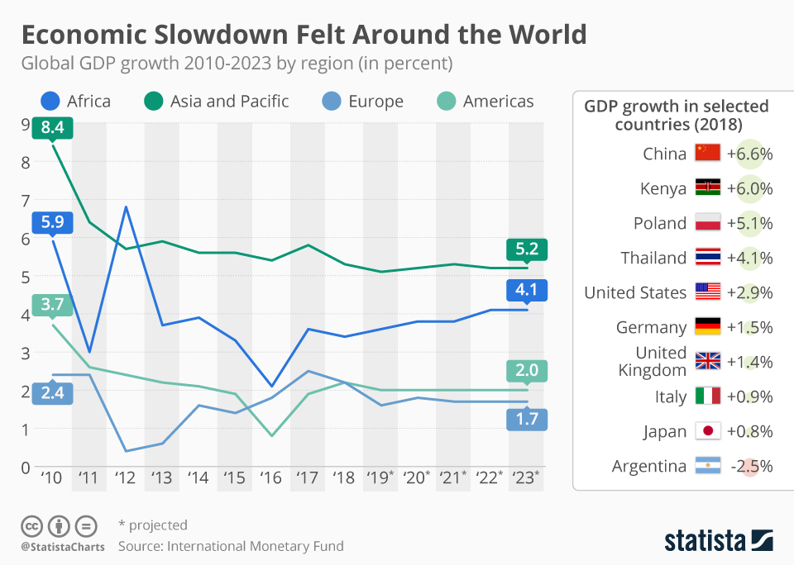
Global Economic Slowdown
The year-over-year pace of increase in the world's total industrial output began a sustained decline in late 2017.
In the last quarter of 2019, the IMF downgraded its global
growth forecast for 2020, citing trade and geopolitical tensions.
Source: statista.com
Notes:
There was a lot of talk about the global economic slowdown. During the year, there was discussion that suggested the trade war was hurting global growth, but it's important to understand that the trade war didn't cause the global slowdown.
The year-over-year pace of increase in the world's total industrial output began a sustained decline in late 2017.
As this chart of 9 countries shows, in the last quarter of 2019, the International Money Fund (IMF) continued to downgrad its global growth forecast for 2020, citing trade and geopolitical tensions.
Source: https://www.statista.com/chart/17687/global-gdp-growth-by-region/

Slide 9

Trade War Fears
Negative trade war news could cause
equity market uncertainty and a sell off!
Notes:
As of now, the U.S. and China are working towards solving some of the “trade war” issues that are outstanding. Both countries have agreed a Phase 1 agreement that would help narrow some of the differences.
For investors, it is helpful to remember that negative trade war news could cause equity market uncertainty and start a potential equity sell off!

Slide 10
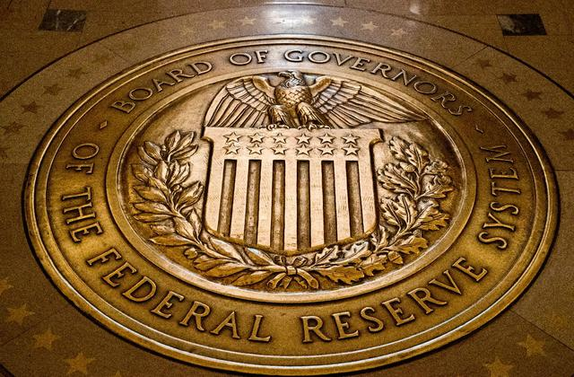
Interest Rates
In
After reducing rates three times in 2019, Chairman Jerome Powell stated that Fed officials are willing to “be accommodative” with rates.
Notes:
Interest rates are another key area for investors to watch in 2020.
After reducing the Federal Funds rates three times in 2019, Federal Reserve Chairman Jerome Powell stated that Fed officials are willing to “be accommodative” with rates in 2020.

Slide 11
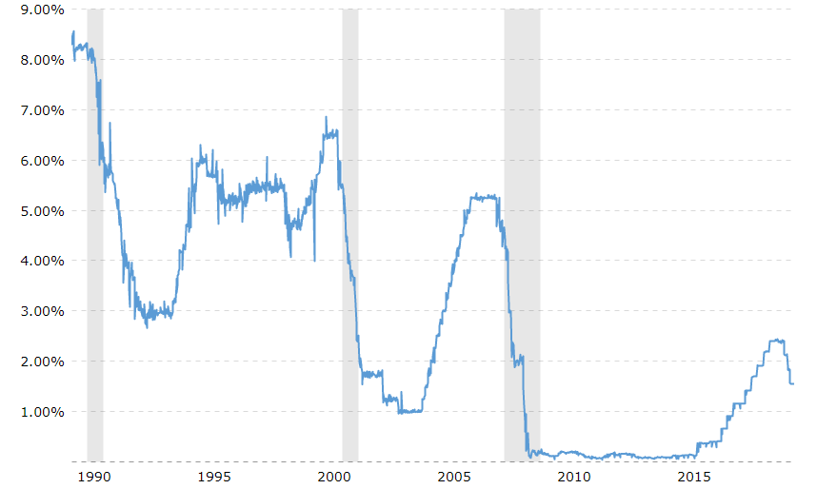
Interest Rates are Low
Federal Funds Rates (1990-2020)
Source: Macrotrends.net
Notes:
As this 30-year chart of Federal Funds rates shows, at slightly over 1%, short term rates are higher than the period of near 0%, but they are still low by historical standards.
Source: macrotrends.net

Slide 12

Political Uncertainty
Notes:
While we will not get political, everyone does know that 2020 is a Presidential election year.
Equity markets do not like uncertainty or disruption and the current political environment can sometimes be a little disruptive.

Slide 13

Geopolitical Uncertainty
Notes:
Again, equity markets dislike uncertainty and in many parts of the world today, there is geopolitical unrest.
Situations like the conflict in the Middle East can escalate and cause turmoil.
This could also lead to disruptive equity markets.

Slide 14
The Cost of Safety
MONEY RATES (as posted in Barron’s 3/2/2020)
 | LATEST WEEK | YR AGO
Bank Money Market* | 0.21% | 0.23%
12-month CD* | 0.76% | 0.98%
c- Annualized yields, adjusted for constant maturity, reported by the Fed Reserve on a weekly average basis. z – Bankrate.com (Source: Barron’s; bankrate.com)
Notes:
Market changes are a part of investing.
Those who want complete safety are looking at very low returns.
As of the beginning of March, the average CD rate and bank money market had yields of 1% and lower.
Do you need more than a 1% return on investment to achieve your financial goals?
For many investors, the answer is YES!

Slide 15
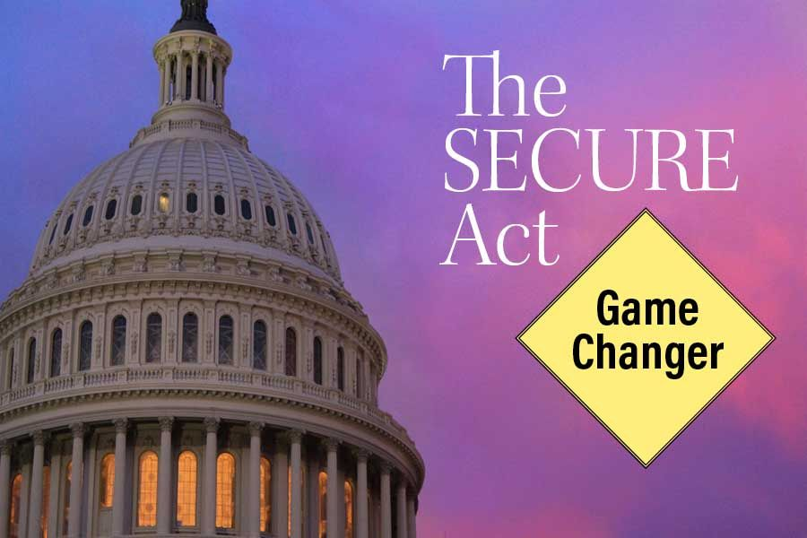
New Legislation
Signed into law on
December 20, 2019
Notes:
Also, on December 20th 2019, a major piece of legislation known as the SECURE ACT was signed into law.
This new act brings massive changes for those of us with retirement savings.

Slide 16

Typically, the most successful investors think and act for the long-term...
It’s near impossible to predict,
but you can prepare.
Notes:
Typically, the most successful investors think and act for the long-term.
It’s near impossible to predict exact market movements, however, you can prepare.

Slide 17

2020 Outlook
Notes:
So how should an investor approach 2020?

Slide 18
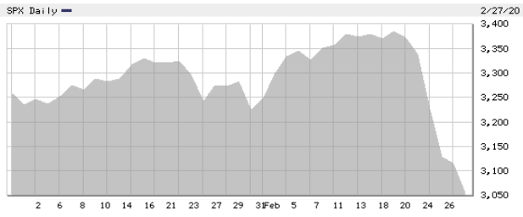
2020 Outlook
Equity markets advanced early in the year and then declined rapidly in mid-February.
S&P 500: January 1 – February 27, 2020
Chart Source: bigcharts.com
Notes:
As this chart for 2020 shows, equity markets advanced early in the year and made new highs in mid-February and then they rapidly declined after February 19th.

Slide 19

2020 Outlook
Many analysts are pointing to the Coronavirus outbreak as the source
of the equity market declines.
Notes:
Many analysts are pointing to the Coronavirus outbreak as the source of the equity market declines.
The Coronavirus is disrupting business and can affect some companies earnings. This is causing fears in equity markets.

Slide 20
2020 Outlook
S&P 500 Corrections Over 10% Since March 2009
Time Period | # of Days | Decline | Reason Cited
2018: Sept 21 – Dec 26 | 96 | -20.2% | Rising rates, China slowdown, trade war/tariffs, housing slowdown
2018: Jan 26 – Feb 9 | 14 | -11.8% | Inflation fears, rising rates
2015/16: Nov 3 – Feb 11 | 100 | -14.5% | China, EM currencies, falling oil, Middle East, North Korea nukes
2015: May 20 – Aug 24 | 96 | -12.5% | Greece default concerns, China stock crash, EM currency turmoil
2012: Apr 2 – June 4 | 63 | -10.9% | Europe’s debt crisis
2011: Oct 27- Nov 25 | 29 | -10.4% | Europe’s debt crisis
2011: May 2 – Oct 4 | 155 | -21.6% | Europe’s debt crisis, double-dip recession fears, U.S. debt downgrade
2010: April 26- July 1 | 66 | -17.1% | Europe’s debt crisis, flash crash, growth concerns
Source: Seekingalpha.com
Notes:
Equity markets have caused concerns lately and so it might be helpful to remind ourselves that while downturns are unpredictable, they are not unprecedented.
A move downward of 10% is called a “correction”.
Since the March 2009 low of the S & P 500 the market has had a great rise but if you look carefully you will find that the S&P has experienced eight corrections over 10% during that time-period .

Slide 21

2020 Outlook
On March 3, the Fed reduced the Federal Funds Rate by 50 basis points to a range of
1 – 1.25% and the 10-year Treasury yield reached a record low.
News of the Coronavirus spreading to U.S. communities pushed the 10-year yield down to under 1.1%.
Notes:
How has the bond market responded?
On March 3, the Fed reduced the Federal Funds Rate by 50 basis points to a range of 1 – 1.25% and the 10-year Treasury yield reached a record low.
News of the Coronavirus spreading to U.S. communities pushed the 10-year yield down to under 1.1%.
Source: Barron’s 2020

Slide 22
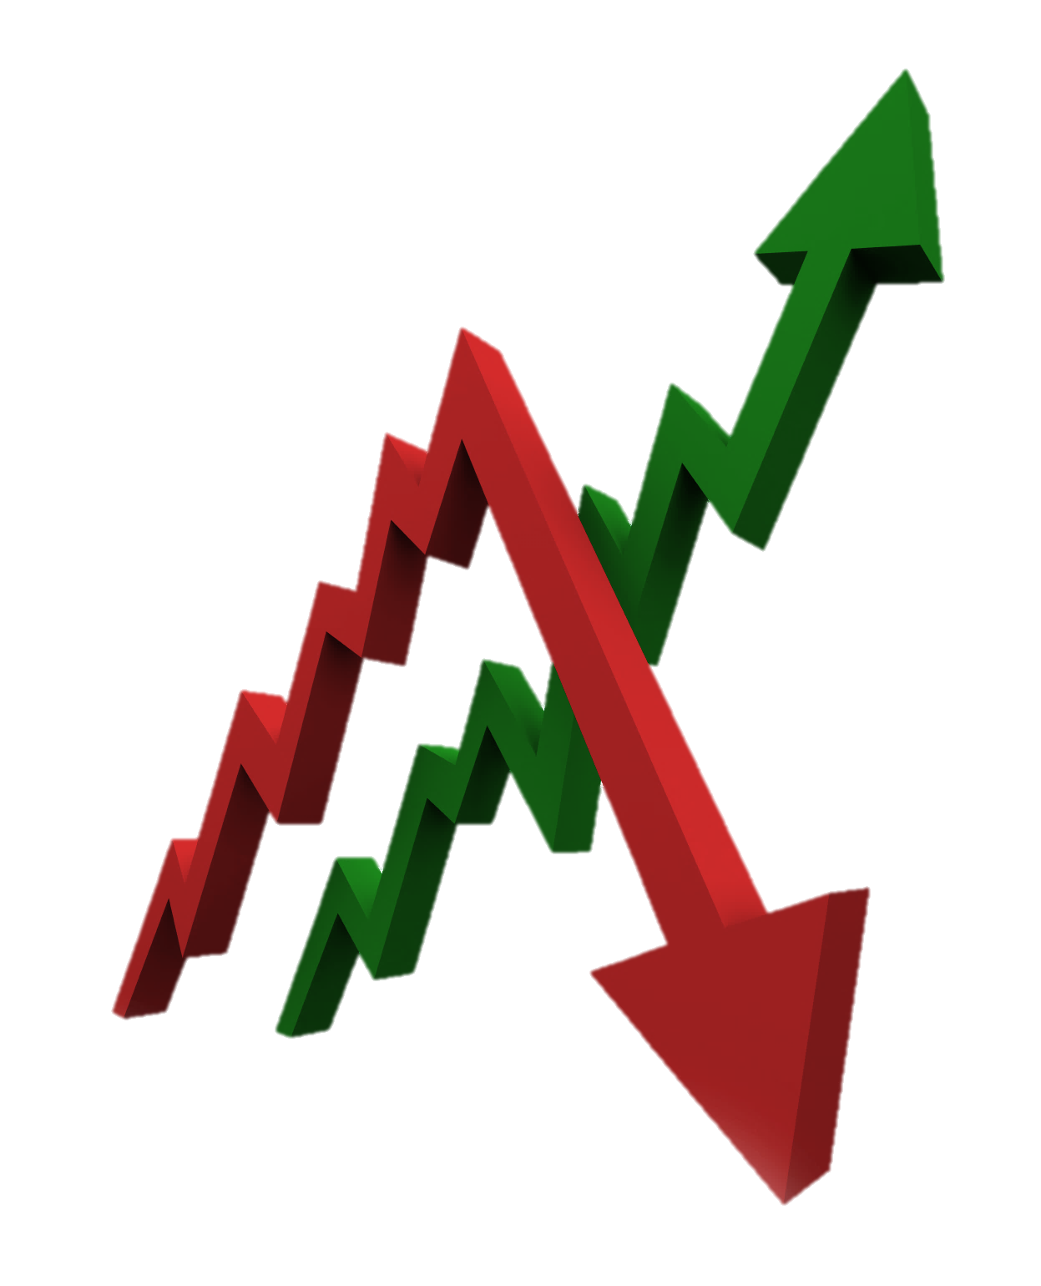
2020 Outlook
Do you think equity markets
will finish up or down in 2020?
Notes:
Do you think the market will finish up or down in 2020?
The key can be not to speculate or try to predict – but rather plan!

Slide 23
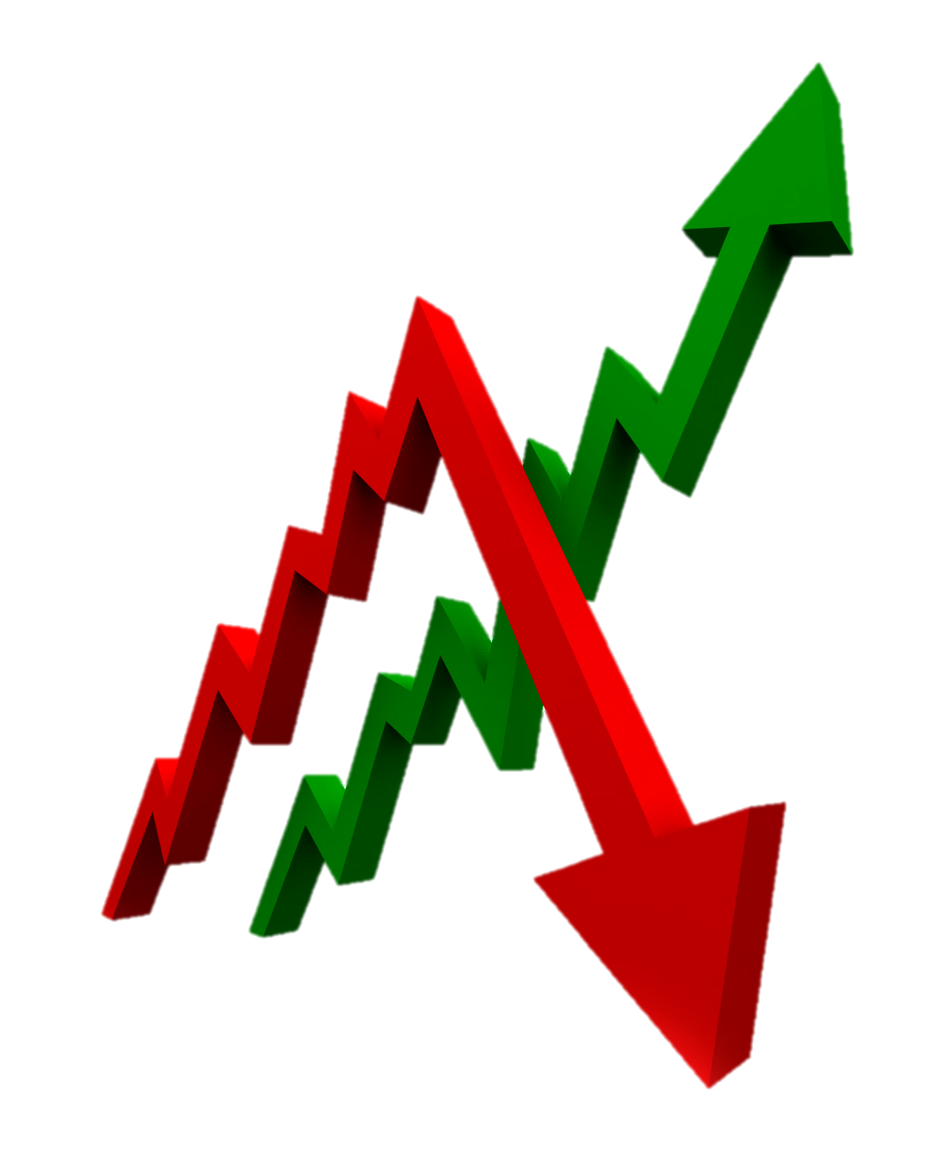
2020 Outlook
Firm | Strategist | 2020 S&P 500 Target
Credit Suisse | Jonathan Golub | 3,425
Goldman Sachs | David Kostin | 3,400
JPMorgan Chase | Dubravko Lakos-Bujas | 3,400
Wells Fargo | Chris Harvey | 3,388
Citigroup | Tobias Levkovich | 3,375
Bank of America | Savita Subramanian | 3,300
Deutsche Bank | Binky Chada | 3,250
Morgan Stanley | Mike Wilson | 3,000
UBS | Francois Trahan | 3,000
 | MEAN | 3,282
Source: Banks’ 2020 outlooks
Notes:
Many of Wall Street's strategists made their stock market predictions for 2020, and they are primarily bullish, but they are only calling for modest gains.
As we said earlier, no one has a crystal ball and for 2019 analysts did not expect or predict the robust year we experienced.
Our goal is to continue to be watchful of equity markets at all times.
https://markets.businessinsider.com/news/stocks/prediction-consensus-what-the-experts-see-coming-in-2020-1028792192#

Slide 24
Key Takeaways
    2019 produced strong returns for equity investors
    Extreme volatility has reemerged!
    Many key economic data indicators are still
    reasonable.
    Most analysts suggest 2020 will have positive
    equity returns.
Notes:
As a recap, what are some key takeaways for investors.
They include:
2019 produced strong returns for equity investors
Extreme volatility has reemerged!
Many key economic data indicators are still reasonable.
Most analysts suggest 2020 will have positive equity returns.

Slide 25
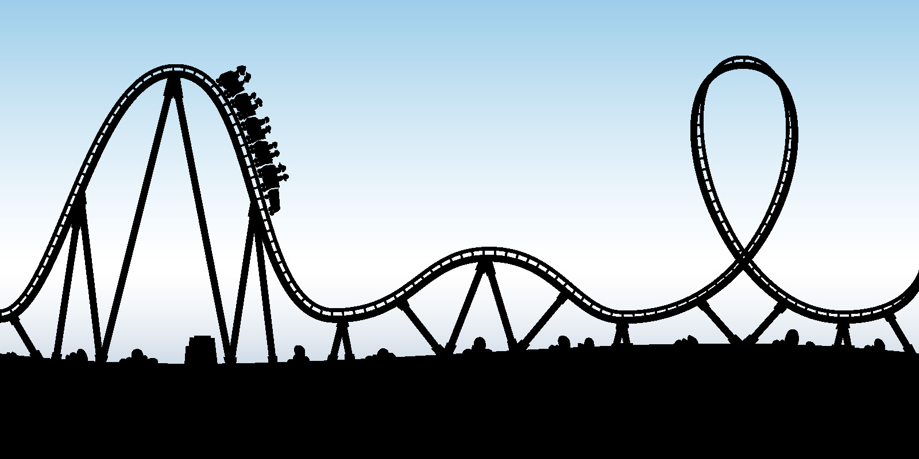
2020 Outlook
Don’t panic!
Beware of media magnification!
Remember your personal goals!
Call us!
Notes:
Four things to remember during times of extreme volatility are:
Don’t panic because panic is not a plan.
Beware of media magnification. The media makes money attracting viewers, not advising investors.
Remember your personal goals.
And please call us if you have any concerns.

Slide 26
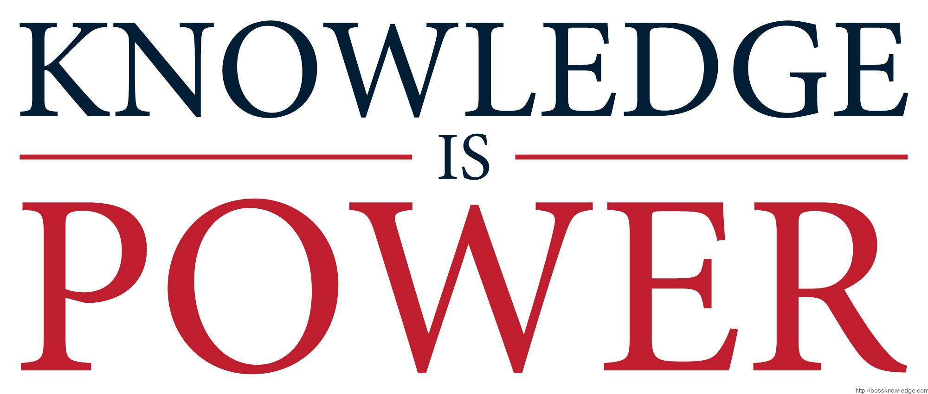
Notes:
We all know the old saying, “Knowledge is power.”
Well, it is!

Slide 27


New Legislation – SECURE Act
Notes:
We shared earlier that a major piece of legislation known as the SECURE ACT was signed into law in December of 2019 and this act brings massive changes for those of us with retirement savings.
So what are some of the things investors need to know?

Slide 28
Secure Act
The Setting Every Community Up for Retirement Enhancement (SECURE) Act was a bipartisan retirement bill that was included in a larger legislative package. It was signed into law on December 20, 2019.
What are some of the Act’s major Changes to Retirement Planning?
Allows for Multiple employer sponsored retirement plans.
Moves the Required Minimum Distribution(RMD) starting age from 70½ to 72.
Allows anyone with earned income the ability to contribute to an IRA after age 70½.
In most instances, eliminates ‘Stretch’ IRAs and now mandates inherited IRAs with most non-spouse beneficiaries (i.e. kids or grandkids) must be withdrawn within 10 years.
Notes:
The Setting Every Community Up for Retirement Enhancement (SECURE) Act is a bipartisan retirement bill that was included in a larger legislative package.
What are some of the bills major Changes to Retirement Planning?
It allows for multiple employer sponsored retirement plans.
It moves the Required Minimum Distribution(RMD) starting age from 70½ to 72.
It allows anyone with earned income the ability to contribute to an IRA after age 70½.
And in most instances, it eliminates ‘Stretch’ IRAs and now mandates inherited IRAs with most non-spouse beneficiaries (i.e. kids or grandkids) must be withdrawn within 10 years.
This new bill needs to be seriously reviewed by all retirement plan savers.

Slide 29
Secure Act
SECURE Act Ten-year Rule
Exceptions for certain beneficiaries including:
  Surviving Spouse
  The employee’s Children under the age of majority
  (not grandchildren or any other children)
  Disabled
  Chronically ill
  Individual not more than ten years younger than employee
Ten Year Rule
Notes:
The new 10-year Rule now says that most inheritors can no longer stretch out their inherited IRAs.
They now need to plan to take out the funds within 10 years of date of death.
There were some exceptions for certain beneficiaries, these include:
Surviving Spouse
The employee’s Children under the age of majority (not grandchildren or any other children)
Disabled
Chronically ill
Individual not more than ten years younger than employee

Slide 30

Secure Act
Managing the income tax consequences of the Ten-year Rule
Planning strategies to consider include:
  Family tax bracket management
  Charitable based strategies (i.e. QCD’s and CRT’s)
  Your overall wealth transfer tax situation
Notes:
Managing the Income Tax Consequences of the Ten-Year Rule is now very important!
Some Planning strategies to consider include:
Family tax bracket management
Charitable based strategies (i.e. QCD’s and CRT’s)
Your overall wealth transfer tax situation.

Slide 31
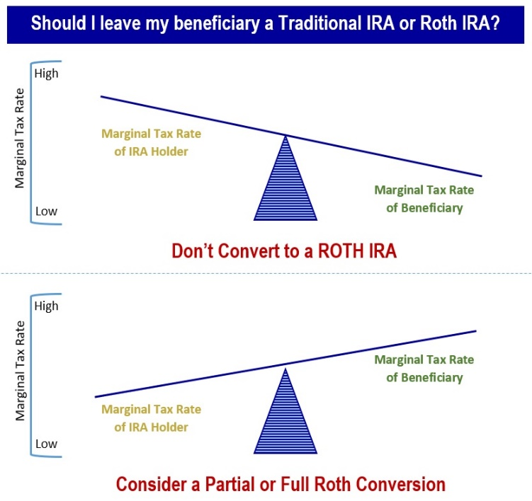
Secure Act
Notes:
Roth IRA conversions are now going to be an area to explore. Deciding whether to convert to a Roth IRA hinges on a variety of issues including what your tax rate is now versus later, the tax bill you'll have to pay to convert, and your future plans for your estate.
Some considerations before deciding include:
Who is in a higher bracket? You or your beneficiaries?
Will you need the money in the first five years? ROTH IRA conversions have penalties if used in the first five years.
Will you end up in a higher or lower bracket in the future?
Where will you take the money from to pay the taxes?
This is where we as financial professionals can offer some suggestions and strategies. We enjoy talking with clients about the pros and cons of both partial or full ROTH conversions.

Slide 32

Secure Act
Proactively managing the income tax consequences of the ten-year Rule
As it relates to the
new ten-year rule,
the purpose of considering ROTH Conversions can
be to spread distributions over many years and
lower brackets.
Notes:
We want to help clients think about proactively managing the Income Tax Consequences of the Ten-Year Rule.
As it relates to the new ten-year rule, the purpose of considering ROTH Conversions can be to spread distributions over many years and lower brackets.

Slide 33


Secure Act
Everyone’s situation
needs to be considered!
Notes:
Our strategy is to be proactive not reactive.
Everyone's situation is different and therefore, everyone’s situation needs to be considered!
Once again, we want to be proactive not reactive!

Slide 34
Risk Tolerance
What is risk?
Risk is a chance of losses.
Risk is the possibility of an unfortunate occurrence.
An occurrence of economic loss.
The probability of some happening that is unwanted and unavoidable.
Notes:
Another area of focus should be thinking about your personal risk tolerance.
So how is RISK defined?
Risk is a chance of losses.
Risk is the possibility of an unfortunate occurrence.
An occurrence of economic loss.
The probability of some happening that is unwanted and unavoidable.

Slide 35
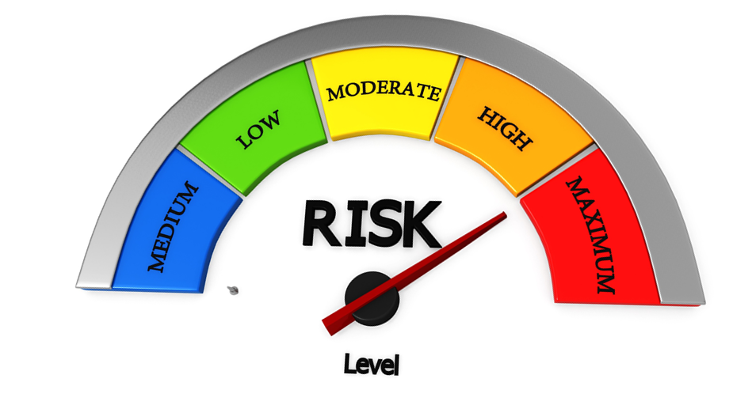
Risk Tolerance
What is your risk tolerance?
Notes:
For clients we talk about your risk tolerance or understanding that investments have risk.

Slide 36
Risk Tolerance
Stocks
Bonds
Cash
More risk, higher potential returns
Less risk, lower potential returns
Notes:
And then we help you make investment decisions based on a risk reward potential strategy.

Slide 37
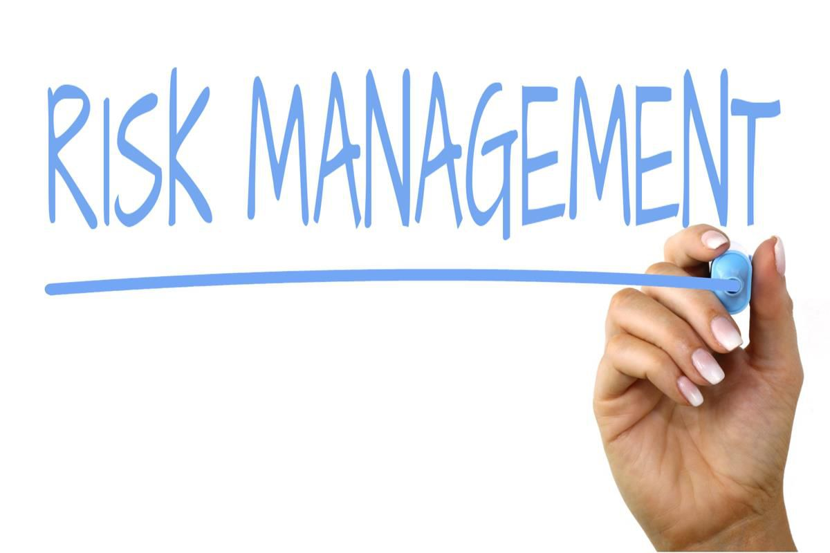
Risk Tolerance
Notes:
One goal after identifying your risk tolerance is to identify any potential risk management strategies.

Slide 38

Volatility
Notes:
There is always a chance that markets get volatile and the year 2020 may possibly bring its fair share of volatility.

Slide 39

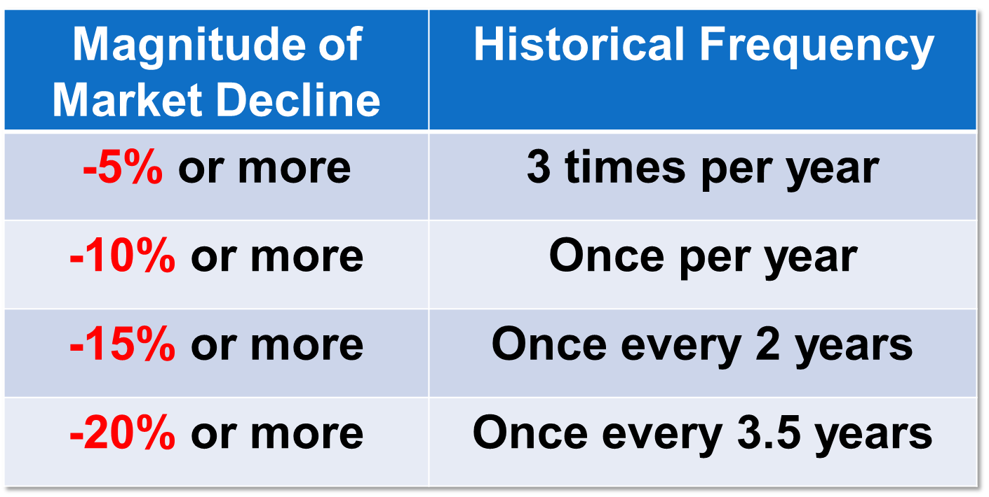
Volatility
Notes:
Market declines are uncomfortable, but not unfamiliar for investors.
As this chart shares, a change of -5% or more historically happens on average 3 times per year.
A decline of 10% or more happens on average once per year.
A decline of 15% or more happens on average once every 2 years.
And, a change of -20% or more happens on average once every 3.5 years.
Should you be concerned during a pullback or decline, then call us.

Slide 40
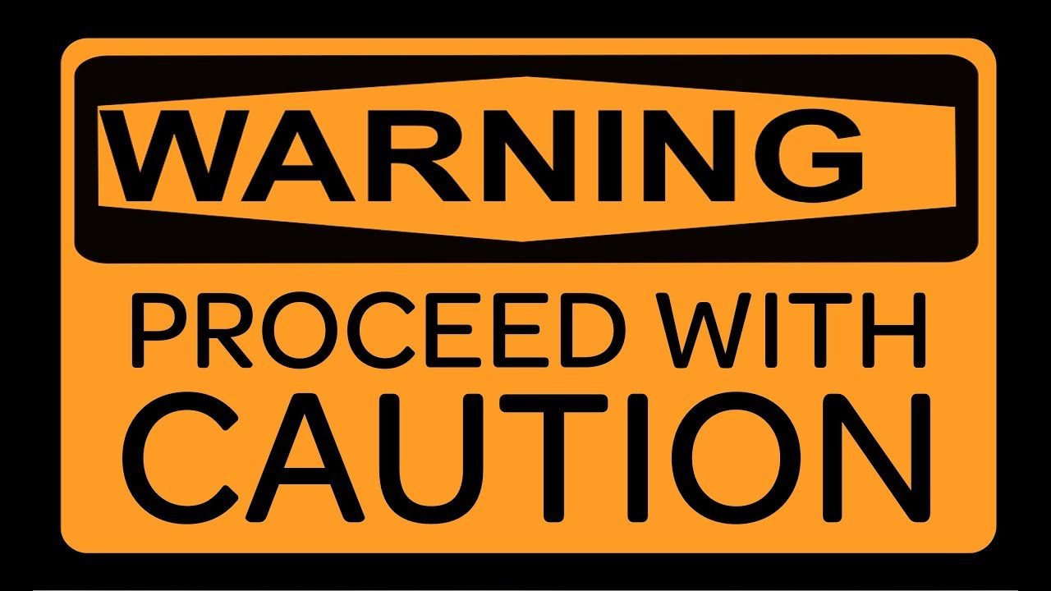
Volatility
Notes:
Perhaps that’s why you might have heard us say “proceed with caution”.

Slide 41

Beware Media Magnification
The media tends to use terms inappropriately to attract viewership, making things larger or more dramatic than they really are.
REMEMBER:
the media is
NOT YOUR ADVISOR!
Notes:
The media tends to use terms inappropriately to attract viewership, making things larger or more dramatic than they really are.
REMEMBER: the media is NOT YOUR ADVISOR!

Slide 42
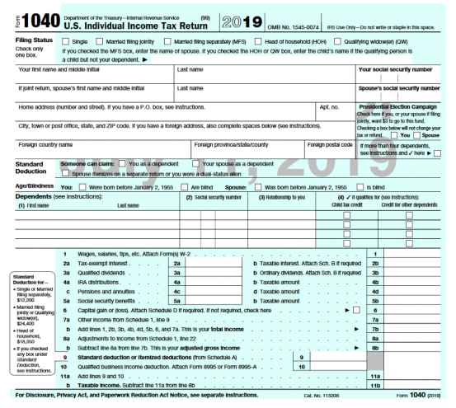
New Tax Forms for 2019
Notes:
Also, this year in 2020, we will file 2019 new slightly revised tax forms.
As a result, later this year, our office would like to talk with you about tax planning.

Slide 43

Plan instead
of predicting!
Notes:
The key is to plan instead of predict!

Slide 44
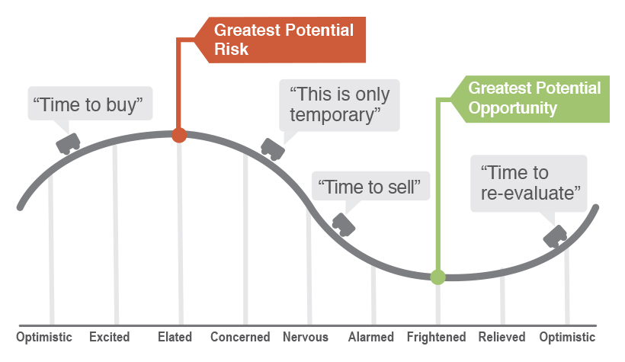
Overall Planning Approaches
Emotions can often play a large role in
how people manage their money.
Notes:
Unfortunately, many times emotions can play a large role in how people manage their money, and that’s not helpful.
The fundamentals of great companies usually do not change on a daily basis, but the emotions of investors can.

Slide 45
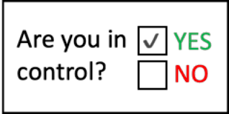
Overall Planning Approaches
Review your overall strategy
    Goals
    Time Horizon
    Risk Tolerance
  Comfort level
Focus on your personal objective
Talk with us!
Notes:
So – what should you do during 2020?
First, It is always helpful to review your overall strategy. This includes a review your time horizons, goals and risk tolerances. Has anything changed? Do you have any new major purchases, lifestyle changes or liquidity events happening or planned? Is your risk tolerance the same? We can help you make these determinations based on your goals.
Then, make sure you are comfortable with your investments. Remember, equity markets can have ups and downs.
Try to focus on your personal objectives. What are your goals – are they still the same as last year?
And of course, talk with us! Discuss any concerns with us. We are here to help you.

Slide 46

Overall Planning Approaches
Rebalance your accounts.
Analyze all sources of income
and cash flow requirements.
Review your overall tax planning strategies.
Review your emergency fund needs.
Fund your retirement accounts early in the year.
Monitor your portfolio regularly.
Notes:
Some strong planning strategies that you should be considering again this year include to:
Rebalance all of your accounts, including retirement plans and personal holdings.
Analyze all sources of income and cash flow requirements.
Review your overall tax planning strategies.
Review your emergency fund needs.
Fund your retirement accounts early in the year.
Monitor your portfolio regularly. It’s important to keep it aligned with your goals. We monitor your portfolio for you regularly and can help provide you with specific options and choices.

Slide 47

Tax Planning Strategies
Maximize retirement plan
contributions
Tax loss or gains harvesting
Tax exempt strategies
Tax advantaged strategies
Notes:
Tax planning strategies to consider for 2020 include:
-Maximizing Retirement Plan contributions
-Tax loss or gains harvesting
-Tax exempt strategies
-Tax advantaged strategies
Our goal is simple - to review tax strategies individually and look for ways to be tax efficient with clients.
Remember, it’s not what you make, but it’s what you keep that counts most!

Slide 48

Key Takeaways
Caution and vigilance
are critical.
Focus on your own personal goals and objectives.
Call us with any concerns!
Notes:
As a quick recap, remember:
Caution and vigilance are critical.
You should focus on your own personal goals and objectives.
And, as always, call us with any concerns!

Slide 49
We review changes
for our clients regularly!
Notes:
One of our main focuses as a financial advisory practice is to review changes for our clients on an ongoing basis.

Slide 50

What Can You Expect From Us?
Constant communication
More frequent discussions
Review of economic, tax, estate and
investment issues for our clients
Notes:
So – what can you expect from us?
You can expect constant communication, more frequent discussions, and you can expect that we are continuously reviewing economic, tax, estate and investment issues for our clients.

Slide 51

Our Role as Your Advisor
We will maintain a
non-emotional objective.
We will avoid emotional-based reactions.
We will assist you in making decisions that are
always in your best interest!
WE WILL BE HERE FOR YOU!!
Notes:
As you know, our role as your advisor is to:
Maintain a non-emotional objective;
Avoid emotional-based reactions;
Assist you in making decisions that are always in your best interest; and
We will be here for you!
Slide 51

Slide 52

Thank You!
We Appreciate the
Opportunity to Assist
With YOUR Financial Needs!
Notes:
Thank you for coming to this workshop. We appreciate the opportunity to assist you with your financial needs.
Can I see by a raise of hands anyone who is not currently a client?
We would like to take this time to invite any of the guests here today to a complimentary session to help you take this important information with your specific financial needs and goals. Please see one of our team members (introduce the team members) at the exit in order to schedule your complimentary session.
As you know, we are also making ourselves available to help some of your friends and colleagues. One theme that you have probably heard from our office already is our company’s “Growth Initiative.” It is our goal to offer our services to several other clients just like you. It is primarily through an introduction from our best clients that we have best been able to meet high quality people who can benefit from our services. We would be honored if you shared with us the names of one or two other friends, relatives or colleagues so we can invite them in for a complimentary consultation.
Again, thank you for attending tonight. At this point, we can take questions.

Slide 53

Help us help others!
Sign your friends up for our complimentary newsletter service!
Notes:
We would like to help others in 2020!
In fact, we would be honored if you could share some names of friends to add to our mailing lists so that they can benefit from this information.

Slide 54

Notes:
Any questions?

Slide 55
The views expressed are not necessarily the opinion of
Insert Broker-dealer name. Information is based on sources believed to be reliable, however, their accuracy or completeness cannot be guaranteed.
CDs are insured by the FDIC, an independent agency of the United States Government, and offer a fixed rate of return whereas both principal and yield of investment securities will fluctuate with changes in market conditions.
Investing involves risk including the potential loss of principal. No investment strategy can guarantee a profit or protect against loss in periods of declining values. Past performance is no guarantee of future results. Diversification and strategic asset allocation do not ensure a profit or protect against a loss. The process of rebalancing may carry tax consequences.
This information is not intended to be a substitute for specific individualized tax, legal, or investment planning advice. You should discuss any tax, legal or investment planning matters with the appropriate professional.
The S&P 500 is an unmanaged index of 500 widely held stocks that is generally considered representative of the U.S. Stock market. The Dow Jones Industrial Average (DJIA) commonly known as “The Dow”, is an index representing 30 stocks of companies maintained and reviewed by the editors of the Wall Street Journal. Index performance does not include transaction costs or other fees, which will affect actual investment performance. Individual investor’s results will vary.
Contents provided by:
The Academy of Preferred Financial Advisors, Inc. © 2020. All rights reserved.
Insert Approved BD Disclaimer here
Insert registered branch address, contact information

