Slide 1
Investor Update
Presented By: Your Name Company
Notes:
Welcome to our 2020 Investor Update.

Slide 2
Today’s Agenda
Investor Update
Planning Ideas and Strategies
Notes:
Today’s agenda is straightforward.
First, I will share a brief investor update.
Then I will discuss some planning ideas and strategies you can consider.

Slide 3
Stay Safe
“The first wealth is HEALTH.” – Ralph Waldo Emerson
Notes:
Before I get to the presentation, I would like to take a minute to remind you to stay safe and please try to also stay positive.
We are all experiencing challenging and unprecedented times, but as Ralph Waldo Emerson said many years ago, “The first wealth is health.”

Slide 4
Five Key Areas of Financial Planning
Preservation Planning
Retirement Planning
Tax Planning
Estate Planning
Investment Planning
Notes:
Before I begin, I find it is always important to review that there are five key areas of financial planning.
They are:
Preservation Planning,
Retirement Planning,
Tax Planning,
Estate Planning, and
Investment Planning
Even though today’s presentation is about the equity markets, as a comprehensive wealth management firm, we try to always consider the impact of any recommendation we make on not just one, but all these areas for our clients.

Slide 5
“What if I told you...”
Equity Market Review
A Global recession was coming,
The U.S. might start a recession,
There was going to be a trade war with China,
The President would get impeached, and
The Middle East would fire rockets at US military bases.
“Would you have expected the stock market to go up?”
Notes:
What if I told you….
A Global recession was coming,
The US might start a recession,
There was going to be a trade war with China,
The President would get impeached, and
The Middle East would fire rockets at US military bases.
Would you have expected the stock market to go up?

Slide 6
2019 was a healthy year for investors and 2020 started strong!
Equity Market Review
Notes:
Well, that happened! And despite all of those concerns, 2019 was a healthy year for investors and 2020 started on a strong note.

Slide 7
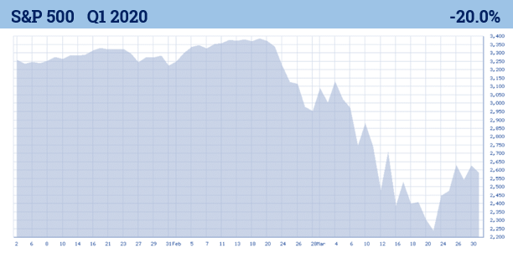
Then equity markets changed quickly...
Equity Market Review
Chart Source: BigCharts.com
Notes:
Then in mid-February after making a new all-time high, things changed quickly. A silent but deadly virus quickly decimated an 11-year bull market.
After the strong year that was not foreseen in 2019, in less than three weeks, the S&P 500 fell from a 52-week high to a 52-week low.
This quick waterfall of the equity markets has set many records. Although most experts predicted a reasonable year for 2020, we are now in an unexpected period where it seems as if the economic outlook is evolving daily.
Chart source: bigcharts.com

Slide 8
Equity Market Review
Notes:
Knowledge is power. I believe an educated client is our best client, so let’s examine some data.

Slide 9
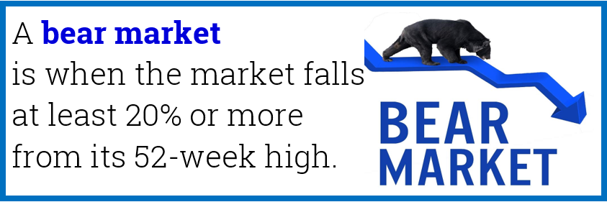
After an 11-year “bull market” we are now in a “bear market.”
Equity Market Review
Notes:
After an 11-year bull market, we quickly entered a bear market.
A bear market is defined as when the market falls at least 20% or more from its 52-week high.
A bear markets most basic principle is that bear markets are a part of the investing experience!
Since entering the bear market, as of early April, a bounce back of equity markets may have ended this bear market, but we are still in very volatile times and are down from all-time highs.

Slide 10
Equity Market Review
Three Major Categories of Bear Markets
Structural: bear markets created by imbalances and financial bubbles, very often followed by a price shock such as deflation.
Cyclical: bear markets that are typically a function of the economic cycle, marked by rising interest rates, impending recessions and falls in profits.
Event-driven: bear markets created by events such as war, an oil price shock, an emerging-market crisis, or like most recently, a sudden viral pandemic (Covid-19).
Notes:
Since we are discussing bear markets (a close of 20% down) it might be helpful to review some information about bear markets.
Bear markets can be classified into one of three categories: structural; cyclical; and, event-driven.
Structural bear markets are those created by imbalances and financial bubbles, very often followed by a price shock such as deflation. This happened in 1929 and again in 2008 when the financial system was in trouble.
Cyclical bear markets are ones that are typically a function of the economic cycle, marked by rising interest rates, impending recessions and falls in profits.
Event-driven bear markets are created by events such as; war, an oil price shock, an emerging-market crisis, or like most recently, a sudden viral pandemic (Covid-19).
We are currently in an “event-driven” bear market. These are the bear markets that are hardest, if not impossible, to forecast or navigate. Covid-19 created a first of its kind bear market, one that was caused by a virus. We have had event-driven bear markets, but none were created by a viral pandemic.

Slide 11
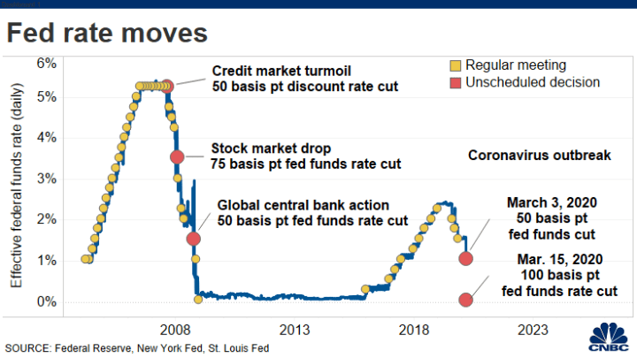
Equity Market Review
January 2019
What are some facts an investor should know?
Interest rates have gone down.
Notes:
After lowering the federal funds rate by a half-point or 50 basis points to a range of 1.0% to 1.25% in between its regularly scheduled meetings, as a response to the risks the COVID-19 coronavirus outbreak was creating, the Federal Reserve cut its benchmark interest rate in mid-March by a full 1% to 0%-0.25%. When the Fed first started reducing interest rates, many experts noted that the central bank was “catching up” to where markets had headed. Now, it seems as if they are responding to both the economy and the fact that the 10-year Treasury had fallen to all-time lows.
The all-time low for the Fed Funds Rate is effectively zero. The Fed has only lowered their rate to a range of 0% to 0.25% twice: once during the financial crisis of 2008 and now again in March of 2020.

Slide 12
Equity Market Review
January 2019
What are some facts an investor should know?
The U.S. Government has responded.
Notes:
The U.S. government is responding by trying to prevent the threat of a recession and help businesses.
They have passed several bills including the $2.2 trillion-dollar Coronavirus Aid, Relief, and Economic Security (CARES) Act.
This emergency relief package is the largest economic relief package in U.S. history.

Slide 13
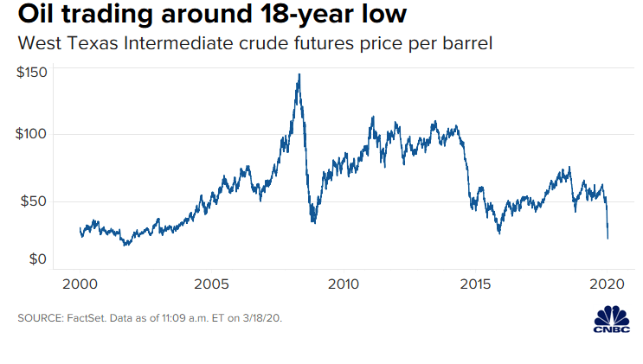
Equity Market Review
January 2019
What are some facts an investor should know?
Oil prices have been troublesome.
Notes:
As if things were not bad enough, the oil price war between Saudi Arabia and Russia, which emerged suddenly and dramatically on March 7, decimated the energy industry.
Oil prices saw the worst month and quarter in oil price history, down over 50%. With energy companies and oil still being a contributing factor to the overall economy, oil prices added to the equity market’s problems.

Slide 14
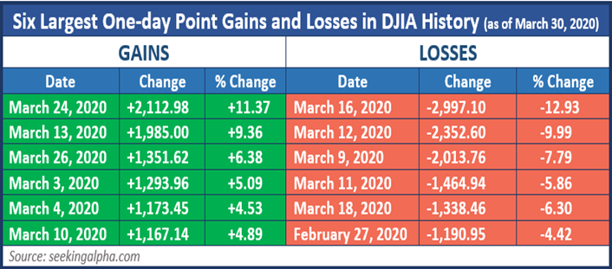
Equity Market Review
Notes:
A bad decision could be harmful.
As this chart shares, the six biggest point declines and the six biggest point increases in the Dow Jones Industrial Average (DJIA) all came in the last five weeks of this quarter.
On March 12, the DJIA fell 2,352 points which was over 9%. Had you sold that day you missed the next day’s (March 13th) rise of 1,985, also a move of over 9%.
This level of volatility is unprecedented and therefore even the savviest of investors needs to PROCEED WITH CAUTION!

Slide 15
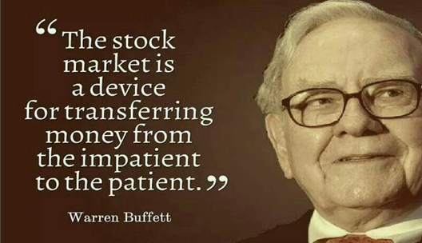
Equity Market Review
How has legendary investor Warren Buffet done?
Bespoke explained in a post noting that the average stocks in his top holdings on March 24th were down 37% from their February highs.
Notes:
The volatility and turbulence of this current economic and political environment has caused even some of the most seasoned investors to become skittish. In March, legendary investor Warren Buffett said that he hadn’t seen anything like the coronavirus pandemic.
Bespoke explained in a post noting that the average stocks in his top holdings on March 24th were down 37% from their February highs. Perhaps the most important thing to think about is that like everybody else, his portfolio obviously hasn’t been immune to all this volatility.
This is a good time to recall one of his most famous quotes, “the stock market is a device for transferring money from the impatient to the patient.”

Slide 16
Ideas and Strategies
PREPARED, NOT SCARED
Notes:
How should an investor approach the rest of 2020?
We advocate being prepared and not scared.

Slide 17
Ideas and Strategies
Notes:
How should an investor move forward?
One of our responsibilities is to look at all situations and guide our clients with ideas. Even a treacherous downfall has opportunities.
Let’s quickly review some of them.

Slide 18
Ideas and Strategies
Focus on Long-term Results
Typically, the most successful investors think and act for the long term.
Notes:
Thinking long term is still the way to look at equity investments.
Typically, the most successful investors think and act for the long-term.
It’s near impossible to predict exact market movements, however, you can prepare.

Slide 19
Ideas and Strategies
Tax swapping and banking losses.
Notes:
While no one likes losses, from a tax standpoint they can be helpful.
A tax swap is a strategy that involves selling an investment that has losses and replacing it with a similar, but not identical, investment.
This tax loss can then be used to offset gains or it could be “BANKED” to offset future gains.
There are some rules to understand, like the wash-sale rule so if this is a strategy you want to discuss, then please call my office.

Slide 20
Ideas and Strategies
Rebalancing Your Portfolio
For many investors 60/40 is no longer 60/40.
Notes:
Maintaining a properly designed and well-diversified portfolio is important.
Now is a good time to look at your portfolio and consider any rebalancing that may need to be performed. For many investors who had a 60/40% stock to bond portfolio a few months ago, this percentage may have changed in the past few weeks.
For some investors, this could include selling things that have risen and buying things that have fallen.
This can sometimes be a good opportunity to invest at “lower prices.”

Slide 21
Ideas and Strategies
Suspend distributions for IRA holders if possible. RMD’s for 2020 were waived.
Notes:
The required minimum distributions (RMDs) for 2020 on some retirement accounts has been waived.
Some investors may not need to take distributions from their retirement accounts at this time. If you are comfortable with suspending distributions and looking for a potentially better time to take them, please call my office and we can see if this strategy works for your personal situation.

Slide 22
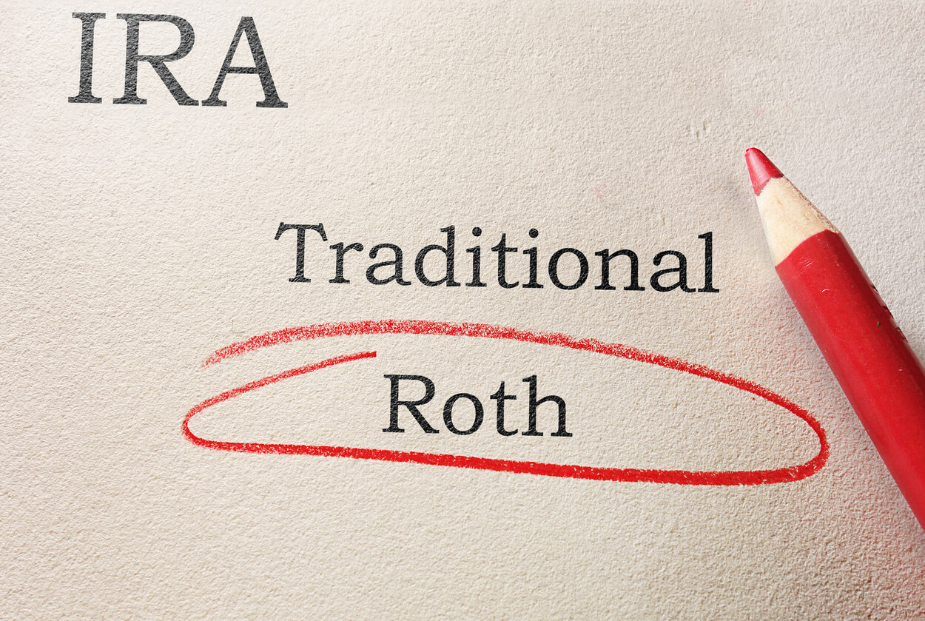
Ideas and Strategies
Roth conversions if appropriate...
Please check with your tax advisor before converting to a Roth IRA. Roth Conversions involve complicated rules.
Notes:
Though they can be complicated, there are many reasons to consider Roth IRA conversions.

Slide 23
Ideas and Strategies
Some Reasons to Consider Roth conversions, if appropriate…
Tax brackets could rise
Account values might be down
Secure Act
Please check with your tax advisor before converting to a Roth IRA. Roth Conversions involve complicated rules. Traditional IRA account owners should consider the tax ramifications, age and income restrictions in regard to executing a conversion from a Traditional IRA to a Roth IRA. The converted amount is generally subject to income taxation.
Notes:
These include:
Depending on who wins the presidential election this year, or how much the government injects into their stimulus, there is a chance that for some investors, tax brackets may rise.
Also, for many retirement accounts with equities, account values are down. This can create opportunities, especially for those investors currently in the 12%, 22% and 24% tax brackets.
Another reason to think about the pros and cons of Roth conversions is the new SECURE Act’s changes to Inherited IRAs.

Slide 24
New Legislation
Signed into law on December 20, 2019
Notes:
As a reminder, on December 20, 2019, a major piece of legislation known as the SECURE ACT was signed into law.
This new act brings massive changes for those of us with retirement savings.

Slide 25
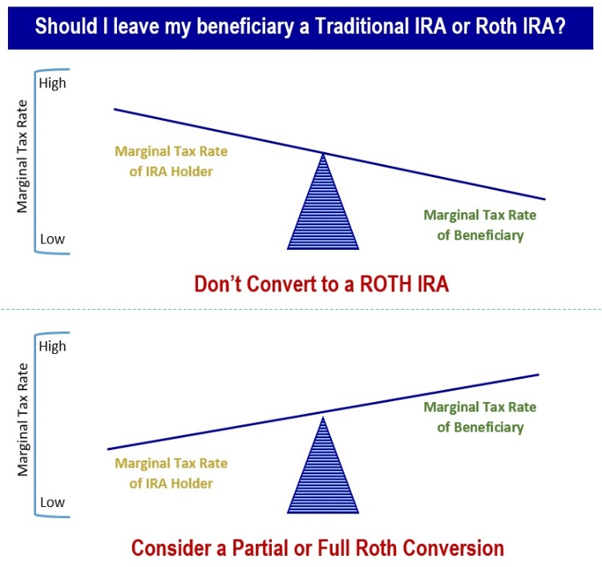
SECURE Act
SECURE Act Ten-year Rule
Notes:
While I am not reviewing the Secure Act today, it has a new 10-year Rule that now says that most inheritors can no longer stretch out their inherited IRAs. They now need to plan to take out the funds within 10 years of date of death.
That means we should review your retirement plan sometime this year and look into the family tax management of you and your beneficiaries.

Slide 26
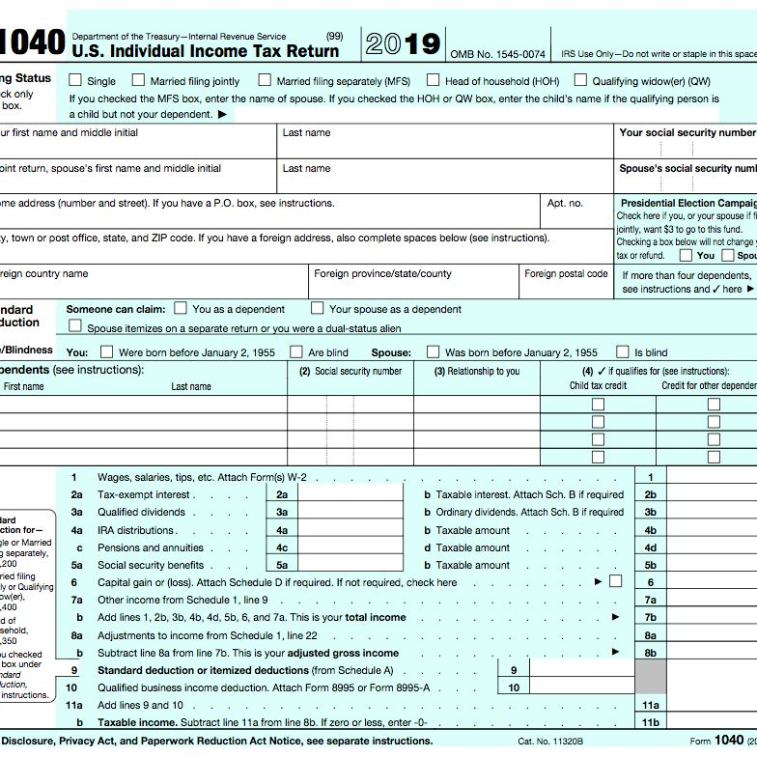
Ideas and Strategies
New Federal Tax Filing Date is Now July 15th
Notes:
The deadline for filing 2019 income tax returns has been officially changed to July 15, 2020. The deadline for making 2019 IRA and HSA contributions has thus also moved to July 15, 2020.
Deadlines for contributions to workplace savings plans have not changed. Please check with your state for any changes to state filing deadlines.

Slide 27
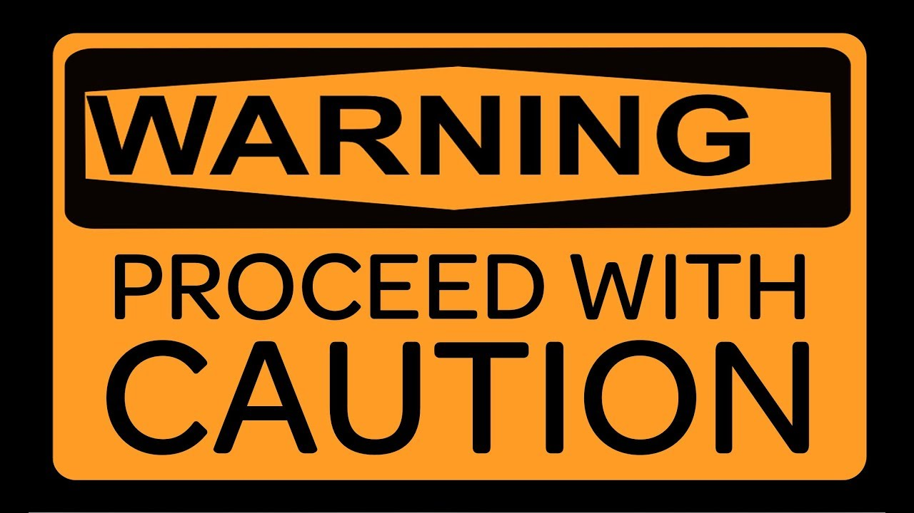
Ideas and Strategies
Volatility can be scary!
Notes:
Equity market volatility is back and it can be scary.
That’s why we always say proceed with caution!

Slide 28
Panic and fear is profiled by the media!
Ideas and Strategies
Panic and bad choices can cause more harm for investors than a virus or market downturn!
Notes:
Fear sells and everywhere you look, the media magnification of the current financial crisis is putting a major emotional strain on most viewers.
During these times, it is prudent to resist the temptation to watch news reports and obsessively watch your portfolio performance. Sometimes, the more information you have, the more likely you could make a decision that deviates from your long-term strategy. Adhering to a long-term investment plan often requires taking the news with a grain of salt and putting the impromptu advice of others on the back burner.
Remember, panic and bad decisions can cause more harm for investors than a virus or downturn.

Slide 29
Key Takeaways
2019 produced strong returns for equity investors
Extreme volatility has reemerged.
Your health is our first priority!
Focus on your personal goals and call us with any concerns.
Notes:
As a recap, what are some key takeaways for investors?
2019 produced strong returns for equity investors.
Extreme volatility has reemerged!
Your health is our first priority.
Continue to focus on your personal goals and call us with any concerns.

Slide 30
What Can You Expect From Us?
Regular communication
More frequent discussions
Review of economic, tax, estate and investment issues for our clients
Notes:
So – what can you expect from us?
You can expect regular communication, more frequent discussions, and you can expect that we are continuously reviewing economic, tax, estate and investment issues for our clients.

Slide 31
Thank You!
Your health and well-being is our highest priority!
We appreciate the opportunity to assist with YOUR financial needs!
Notes:
Thank you for your time today.
Remember, your health and well-being is our highest priority.
We appreciate the opportunity to assist you with your financial needs.

Slide 32
Help Us
Help Others!
Please share!
Notes:
We would like to help others in 2020!
In fact, we would be honored if you could share some names of friends to add to our mailing list so that they can benefit from our information.

Slide 33
The views expressed are not necessarily the opinion of (Insert Broker-dealer name). Information is based on sources believed to be reliable, however, their accuracy or completeness cannot be guaranteed. This information is not intended to be a substitute for specific individualized tax, legal, or investment planning advice and should not be construed as a recommendation or solicitation to buy or sell any security. Past performance is not indicative of future results.
Investors should be aware that there are risks inherent in all investments, such as fluctuations in investment principal. No investment strategy can guarantee a profit or protect against loss in periods of declining values. Diversification does not ensure a profit or protect against a loss. Rebalancing a portfolio may cause investors to incur tax liabilities and/or transaction costs and does not assure a profit or protect against a loss. Diversification and strategic asset allocation do not ensure a profit or protect against a loss. Due to the volatility within the markets mentioned, opinions are subject to change without notice.
Material discussed herewith is meant for general illustration and/or informational purposes only, please note that individual situations can vary. Therefore, the information should be relied upon when coordinated with individual professional advice. This material may contain forward looking statements and projections. There are no guarantees that these results will be achieved.
Unless certain criteria are met, Roth IRA owners must be 59½ or older and have held the IRA for five years before tax-free withdrawals are permitted. Additionally, each converted amount may be subject to its own five-year holding period. Converting a traditional IRA into a Roth IRA has tax implications. Investors should consult a tax advisor before deciding to do a conversion. rebalancing a non-retirement account could be a taxable event that may increase your tax liability.
The S&P 500 is an unmanaged index of 500 widely held stocks that is generally considered representative of the U.S. Stock market. The Dow Jones Industrial Average (DJIA) commonly known as “The Dow”, is an index representing 30 stocks of companies maintained and reviewed by the editors of the Wall Street Journal. All indices referenced are unmanaged and cannot be invested into directly. Unmanaged index returns do not reflect fees, expenses, or sales charges. Index performance is not indicative of the performance of any investment and individual investor’s results will vary.
Contents provided by: The Academy of Preferred Financial Advisors, Inc. © 2020. All rights reserved.
Insert Approved BD Disclaimer here
Insert registered branch address, contact information

