Slide 1

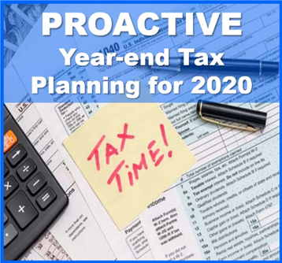
Proactive Year-End Tax Planning Ideas for 2020
A “Proactive” approach to your tax planning instead of a “Reactive” approach could produce better results!
Presented By:
Notes:
Welcome to our Proactive Year End Tax Planning Ideas for 2020 Workshop.
One of our main goals as comprehensive financial professionals is to help our clients recognize tax reduction opportunities both within their investment portfolios and in their overall financial planning strategies.
Staying current on the ever-changing tax environment is a key component to help our clients benefit from potential tax reduction strategies.
The objective of this workshop is to share strategies that could be effective if considered and implemented before year-end.
Please note that this workshop is not a substitute for using a tax professional. In addition, many states do not follow the same rules and computations as the federal income tax rules. Make sure you check with your tax preparer to see what tax rates and rules apply for your state.
Our main theme for this workshop is that a proactive approach to your tax planning instead of a reactive approach could produce better results.

Slide 2
Today’s Agenda
Year End Tax Planning Review
Tax Planning Ideas and Strategies
Notes:
Today’s agenda is straightforward.
We will review year-end tax planning.
While doing so, we will discuss some tax planning ideas and strategies you can consider.
We believe in educating our clients on their choices.
Our goal today is to give an overview of tax planning so that when you look at your situation you have some strong foundational information.
Please remember, each taxpayer’s situation should be looked at individually. The good news is we are available to talk with you about the specifics of your situation.

Slide 3

Stay Healthy
Your First Wealth is Health!
Notes:
Before I get to the presentation, I would like to take a minute to remind you to stay healthy because your health is our highest priority.
We are all still experiencing challenging and unprecedented times, and as we like to share, your first wealth is health.

Slide 4

Five Key Areas of Financial Planning
Preservation Planning
Retirement Planning
Tax Planning
Estate Planning
Investment Planning
Notes:
I find it is always important to review that there are five key areas of financial planning.
They are:
Preservation Planning,
Retirement Planning,
Tax Planning,
Estate Planning, and
Investment Planning
Today’s presentation is about tax planning, which can also affect estate planning.
As a comprehensive wealth management firm, we try to always consider the impact of any recommendation we make on not just one, but all these areas for our clients.

Slide 5



Tax Planning in 2020
Notes:
Tax planning for 2020 became a little more complicated because of the SECURE Act, which signed into law in December of 2019, and the 2020 CARES Act added some new laws and rules for taxpayers.
Also, with this being a Presidential election year, it is helpful to consider some of the tax proposals that are being discussed so that you can plan in an informed way.

Slide 6

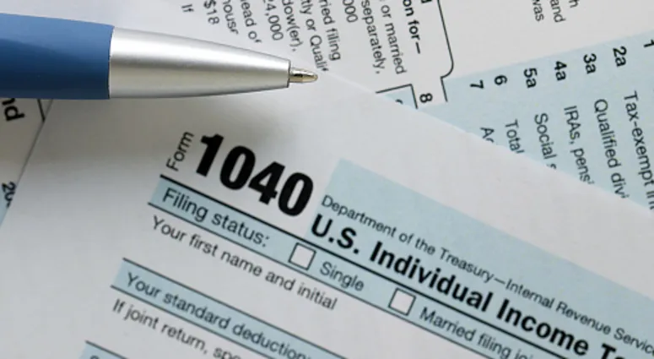
Tax Planning vs. Tax Preparation
“By failing to prepare, you are preparing to fail.”
Benjamin Franklin
Notes:
Let’s start by quickly distinguishing the difference between tax planning and tax preparation.
Tax planning is looking ahead before year end, whereas tax preparation is filling out your tax forms after year end.
This workshop is about tax planning, not tax preparation. It is about hearing some proactive ideas that you can consider now to potentially reduce your taxes.
One of our Founding Fathers, Benjamin Franklin is credited with saying, “By failing to prepare, you are preparing to fail.”

Slide 7
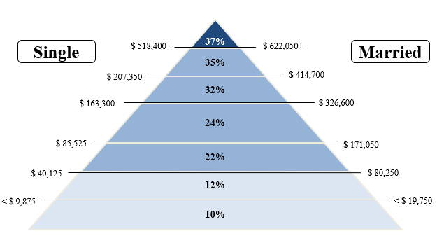
Tax Brackets for 2020
For 2020 there are still seven tax rates. They are 10%, 12%, 22%, 24%, 32%, 35%, and 37%.
Under current law this seven-rate structure will phase out on January 1, 2026.
2020 Tax Rates
Notes:
For 2020, there are still seven tax rates. They are 10%, 12%, 22%, 24%, 32%, 35%, and 37%.
Under current law this seven-rate structure which was created by the Tax Cuts and Jobs Act is scheduled to automatically phase out on January 1, 2026.

Slide 8
Tax Planning in 2020
Sunset
Married
(2026)
Married
2020
Single
2020
Tax Brackets
Are Important
Notes:
Here are the current tax rates for married filing jointly and single filers.
Married filling jointly has lower rates on many amounts.
For planning purposes, something you need to remember is that even if NO changes are made to tax rates, in 2026 the law says we go back to the older higher rates. Tax brackets are important and current tax laws call for a “sunset” in 2026, which means we go back to the older higher rates automatically in 2026. When thinking about your plan, please remember this.
As this arrow shows, for some people that means income that would be taxed at 24% today could be taxed in 2026 at 33%, a much higher rate.

Slide 9
Evaluate the use of itemized deductions
versus the standard deduction.
2020 STANDARD DEDUCTION Amounts
Single | MFJ/QW | MFS | HOH
$ 12,400 | $ 24,800 | $ 12,400 | $ 18,650
Notes:
For 2020, the standard deduction amounts are:
$12,400 for individuals
$24,800 for married couples filing jointly and surviving spouses.
$12,400 for married couples filing separately, and
$18,650 for heads of households.

Slide 10
Tax Planning in 2020
How to View Itemized Deductions
THE OLD RULE WAS TO
ACCELERATE DEDUCTIONS
THE NEW RULE IS TO
TIME or PLAN DEDUCTIONS
Notes:
So, how should you view itemized deductions if you do not take the standard deduction..
The old “rule” was to accelerate or realize deductions and take them as soon as possible.
With the higher standard deductions, the new “rule” is to time or plan deductions.

Slide 11
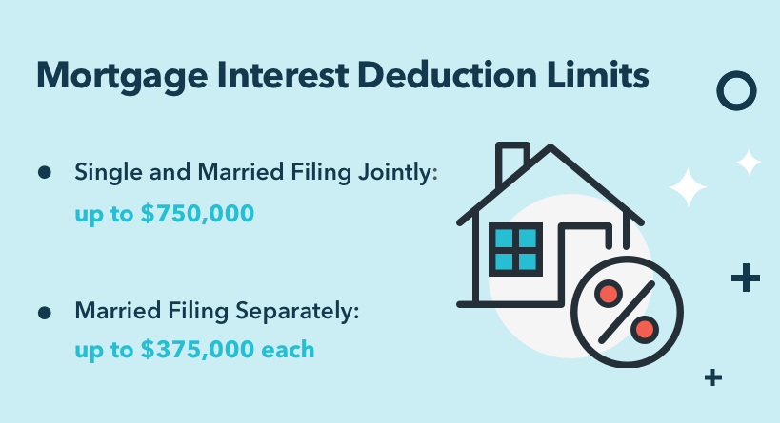

Understand your ability to deduct mortgage interest
& state and local taxes (SALT).
Mortgage Interest Deduction Limits:
Single and Married Filing Jointly: up to $750,000
Married Filing Separately: up to $375,000 each
State and Local Tax (SALT) Deductions:
Limited to $10,000
Notes:
Two of the more widespread deductions that taxpayers look at if they choose to itemize and not use the standard deduction are mortgage interest and State and Local taxes, known as SALT.
Under the new rules, for mortgages taken out after October 13, 1987, and before December 16, 2017, mortgage interest is fully deductible up to the first $1,000,000 of mortgage debt.
That threshold has been lowered to the first $750,000 or $375,000 (married filing separately) on homes purchased after December 15, 2017.
For those of you with mortgages, please check with your tax preparer for how much of a deduction you could take.
The TCJA act also limited state and local income, sales, and real and personal property taxes (SALT) to a maximum deduction of $10,000.

Slide 12
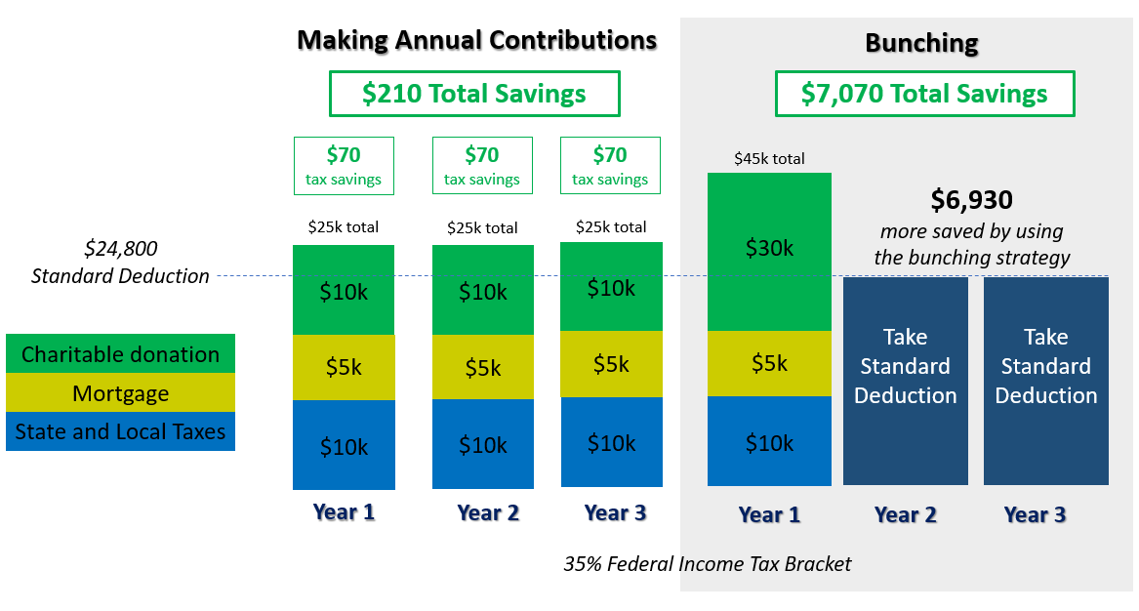
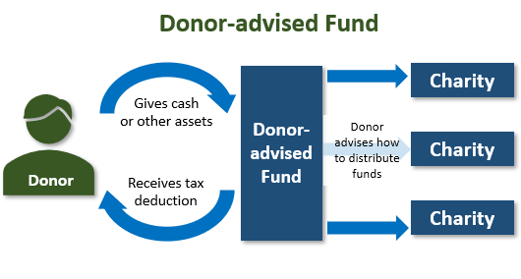
Charitable Giving Tax Planning for 2020
Consider bunching charitable contributions or using a Donor-advised Fund (DAF)
Donor
Example is For illustration Purposes only!
Notes:
One strategy for those taxpayers who like to give to charities is to consider “bunching” charitable contributions.
Here is an illustration of how that could work.
If you were married filing jointly and had $10,000 of State and Local Taxes (which incudes property taxes) and $5,000 of mortgage interest and give $10,000 to charity and no other itemized deductions. Then, you would have itemized deductions of $25,000.
The standard deduction for you is $24,800 so you would gain $200 by itemizing. In a 35% Federal income tax bracket that has an after-tax savings value of $70 to you. If you were to do that for three years, it would be worth $210 to you.
An alternative strategy is to gift $30,000 in one year and then use the standard deduction in years 2 and 3. That would bring your deductions to $45,000 in year 1 and save you $7,070 over the standard deduction in year 1 at a 35% tax rate. By doing this you would lose the additional $70 in tax savings from years 2 and 3 that you received in the other scenario, but your total tax savings is $6,930 versus $210 which is $6,720 more.
Now you might be thinking, $30,000 is a lot to give in 1 year, so let’s look at how a Donor Advised Fund or DAF works. If you place the $30,000 in the Donor Advised Fund, you get the deduction immediately and then you can give the charitable contributions as you see fit.
If you have any questions on this or want to discuss this strategy, please call us.

Slide 13
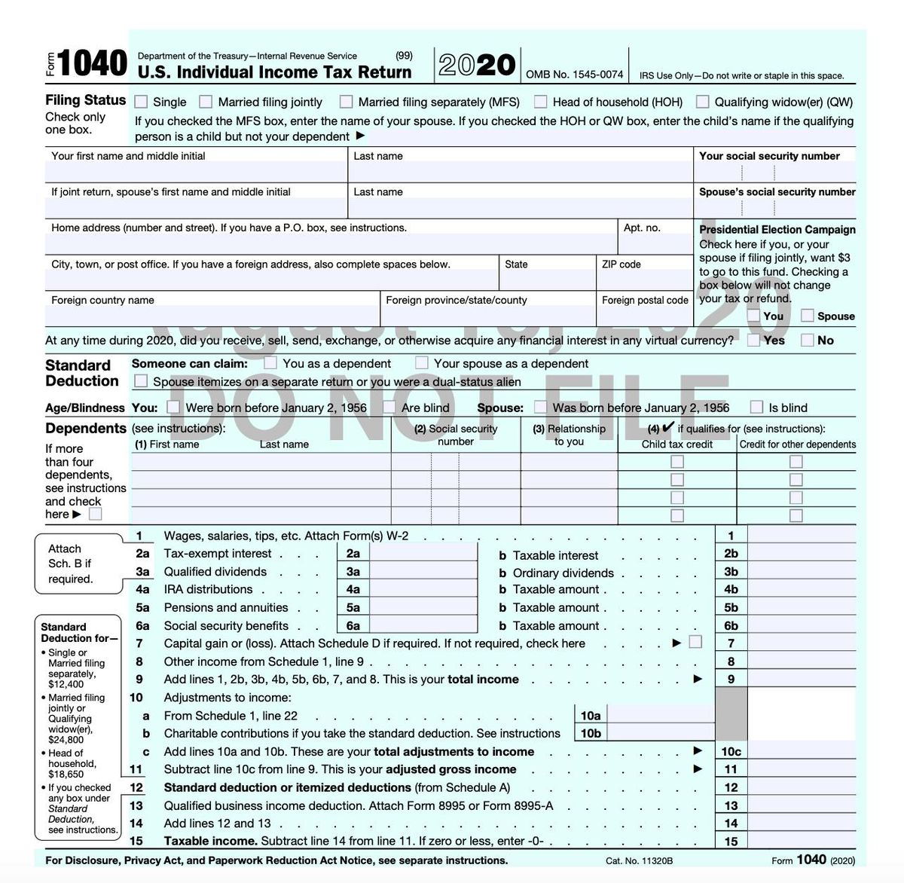
Charitable Giving Tax Planning for 2020
NEW Charitable Deduction
The CARES Act created a new charitable deduction available to taxpayers who do not itemize their deductions in 2020.
This new benefit known as a universal deduction, allows for an above the line charitable deduction of up to $300 per individual ($600 for married filing jointly).
To qualify, the charitable gift must be cash (or cash equivalent) made to a qualified charity (501(c)(3)). This contribution must be made on or before 12/31/2020.
Notes:
Something that the CARES Act offered that is NEW for 2020 is a new charitable deduction available to taxpayers who do not itemize their deductions in 2020.
This new benefit known as a universal deduction, allows for an above the line or before you calculate your taxable income charitable deduction of up to $300 per individual ($600 for married filing jointly).
To qualify, the charitable gift must be cash (or cash equivalent) made to a qualified charity (501(c)(3)). This contribution must be made on or before 12/31/2020.
As this draft 1040 from the IRS website shows, this deduction can be taken before you calculate your Adjusted Gross Income.
If you are itemizing or did last year and like to give to charity, please consider using this deduction and remind your tax preparer that you did!

Slide 14
Charitable Giving Tax Planning for 2020
Qualified Charitable Distributions(QCD)
are still a strategy for retirement savers.
RMDs were changed to 72 and allowed to be skipped in 2020.
QCDs are still allowed at 70½.
Many retirement savers like to use their RMDs or part of them for QCDs.
70 ½
Minimum Age
$100k
Annual Maximum
IRA
Gift to Charity
Notes:
Qualified Charitable Distributions (QCD) are a strategy for retirement savers.
As part of the SECURE Act Required Minimum Distributions or RMD’s were changed to start at age 72 instead of age 70½. Also the CARES Act allowed you to skip or not take your RMD for 2020.
Qualified Charitable Distributions are a tax law provision that allows retirement savers over age 70½ to directly distribute up to $100,000 to eligible charities straight from their retirement accounts and not pay tax on this distribution.
One idea that experts suggest is if you are charitably inclined, consider using part or all of your Required Minimum Distribution or “RMD” for a Qualified Charitable Distribution.
Like many of the other strategies we are discussing today, this is one you should see us about if you are interested in evaluating your situation.

Slide 15
Capital Gains Rates for 2020
TOP OF EACH CAPITAL GAINS BRACKET
 | S | MFJ/QW | MFS | HOH
0% | $40,000 | $80,000 | $40,000 | $53,600
15% | $441,450 | $496,600 | $248,300 | $469,050
20% | $441,451 + | $496,601+ | $248,301+ | $469, 051+
Notes:
In 2020, Long-term Capital gains still receive a tax break.
Here are the three tax rates of 0%, 15% and 20% for Long-term capital gains.

Slide 16

Tax Gains & Loss Harvesting
Notes:
One planning item that many taxpayers think about is Tax Gains and Loss Harvesting.

Slide 17
Harvesting Capital Losses
Selling assets at a loss to offset capital gains.
Reduces or eliminates tax on current capital gain.
On the surface, loss harvesting produces an economic benefit equal to the tax saved, however it could only provide a timing benefit.
  Tax deferral could be valuable!
Notes:
Harvesting capital losses is a strategy that has a taxpayer selling assets that are at a loss to offset capital gains.
This reduces or eliminates tax on current capital gains.
On the surface, loss harvesting produces an economic benefit equal to the tax saved. However, sometimes, it could only provide a timing benefit.
This is a tax deferral strategy that could be valuable.

Slide 18
Harvesting Capital Losses
Capital losses are highly tax effective if they can be used to offset income taxed at higher rates.
Warning: Watch out for the wash sale rule, which prevents taxpayers from
repurchasing a substantially similar security within 30 days of selling at a loss.
KEY FACT:
Taxpayers can use up to $3,000 capital loss
above capital gains to offset ordinary income!
Notes:
Capital losses are highly tax effective if they can be used to offset income taxed at higher rates.
A key fact to remember is you can use up to $3,000 in capital loss above capital gains to offset ordinary income.
Also, as a warning: watch out for the wash sale rule, This rule prevents taxpayers from repurchasing a substantially similar security within 30 days of selling at a loss.
If you have any questions on Loss or Gain Harvesting call us or your tax professional.

Slide 19

Harvesting Capital Gains
On the surface, it might appear that taxpayers should always harvest gains.
However, harvesting gains introduces a tradeoff between lower tax rates versus the loss of tax deferral.
Remember although tax is paid at a lower rate, it might be paid sooner.
Notes:
Capital gains harvesting means taking capital gains in the current tax year.
On the surface, it might appear that taxpayers should always harvest gains because of favorable rates. However, harvesting gains introduces a tradeoff between lower tax rates versus the loss of tax deferral.
Remember, when taking a gain for tax purposes, although the tax is paid at a lower rate, it is paid sooner.

Slide 20

Former Vice President Biden
Tax Policy Proposals
Proposal to eliminate the preferential rate for long-term capital gains and qualified dividends on income over $1,000,000.
  Most significant proposal and a fundamental shift.
  Basically, an increase from 20% to 39.6%.
  Some people could sell assets if it is set to take effect.
Notes:
In a few minutes we are going to talk about some tax policy proposals - but this is timely, so let’s look at one of Former Vice President Joe Biden’s tax proposals that is about capital gains rates.
The proposal is to eliminate the preferential rate for long-term capital gains and qualified dividends on income over $1,000,000.
This is a significant proposal and a fundamental shift, because capital gains rates have never been eliminated for any taxpayers. This proposal is for those affected, basically an increase from 20% to 39.6%.
If it looks like it could be enacted, then at today’s lower rates, some people could sell assets.

Slide 21
Capital Gains & Qualified Dividend Tax Rates
Married Filing Jointly Capital Gain & Qualified Dividend Tax Rates
2017
2020
2022 ?
Notes:
Let’s look at how this works.
Old 2017 rules had three rates for Long Term Capital Gains and Qualified Dividends.
2020 still has three rates for Long Term Capital Gains and Qualified Dividends.
2022 could bring four rates for Long Term Capital Gains and Qualified Dividends.
Therefore, we need to continue to follow the tax law changes and proposals.

Slide 22

Retirement Contribution Planning for 2020
Review Your Retirement Savings
Strategy Before Year-end!
Notes:
Remember to review your year end retirement contribution planning.

Slide 23
Retirement Contribution Planning for 2020
Retirement Contribution Plan Limits
IRA/ROTH IRA CONTRIBUTION LIMIT | $6,000
IRA/ROTH IRA “CATCH UP” | $1,000
401K ELECTIVE DEFERRAL | $19,500
401K ELECTIVE DEFERRAL “CATCH UP” | $6,500
SIMPLE IRA CONTRIBUTION LIMIT | $13,500
SIMPLE IRA “CATCH UP” | $3,000
SEP IRA EMPLOYEE PERCENTAGE MATCH LIMIT | 25%
SEP IRA SELF-EMPLOYED PERCENTAGE MATCH LIMIT | 20%
OVERALL LIMIT ON COTRIBUTIONS TO Defined Contribution Plans (DCPs) | $57,000
Notes:
Here are some contribution plan maximums that could be applicable if you are participating in one of these plans.

Slide 24
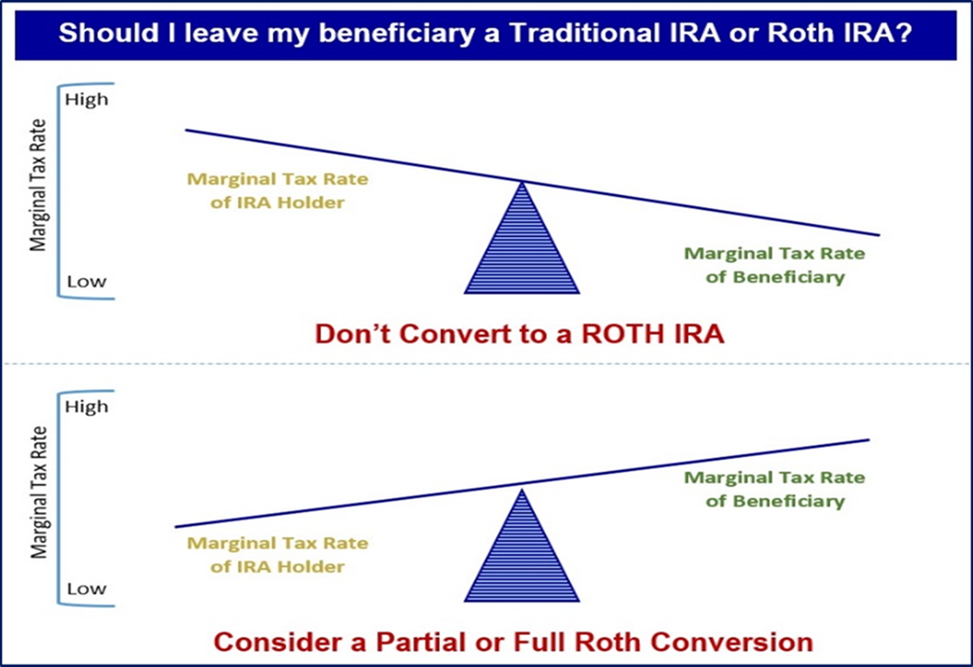
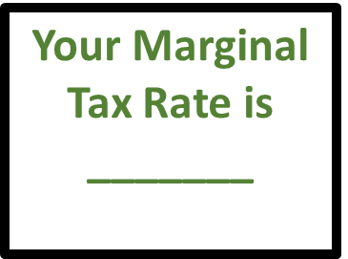
Proactive Tax Planning with the SECURE ACT
A critical area to review is overall Family Tax Bracket Management ©
Your Beneficiaries Marginal Tax Rate(s) is/are
_______
Notes:
Another critical area to review before year end because of the SECURE Act is what we refer to as overall Family Tax Bracket Management©.
Logically speaking, if you are in a higher tax bracket than your beneficiaries, then it might make sense to let them take distributions after your death in their tax bracket rather than you in yours.
However, if your beneficiaries are in a higher tax bracket, then it might make sense to take distributions in your tax bracket before death and then to convert these accounts to Roth IRAs and leave your beneficiaries an account that still must be taken out in 10 years, but can grow tax free.
An annual step to consider is to review your marginal tax rate and your beneficiaries marginal tax rate(s) each year.

Slide 25
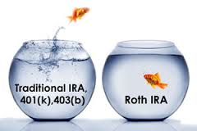
Proactive Tax Planning with the SECURE ACT
Explore Roth IRA Conversion Benefits
Lowers overall taxable income long-term
Tax-free compounding
No RMDs (at age 72)
Tax-free withdrawals for beneficiaries
*Withdrawals from Roth IRA may be tax free, as long as they are considered qualified. Limitations and restrictions may apply. Withdrawals prior to age 59 ½ may result in a 10% IRS penalty tax. Future tax laws can change at any time and may impact the benefits of Roth IRAs. Their tax treatment may change.
Notes:
Some benefits from Roth IRA Conversions include:
They could lower your overall taxable income long-term.
ROTH IRAs enjoy tax-free compounding.
ROTH IRAs have no RMDs (at age 72).
ROTH IRAS allow tax-free withdrawals for beneficiaries.

Slide 26

Consider Qualified Tuition Plans
Notes:
Qualified tuition plans, also named 529 plans, are a great way to tax efficiently plan the financial burden of paying tuition for children or grandchildren.
Originally, earnings in a 529 plan originally could be withdrawn tax-free only when used for qualified higher education at colleges, universities, vocational schools or other post-secondary schools. However, the rules changed that so now 529 plans can also be used to pay for tuition at an elementary or secondary public, private or religious school, up to $10,000 per year.
Unlike IRAs, there are no annual contribution limits for 529 plans. Instead, there are maximum aggregate limits, which vary by plan. Under federal law, 529 plan balances cannot exceed the expected cost of the beneficiary's qualified higher education expenses. 529 Plan limits vary by state, ranging from $235,000 to $529,000. Some states even offer a state tax credit or deduction up to a certain amount.
Contributions to a 529 plan are considered completed gifts for federal tax purposes, so in 2020 up to $15,000 per donor, per beneficiary, qualifies for the annual gift tax exclusion. Excess contributions above $15,000 must be reported on IRS Form 709 and will count against the taxpayer’s lifetime estate and gift tax exemption amount (currently $11.58 million in 2020).
There is also an option to make a larger tax-free 529 plan contribution, if the contribution is treated as if it were spread evenly over a 5-year period. For example, a $75,000 lump sum contribution to a 529 plan can be applied as though it were $15,000 per year, as long as no other gifts are made to the same beneficiary over the next 5 years. Grandparents sometimes use this 5-year gift-tax averaging as an estate planning strategy.
If you want to explore using or setting up a 529 plan, it can be confusing so call us and we would be happy to assist you.

Slide 27

Annual Gifting Tax Planning for 2020
Gift Tax Exclusion for 2020 is $15,000 (per Donee)
A payment made directly to a medical institution to pay for the medical bills of someone else does not count as a gift for gift tax purposes.
A payment made directly to an educational institution to pay for the tuition of a student does not count as a gift to the student for gift tax purposes.
Notes:
Let’s talk about annual gifting now.
You may gift up to $15,000 tax-free to each donee in 2020. These “annual exclusion gifts” do not reduce your lifetime gift tax exemption. This annual exclusion gift is doubled to $30,000 per donee for gifts made by married couples.
You can also help someone with medical or education expenses without incurring gift taxes.
There are opportunities to give unlimited tax-free gifts when you pay the provider of the services directly. The medical expenses must meet the definition of deductible medical expenses. Qualified education expenses are tuition, books, fees, and related expenses, but not room and board. You can find the detailed qualifications in IRS Publications 950 and the instructions for IRS Form 709 at www.irs.gov.

Slide 28
Wealth Transfer Planning for 2020
Exemption amounts for gift, estate, and generation-skipping taxes for 2020
is $11.58 million ($23.16 million for married couples).
 | 2020-2025 | 2026
Estate & Gift Tax Exemption Amount | $11.58 million is current exemption (indexed or inflation each year) | $5.49 million (indexed for inflation from 2017)
Generation-skipping Transfer Tax Exemption Amount | $11.58 million is current exemption (indexed or inflation each year) | $5.49 million (indexed for inflation from 2017)
Estate, Gift, and GST Tax Rate | 40% | 40%
Notes:
A wealth transfer planning item to think about is the exemption amounts for gift, estate, and generation-skipping taxes for 2020 is $11.58 million($23.16 million for married couples). Any amount over that is subject to 40% Federal taxes. This high amount provides high net worth individuals a significant planning window to make gifts and set up irrevocable trusts.
As a reminder, as of now, in 2026, the estate tax exclusion will return to $5.49 million (which is $5 million adjusted for inflation). On November 26, 2019, the Treasury Department and the Internal Revenue Service issued final regulations under IR-2019-189 confirming that individuals who take advantage of the increased gift tax exclusion or portability amounts in effect from 2018 to 2025 will not be adversely impacted when TCJA sunsets on January 1, 2026.
If you have a large estate, please call us to discuss this.

Slide 29

Tax Planning for 2020
Possible Tax Changes if Joe Biden Wins
Increase Corporate Tax Rates to 28%.
Increase the marginal tax rate for top earners from 37% to 39.6%.
Raise the capital gains tax on filers with incomes above $1 million to 39.6%.
Limit itemized deductions to a cap of 28%.
Phase out small business income deductions for those earning over $400,000.
Eliminate step-up in basis.
Reduce Estate Tax exemption to $3.5 million.
Notes:
While the election is in November, Democratic Party nominee Joe Biden has released some possible tax law changes he would like to make if he wins the presidency. While these would be future changes and must be approved by Congress, to help you think about planning your future strategies here are some of the proposed changes to be aware of:
Increase Corporate Tax Rates from 21% to 28%.
Increase the marginal tax rate for top earners from 37% to 39.6%
Raise the capital gains tax on filers with incomes above $1 million to 39.6%
Limit itemized deductions. Biden’s tax plan includes a cap on itemized deductions of 28%. This means for each dollar of itemized tax deductions, including charitable contributions, a taxpayer or couple filing jointly would only receive a maximum benefit of $0.28 even if a filer is paying a higher marginal tax rate.
Phase out small business income deductions for those earning over $400,000.
Eliminate step-up in basis. A step-up in basis refers to the cost basis of assets or property transferrable to an heir upon death. If, as an example, an individual purchased a home for $300,000, but it was worth $600,000 at the time of their death, today their heir would pay capital gains on anything over $600,000 if the home were ever sold. If Biden's tax proposal were to become law, heirs would not "inherit" a stepped-up cost basis and have to pay taxes on anything over $300,000.
Reduce Estate Tax exemption to $3.5 million immediately. This means estates over that value would be taxed.
Obviously, this is all a proposal, but it could be helpful information as you plan future tax years depending upon the election outcome.

Slide 30

Year-end Tax Planning
Summary Checklist
Bracket Management
Itemized Deduction Timing
Gain &Loss Harvesting
Retirement Planning
Education Planning
Charitable Planning
Estate Tax Planning
Planning for Major Financial or Life Events Next Year/Future
Planning for Any Other Personal Situational Concerns
Notes:
In summary, Here are some items that you should review prior to tax time:
What is you tax bracket?
Do you take Standard or Itemized Deduction for timing purposes?
Capital Gain & Loss Harvesting
Retirement Planning Contributions
Education Planning Opportunities
Charitable Gifting Planning, and
Estate Tax Planning Opportunities
Its also helpful to think about tax planning for any major financial or life events next year or in the future as well as tax planning for any other personal situational concerns.

Slide 31

Tax Planning for 2020
A “Proactive” approach to your tax planning instead of a “Reactive” approach could
produce better results!
Notes:
Our tax report for year-end tax planning is available and as we said when we started, a “proactive” approach to your tax planning instead of a “reactive” approach could produce better results!
If you know anyone who could benefit from our report or this workshop, please pass it on or let us know.
We enjoy helping others and always consider an introduction to others to be the highest compliment we receive.

Slide 32

Thank You!
Your health and well-being
is our highest priority!
Our Goal is to help You.
We appreciate the opportunity to assist with YOUR financial needs!
Notes:
Thank you for your time today.
Remember, your health and well-being is our highest priority.
Our goal is to help you and we appreciate the opportunity to assist you with your financial needs.
Please call our offices whenever you need to.

Slide 33

The views stated in this workshop are not necessarily the opinion of broker/dealer and should not be construed, directly or indirectly, as an offer to buy or sell any securities mentioned herein. Information is based on sources believed to be reliable; however, their accuracy or completeness cannot be guaranteed. Please note that statements made may be subject to change depending on any revisions to the tax code or any additional changes in government policy. Please note that individual situations can vary. Unless certain criteria are met, Roth IRA owners must be 59½ or older and have held the IRA for five years before tax-free withdrawals are permitted. Additionally, each converted amount is subject to its own five-year holding period. Investors should consult a tax advisor before deciding to do a conversion.
Rules and laws governing 529 plans are varied and subject to change. As with other investments, there are generally fees and expenses associated with participation in a 529 plan. There is also a risk that these plans may lose money or not perform well enough to cover college costs as anticipated. Most states offer their own 529 programs, which may provide advantages and benefits exclusively for their residents. Investors should consider, before investing, whether the investor's or the designated beneficiary's home state offers any tax or other benefits that are only available for investment in such state's 529 college savings plan. Such benefits include financial aid, scholarship funds, and protection from creditors. The tax implications can vary significantly from state to state. Tax laws and provisions may change at any time. Please consult a qualified tax professional to discuss tax matters. Contents provided by the Academy of Preferred Financial Advisors, Inc. Information is based on sources believed to be reliable; however, their accuracy or completeness cannot be guaranteed.
Contents provided by:
The Academy of Preferred Financial Advisors, Inc. © 2020. All rights reserved.
Reviewed by Keebler & Associates.
Insert Approved BD Disclaimer here
Insert registered branch address, contact information

