Slide 1
PROACTIVE TAX PLANNING Helpful Information for Filing 2020 Income Taxes and Proactive Tax Planning for 2021
Presented By: Your Name Company
Notes:
Welcome to our Proactive Tax Planning Workshop.
Today our goal is to provide helpful information to those who are about to or have already filed their 2020 income tax forms and to also provide some proactive tax planning tools for 2021.

Slide 2
Five Key Areas of Financial Planning
Preservation Planning
Retirement Planning
Tax Planning
Estate Planning
Investment Planning
Notes:
Before I begin, I find it is always important to review that there are five key areas of financial planning.
They are:
Preservation Planning,
Retirement Planning,
Tax Planning,
Estate Planning, and
Investment Planning
Even though today’s presentation is about tax planning, as a comprehensive wealth management firm, we try to always consider the impact of any recommendation we make on not just one, but all these areas for our clients.

Slide 3
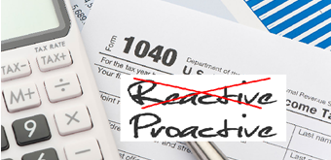
Proactive tax planning
should always be a key focus when reviewing
your personal financial situation.
Notes:
Proactive tax planning should always be a key focus when reviewing your personal financial situation.
One of our goals is to point out as many tax saving opportunities and strategies as possible for clients.
This workshop will review some of the broad tax issues and some potential tax reduction ideas.
As we go through this workshop, please remember that not all ideas may be appropriate for your personal situation. This workshop is for informational purposes only and we always recommend you always address any tax strategy with your tax professional.

Slide 4
Helpful Information for Filing Your 2020 Taxes
Notes:
First, let’s look at some helpful information for filing or understanding your 2020 taxes.

Slide 5
2020 Tax Brackets
RATE | SINGLE FILERS | HEAD OF HOUSEHOULD | MARRIED FILERS
10% | $0-$9,875 | $0-$14,100 | $0-$19,750
12% | $9,876-$40,125 | $14,101-$53,700 | $19,751-$80,250
22% | $40,126-$85,525 | $53,701-$85,500 | $80,251-$171,050
24% | $85,526-$163,300 | $85,501-$163,300 | $171,051-$326,600
32% | $163,301-$207,350 | $163,301-$207,350 | $326,601-$414,700
35% | $207,351-$518,400 | $207,351-$518,400 | $414,701-$622,050
37% | $518,401 + | $518,401 + | $622,051 +
 | Standard Deduction $12,400 | Standard Deduction $18,650 | Standard Deduction $24,800
Source: irs.gov
Notes:
In 2020, there were still seven federal income tax brackets.
Here are the tables for three of the most common ways taxpayer's file: single, head of household and married filing jointly.
The amounts in each bracket were slightly adjusted from the prior year due to inflation. The lowest bracket of the seven tax rates is 10% and the top tax rate is still 37%.
Also, the standard deduction, should you not itemize, is shown for each category.

Slide 6
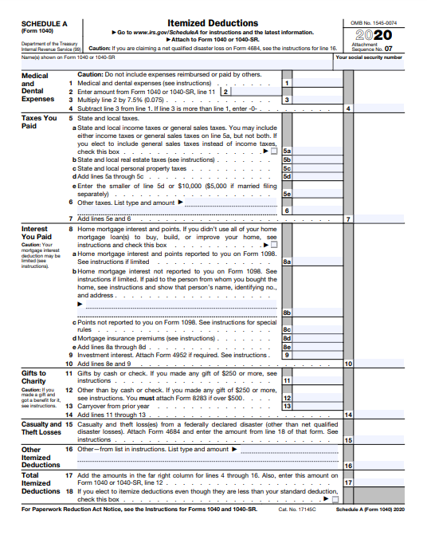
State and Local Taxes (SALT)
State and Local Taxes still capped at $10,000 for taxpayers that itemize.
Notes:
Should you itemize, a major change that still has a big impact from the 2017 Tax Cuts and Jobs Act, is that the state and local tax deductions that you can take, often referred to as SALT, is limited to a combined total of $10,000 or $5,000 for married taxpayers filing separately for state income and property taxes.
This deduction limitation is currently set to remain through the tax year 2025.

Slide 7
2020 Long-term Capital Gains Tax Rates
TAX RATE | SINGLE FILERS | HEAD OF HOUSEHOULD | MARRIED FILERS
0% | $40,000 or less | $53,600 or less | $80,000 or less
15% | $40,001 - $441,450 | $53,601 - $469,050 | $80,001 - $496,600
20% | $441,451 + | $469,051 + | $469,601 +
Source: Tax Foundation. Note: The income figures represent total taxable income, or income after all deductions are taken.
Notes:
Long-term capital gains were still taxed in 2020 at favorable rates so they can be more tax efficient than ordinary income.
Those rates are 0, 15 and 20%.
So, long-term capital gains are usually better taxwise than many other types of income.

Slide 8
Charitable Deductions
Notes:
Charitable donations are still deductible for those who itemize.

Slide 9
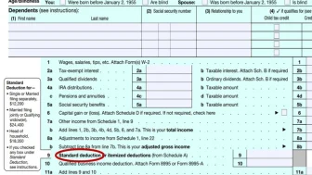
NEW Charitable Deduction
$300 Charitable Contribution Deduction
The CARES Act allows a $300 deduction for charitable contributions even if you don’t itemize your deductions for 2020.
Notes:
However, if you do not itemize, starting in 2020 the CARES Act created a new charitable deduction available to taxpayers who use the standard deduction and do not itemize their deductions.
This new benefit, known as a universal deduction, allows for an above the line charitable deduction of up to $300. To qualify, the charitable gift must be cash (or cash equivalent) made to a qualified 501(3c) charity and should have been made on or before December 31, 2020.
As the tax form here shows it is the NEW line 9 on your tax form.

Slide 10
Retirement Plans
QUALIFIED RETIREMENT PLANS | ANNUAL CONTRIBUTION 2020 LIMITS
 | < 50 AGE 50 | > AGE 50
Traditional/Roth IRA | $6,000 | $7,000
Traditional 401(k) | $19,500 | $26,000
SEP IRA | $57,000 | $57,000
Individual/Solo 401(k) | $57,000 | $63,500
Source: irs.gov
Notes:
Retirement plan funding is always something you should consider. If you have not already funded your retirement account for 2020, there could still be opportunities to do so. To explore if you can, please check with your tax preparer or call us for more information and details.

Slide 11
Overlooked Tax Items and Deductions
Reinvested Dividends
Carried-over Items from Prior Years
Qualified Charitable Distributions (QCDs)
Notes:
Here are some commonly overlooked tax items and deductions.
Reinvested Dividends - This is not a tax deduction, but it is a calculation that is important for tax purposes. Many investors have mutual fund or stock dividends that are automatically used to buy extra shares. Remember that each reinvestment increases your tax basis in that fund. That will, in turn, affect your capital gain calculation when you redeem shares. Please check that your statements keep good records. Forgetting to include reinvested dividends in your basis could result in double taxation of the dividends—once in the year when they were paid out and immediately reinvested and later when they are included in the proceeds of the sale.
If you are not sure what your basis is, ask the fund or us for help.
Carried-over Items from Prior Years – Don’t forget items carried over from prior years because you exceeded annual limits such as capital losses, charitable contributions, and certain tax credits. Please make sure if you switched tax preparers that they see your prior year’s return to look for these items.
Charitable Gift Directly made from IRA - Individuals at least 70½ years of age can still exclude from gross income qualified charitable distributions known as a Qualified Charitable Distribution or QCD from IRAs of up to $100,000 per year. These distributions must be made directly to the charity. Remember to double check on what counts as a qualified charity and distribution before using this tax strategy.

Slide 12
Proactive Tax Planning for 2021
Notes:
Now, let’s look at some helpful proactive tax planning strategies for 2021.

Slide 13
2021 Tax Brackets
RATE | SINGLE FILERS | HEAD OF HOUSEHOULD | MARRIED FILERS
10% | $0-$9,950 | $0-$14,200 | $0-$19,900
12% | $9,951-$40,525 | $14,201-$54,200 | $19,901-$81,050
22% | $40,526-$86,375 | $54,201-$86,350 | $81,051-$172,750
24% | $86,376-$164,925 | $86,351-$164,900 | $172,751-$329,850
32% | $164,926-$209,425 | $164,901-$209,400 | $329,851-$418,850
35% | $209,426-$523,600 | $209,401-$523,600 | $418,851-$628,300
37% | $523,601 + | $523,601 + | $628,301 +
 | Standard Deduction $12,550 | Standard Deduction $18,800 | Standard Deduction $25,100
Source: irs.gov
Notes:
Let’s briefly look at the 2021 tax brackets. There are still seven federal income tax brackets that have been slightly adjusted from 2020.

Slide 14
2021 Long-term Capital Gains Tax Rates
TAX RATE | SINGLE FILERS | HEAD OF HOUSEHOULD | MARRIED FILERS
0% | $40,400 or less | $53,600 or less | $80,800 or less
15% | $40,401 - $445,850 | $53,601 - $469,050 | $80,801 - $501,600
20% | $445,851 + | $469,051 + | $501,601 +
Source: Tax Foundation. Note: The income figures represent total taxable income, or income after all deductions are taken.
Notes:
Long-term capital gains are still currently scheduled at favorable rates.

Slide 15
Contribute to Your Retirement Plans
2021 Retirement Contribution Plan Limits
Elective deferrals to 401(k), 403(b), 457(b)(2), 457(c)(1) plans | $19,500
Contributions to defined contribution plans | $57,000
Contributions to SIMPLEs | $13,500
Contributions to traditional IRAs | $6,000
Catch-up Contributions to 401(k), 403(b), 457(b)(2), 457(c)(1) plans | $6,500
Catch-up Contributions to SIMPLEs | $3,000
Catch-up Contributions to IRAs | $1,000
Notes:
It’s never too early in the year to start contributing to your retirement plan. If you have any questions about your retirement plant, please give us a call.

Slide 16
Annual Exclusion Gifts
$15,000
2021 maximum amount of gift tax exemption per person.
Ideas for gifting can include:
contributing to a working child (or grandchild’s) IRA
gifting to a 529 plan
Notes:
You might want to examine taking advantage of annual exclusion gifts. For 2021, the maximum amount of gift tax exemption is $15,000 per person. For example, you can give up to that amount to a family member without having to pay a gift tax.
Some ideas for gifting can include:
contributing to a working child (or grandchild’s) IRA,
or gifting to a 529 plan, which is a tax-sheltered plan for college expenses

Slide 17
Above the Line Charitable Deduction Increase
$600
The new above the line charitable deduction increases from $300 to $600 in 2021 for taxpayers married filing jointly.
Notes:
The new above the line charitable deduction we showed you earlier for those who do not itemize increases in 2021 from $300 to $600 for taxpayers married filing jointly. For individual filers it is still $300.

Slide 18
2021 Tax Projection
A qualified tax preparer should be able to help you with a tax projection for 2021.
Notes:
Also, it could be helpful to formulate a 2021 tax projection – We already know the 2021 rates. A qualified tax preparer should be able to review your 2020 situation and all your 2021 expectations for income so they could provide you with a 2021 tax projection.

Slide 19
OTHER PROACTIVE TAX PLANNING STRATEGIES
A “Proactive” approach to your tax planning instead of a “Reactive” approach could produce better results!
Notes:
Here are some other proactive tax planning strategies because we believe that taking a proactive approach is better than a reactive approach—especially regarding income tax strategies!

Slide 20
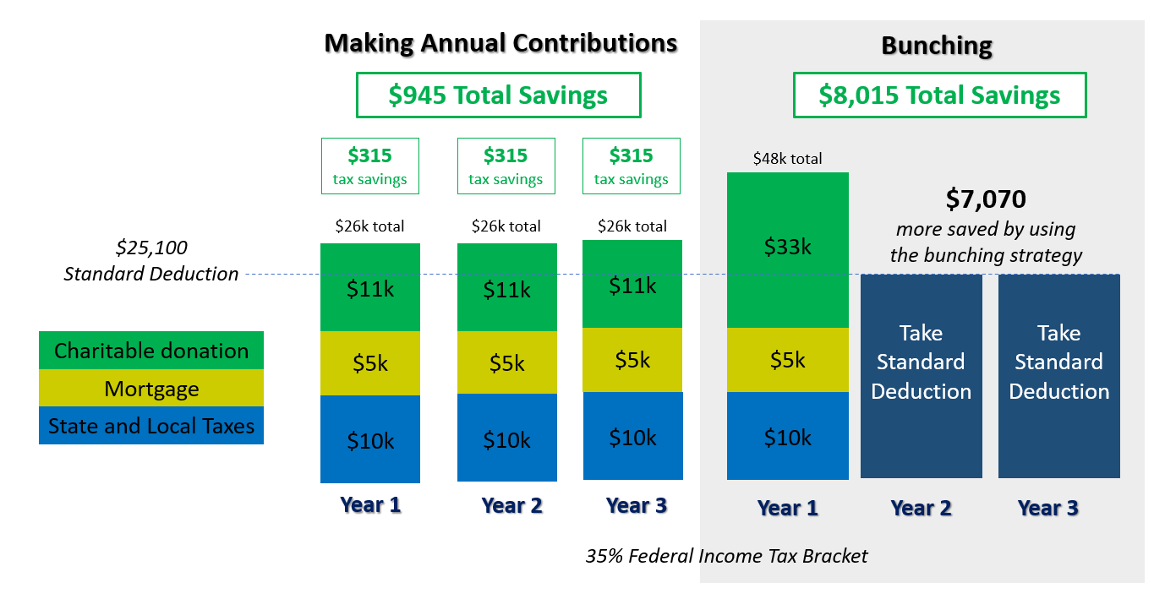
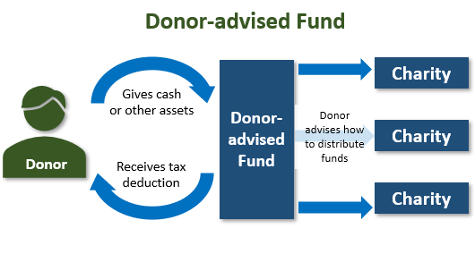
Consider Bunching Charitable Contributions Using a Donor Advised Fund (DAF)
Donor
Donor
Example is for informational purposes only.
Notes:
If you are close to the standard deduction level a strategy to consider is “bunching” your charitable donations into a Donor Advised Fund (DAF).
As this example shows, someone who is slightly over the standard deduction each year can “bunch” three years of charitable contributions into a Donor Advised Fund in year one. This could bring that taxpayer a much larger overall tax savings over, in this example, three years.
Then, as the other side of the screen shows, from your Donor Advised Fund you can still give your favorite charity money each year.
Now is the time to explore if it is helpful for your tax situation to deposit cash, appreciated securities or other assets into a Donor Advised Fund, and then distribute the money to charities over time. For more information on this strategy, call us.

Slide 21
Family Tax Bracket Management
Your Marginal Tax Rate is:
_____________
Your Beneficiaries Marginal Tax Rate(s) is/are:
_____________
Notes:
A critical area to review in tax planning is what we refer to as overall Family Tax Bracket Management©.
If you have retirement assets that are not in a ROTH IRA, when and who takes distributions can make a huge difference from a tax standpoint.
Simply put, if you are in a higher tax bracket than your beneficiaries, then it might make sense to let them take distributions in their tax bracket rather than you in yours.
However, if your beneficiaries are in a higher tax bracket, then it might make sense to take distributions in your bracket, convert these accounts to Roth IRAs and leave them an account that still has to be taken out in 10 years after your death, but can grow tax free for up to those ten years.
A key step is to explore considering your marginal tax rate and your beneficiaries marginal tax rate(s) each year. That is something we try to think about for clients with large retirement accounts.

Slide 22
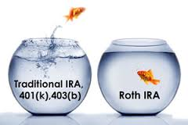
Roth IRA Conversion Benefits
Explore Roth IRA Conversion Benefits
Lowers overall taxable income long-term
Tax-free compounding
No RMDs (at age 72)
Tax-free withdrawals for beneficiaries
*Withdrawals from Roth IRA may be tax free if they are considered qualified. Limitations and restrictions may apply. Withdrawals prior to age 59 ½ or prior to the account being opened for 5 years, whichever is later, may result in a 10% IRS penalty tax. Future tax laws can change at any time and may impact the benefits of Roth IRAs. Their tax treatment may change. Traditional IRA account owners have considerations to make before performing a Roth IRA conversion. These primarily include income tax consequences on the converted amount in the year of conversion, withdrawal limitations from a Roth IRA, and income limitations for future contributions to a Roth IRA. In addition, if you are required to take a required minimum distribution (RMD) in the year you convert, you must do so before converting to a Roth IRA.
Notes:
For Some people, exploring a ROTH IRA Conversion could be helpful. Some benefits from Roth IRA Conversions include:
They could lower your overall taxable income long-term.
ROTH IRAs enjoy tax-free compounding.
ROTH IRAs have no RMDs (at age 72).
ROTH IRAS allow tax-free withdrawals for beneficiaries.
Whether to convert part or all your traditional IRA to a Roth IRA depends on your situation. It is best to prepare a tax projection and calculate the appropriate amount to convert.
There are several pros and cons to making this change. Please call us or talk with your tax advisor to see if this makes sense for you.

Slide 23
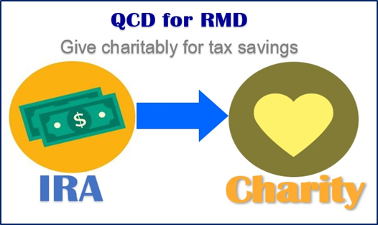
Qualified Charitable Distributions (QCD)
Qualified Charitable Distributions (QCD) are a strategy for retirement savers.
Allowed at 70½.
Many retirement savers like to use their RMDs or part of them for QCDs.
Notes:
Qualified Charitable Distributions (QCD) are still a strategy for retirement savers in 2021. This provision allows retirement savers to directly distribute up to $100,000 to eligible charities straight from their retirement accounts after age 70½ and not pay tax on this distribution.
One idea that experts suggest is if you are charitably inclined, consider using part or all your Required Minimum Distribution or “RMD” if you are over age 72 for a Qualified Charitable Distribution or “QCD”.
Like many of the other strategies we are discussing today, this is one you should see us about if you are interested in evaluating your situation.

Slide 24
YY What Can You Expect From Us?
Regular communication
More frequent discussions
Review of economic, tax, estate and investment issues for our clients
Notes:
So – what can you expect from us?
You can expect regular communication, more frequent discussions, and you can expect that we are continuously reviewing economic, tax, estate and investment issues for our clients.
We hope you’ve received our special tax report. If you haven’t, or if you’d like a copy sent to someone you think may benefit from the information in it, please give us a call and we’d be happy to share this report.

Slide 25
Thank You!
Your health and well-being is our highest priority!
We appreciate the opportunity to assist with YOUR financial needs!
Notes:
Thank you for your time today.
Remember, your health and well-being is our highest priority.
We appreciate the opportunity to assist you with your financial needs.

Slide 26
This information is not intended to be a substitute for specific individualized tax, legal or investment planning advice. ­ We suggest that you discuss your specific tax issues with a qualified tax advisor.
Note: The views stated in this letter are not necessarily the opinion of broker/dealer and should not be construed, directly or indirectly, as an offer to buy or sell any securities mentioned herein. Information is based on sources believed to be reliable; however, their accuracy or completeness cannot be guaranteed. Please note that statements made may be subject to change depending on any revisions to the tax code or any additional changes in government policy. Investing involves risk including the potential loss of principal. No investment strategy can guarantee a profit or protect against loss in periods of declining values. Past performance is no guarantee of future results. Please note that individual situations can vary.
Contributions to a traditional IRA may be tax deductible in the contribution year, with current income tax due at withdrawal. Withdrawals prior to age 59 ½ may result in a 10% IRS penalty tax in addition to current income tax.
The Roth IRA offers tax deferral on any earnings in the account. Withdrawals from the account may be tax free, as long as they are considered qualified. Limitations and restrictions may apply. Withdrawals prior to age 59 ½ or prior to the account being opened for 5 years, whichever is later, may result in a 10% IRS penalty tax. Future tax laws can change at any time and may impact the benefits of Roth IRAs. Their tax treatment may change. Additionally, each converted amount is subject to its own five-year holding period. Investors should consult a tax advisor before deciding to do a conversion.
Sources: www.IRS.gov, turbotax.com. Contents Provided by The Academy of Preferred Financial Advisors, Inc 2021© All rights reserved. Reviewed by Keebler & Associates.
Insert Approved BD Disclaimer here
Insert registered branch address, contact information

Slide 27
Help Us
Help Others!
Please share!
Notes:
We would like to help others in 2021!
In fact, we would be honored if you could share some names of friends we could forward this presentation to or add to our mailing list so that they can benefit from our information.
Thank you again for your time today and remember – a proactive approach can many times lead to better results than a reactive one.

