Slide 1

Economic and Market Update
Presented By:
Your Name
Company
Notes:
Hello clients and friends. This is ___________________ from the __________________ and it’s my pleasure to present our economic and market update.

Slide 2

Agenda
Economic and Market Update
Proactive Guidance
Notes:
Today’s agenda is very straightforward.
First, I will share with you a brief economic and market update.
Then, we will discuss some proactive guidance moving forward.

Slide 3

Five Key Areas of Financial Planning
Preservation Planning
Retirement Planning
Tax Planning
Estate Planning
Investment Planning
Notes:
Before we begin, it is always important to review that there are five key areas of financial planning.
They are:
Preservation Planning,
Retirement Planning,
Tax Planning,
Estate Planning, and
Investment Planning
As a comprehensive financial services firm, we try to always consider the impact of any recommendation we make on not just one, but all these areas for our clients.
Today's presentation will be primarily focused on investment planning and equity markets.

Slide 4

An Educated Client Is Our Best Client!
Notes:
At our firm, we partner with clients and believe an educated client is our best client. While we will always try our best to help you, when it comes to your finances, we believe that knowledge is power. One of our missions is to share with clients any knowledge that can help them make an informed decision.

Slide 5
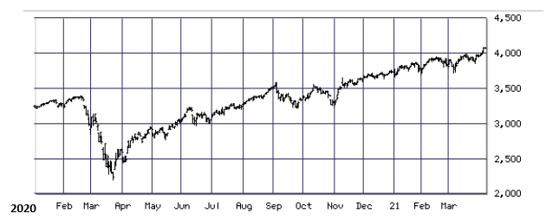

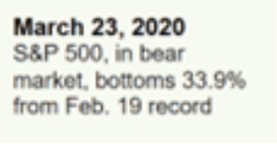
Equity Market Review
What a difference a year makes!
April 2021
NEW HIGHS
Source: Bigcharts.com
Notes:
Looking back to the start of 2020, investors have had a most unusual ride.
On February 19th of 2020, the Standard and Poor's, or S&P 500 index, closed at a then all-time high.
Sadly, without warning, when COVID first became a worldwide pandemic, investors saw a 30+ day decline of over 33%, which finally reached a bottom on March 23rd, 2020.
For those who did not panic, good news arrived on August 18th, as the S&P index rallied to a new all-time high.
Fast forward to late April 2021 and the index, despite volatility, again made new highs.

Slide 6
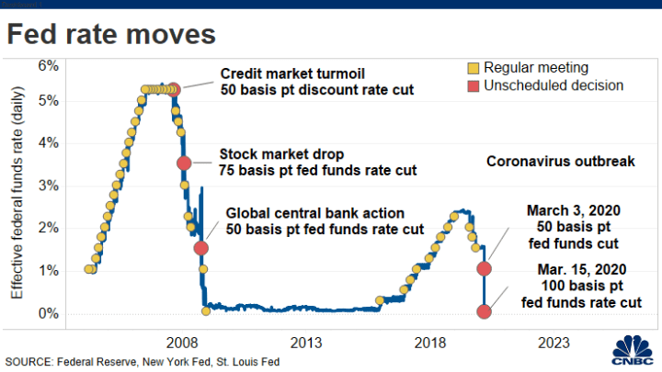
Interest Rates
Notes:
Interest rates continue to be in the forefront of our watch list.
With vaccinations being distributed and the economy on the rebound, the Federal Reserve offered an improved economic forecast during its March 2021 monetary policy meeting. Despite the predicted upward trend in the economy and inflation, the majority of Fed policy committee members remained steadfast to keeping their key Federal Funds Rate at or near the 0% rate they moved to in March of 2020.
They cited 2024 as the first year they anticipate rate hikes noting that the Fed needed “substantial further progress” toward employment numbers and price stability before they could raise rates.
Source: https://www.cnbc.com/2021/03/17/fed-decision-march-2021-fed-sees-stronger-economy-higher-inflation-but-no-rate-hikes.html

Slide 7
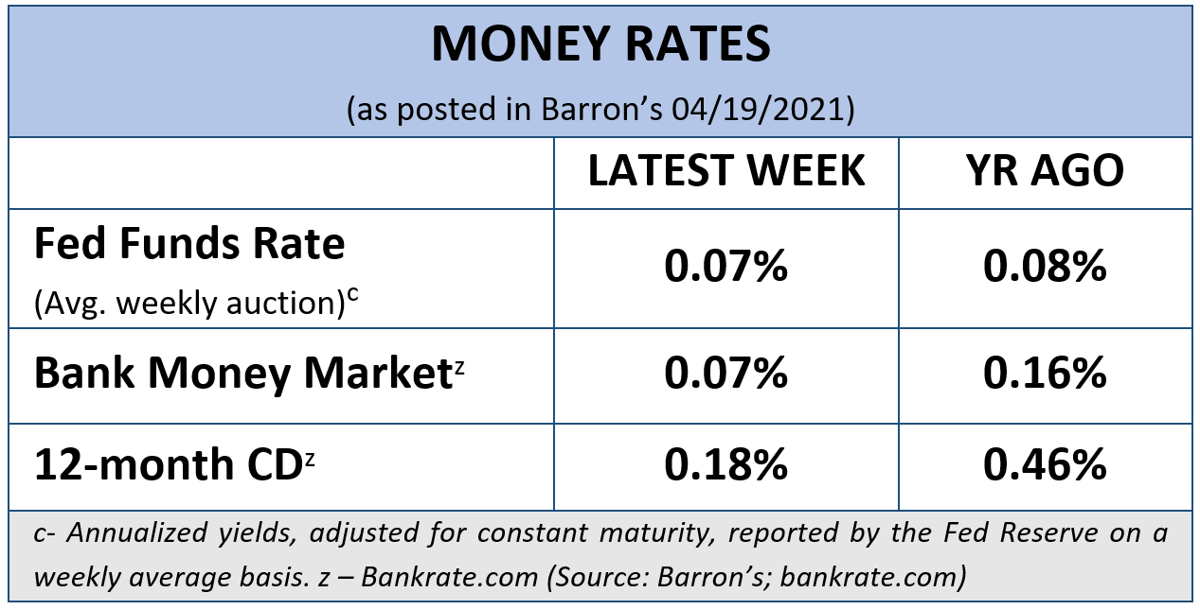
Cost of Safety
Notes:
Safety comes with a cost.
Have you seen what interest rates banks are currently offering to savers?
According to Barron’s, the average bank money market rates on April 19, 2021, were 0.07% and the average 12-month CD rate was 0.18%.
At a rate of 0.18%, without taxes, it would take over 350 years to double your money!
For many investors, today’s low rates might not help them reach their goals.
Therefore, equities could be a part of your diversified portfolio.

Slide 8


Notes:
This past quarter brought investors many tempting distractions. Media magnification is a powerful force. Sensational headlines can leave investors overwhelmed, stressed, and confused.
Our objective is to help you carefully create and follow a strategy with realistic financial goals. Veering off course in the hopes of short-term gains could potentially compromise the financial fortitude of your long-term goals. Call us if you have any questions about your path and please contact us before making any sudden moves.
Also, your personal health is imperative, and stress doesn’t help! So, lets all try to stay healthy.

Slide 9

Time Horizon
Short term: two years or less
Medium term: two to ten years
Long term: ten years or more
Notes:
An essential factor when selecting the types of investments to include in your portfolio is your time horizon. This is the amount of time you earmark to reach your goals. An investor that can commit to a 10-year time horizon can review different choices as compared to someone who needs to use that money in 6 months.
Investors should always try to match their portfolios to their goals and time horizons. This can help them keep the big picture in mind and hopefully curtail any distractions caused by short-term developments. This is something that we enjoy helping our clients with. If clients are focused on their long-term goals, we can help manage any anxieties caused by short-term market noise or volatility. Our goal is to help clients avoid making impulsive investing decisions.

Slide 10
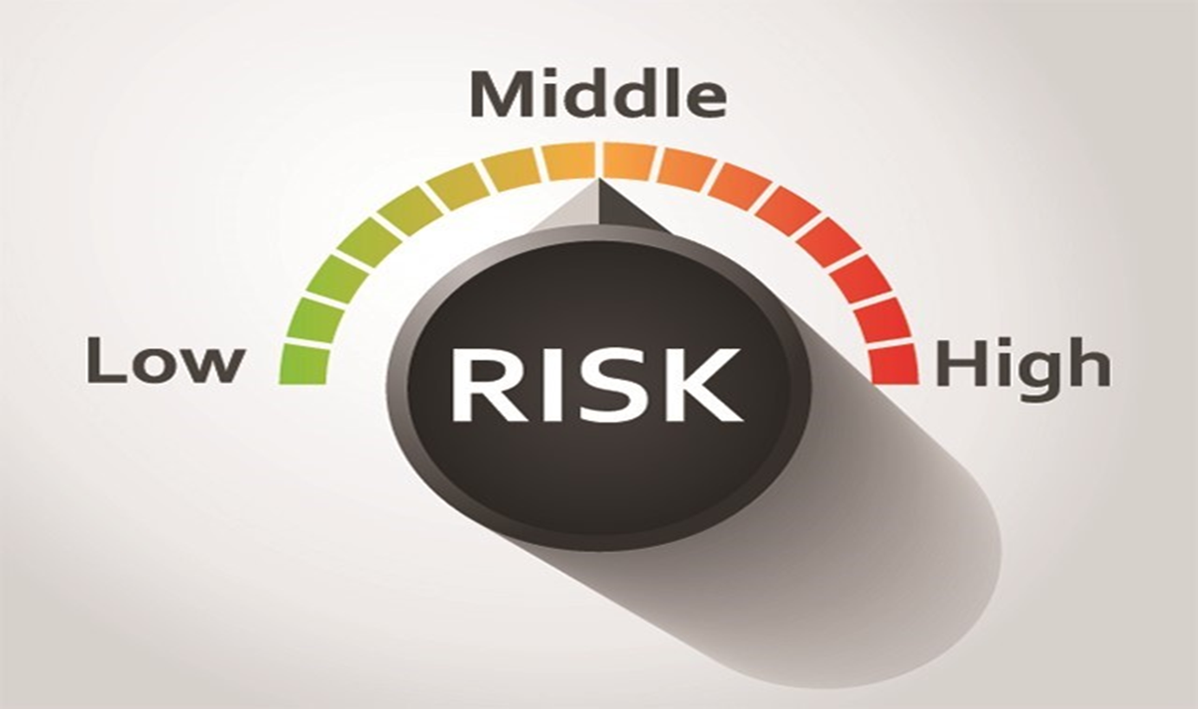
Risk Appetite
Notes:
Another key investment factor that you can control is your risk appetite or the amount of acceptance that you have for risk.

Slide 11
Notes:
We want to emphasize the importance of keeping your focus on what you can control, versus what you cannot.
As this illustration shares, you can control your risk, your time horizon and your behavior.
Although many investors focus on outcome or investment return, that is something you cannot control.

Slide 12
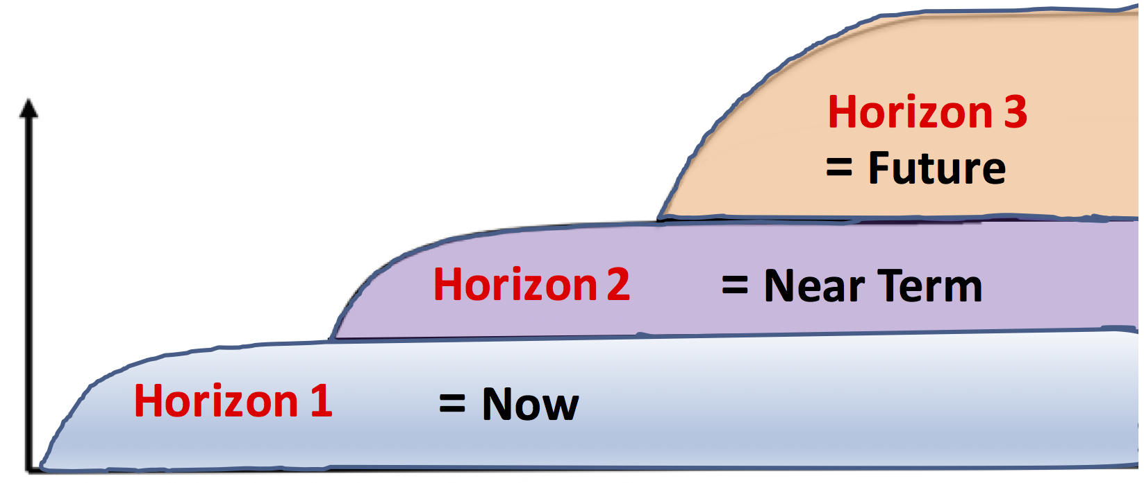
What you CAN control:
Risk Appetite
Time Horizons
Potential
High Reward
Potential
Low Reward
Confirm your risk appetite and time horizons!
Notes:
Reviewing your risk appetite to see if it has shifted or checking to see if your time horizon has changed is always important. After you fully outline or update these two foundations for your investment strategy, you can then match your behavior to your investment plan.

Slide 13

Typically, the most successful investors think and act for the long term.
Notes:
Thinking long term is still a great way to look at equity investments.
Typically, the most successful investors think and act for the long-term.
It’s nearly impossible to predict exact market movements, however, you can prepare.

Slide 14


Investors need to be prepared!
Notes:
Equity market volatility is still present. Equity market downturns or declines are a normal part of the investment experience.
Now is an excellent time to move forward with confidence in the path you’ve chosen toward your investment goals, but remember, equity markets are currently high and we always alert clients that we need to proceed with caution.

Slide 15

Proactive Tax Planning for 2021
Notes:
Recently, President Joe Biden said that he was going to recommend some changes to tax rates and laws. While nothing is currently approved, this is something we will be watching closely, and we will keep clients updated and informed as things progress.

Slide 16


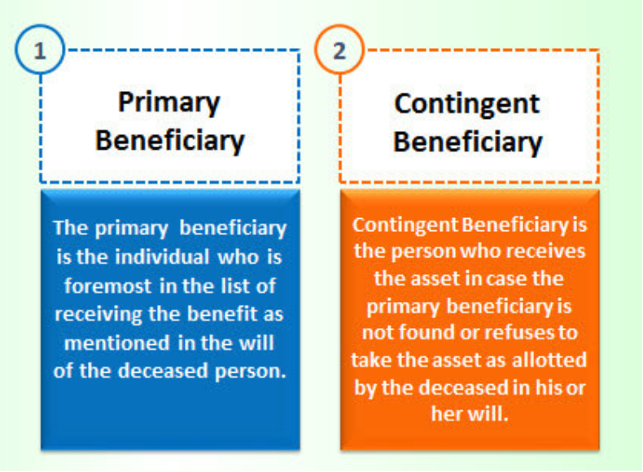
Proactive Tax Planning for 2021
Notes:
The Secure Act was passed in late 2019 and it changed how retirement funds were transferred to heirs.
To try to offer our clients better flexibility on minimizing taxes on their retirement funds, we will be discussing with clients, where appropriate, the strategies that come with designating both primary and contingent beneficiaries.

Slide 17

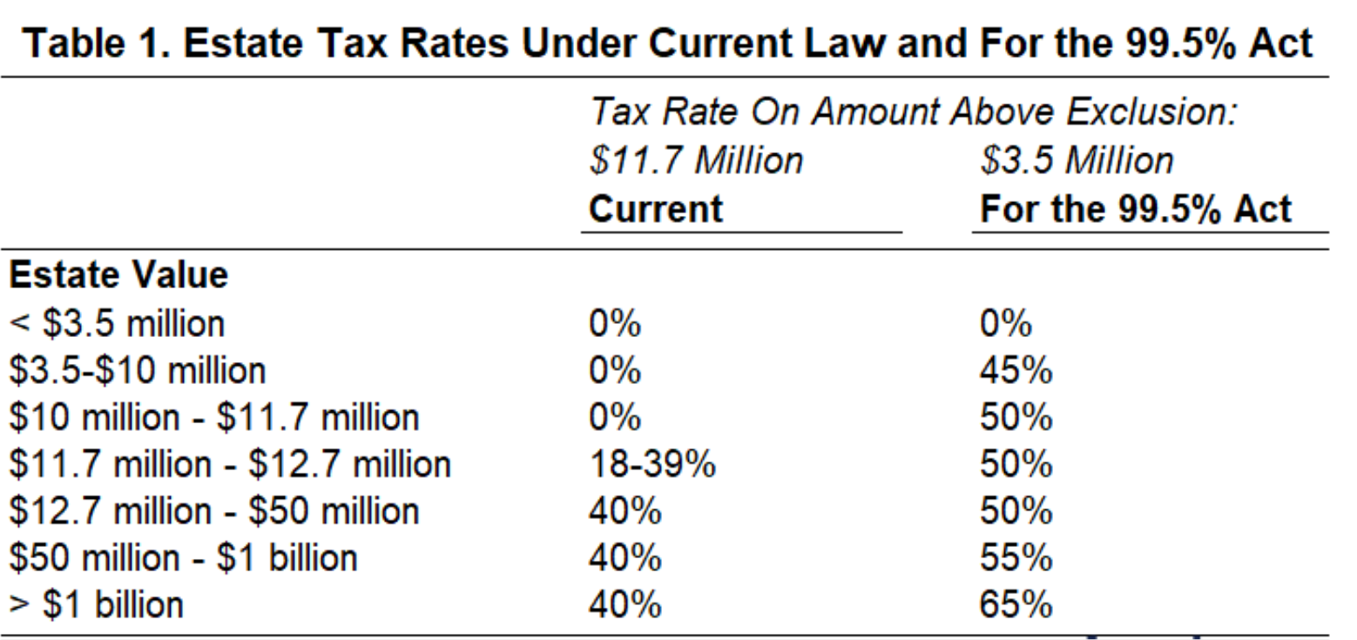
Proactive Tax Planning for 2021
“For the 99.5 Percent Act”
Notes:
Another proactive planning topic we want to be watching is that in March, Senator Bernie Sanders filed a Senate proposal called the, “For the 99.5 Percent Act”.
This proposal was to reduce estate tax exemptions from the current level of $11.7 million dollars per person to $3.5 million per person.
The estate tax rate under Senator Sander’s plan would start at 45% and grow to as high as 65%.
This is a proposal we will be closely watching and as things develop, we will be updating you and talking with clients that could be affected.

Slide 18
Key Takeaways
Despite continued volatility, Equity markets in 2021 have started on a high note.
Interest rates are expected to remain low through 2023.
The economic recovery is still largely based on vaccine distribution and reduction of COVID-19 cases.
A new administration brings new changes and proposals.
Notes:
As a quick recap, here are some key points:
Despite continued volatility, equity markets in 2021 have started on a high note.
Interest rates are expected to remain low for the foreseeable future.
The economic recovery is still largely based on vaccine distribution and reduction of COVID-19 cases.
A new administration brings new changes and proposals.

Slide 19
Key Takeaways
Caution and vigilance are critical.
Avoid distractions that sway you from the path to your goals.
Focus and make sure your time horizon and risk appetite are congruent with your goals.
Call us with any concerns!
Notes:
Also -
Caution and vigilance are critical.
Please avoid distractions that sway you from the path to your goals.
Focus and make sure your time horizon and risk appetite are congruent with your goals.
And as always, call us with any concerns!

Slide 20

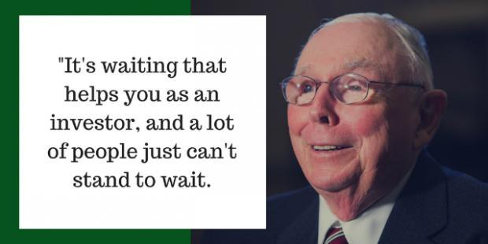
Key Takeaways
“
Charlie Munger
Notes:
Legendary long-term investor Warren Buffet’s business partner Charlie Munger said that, “It’s waiting that helps you as an investor, and a lot of people just can’t stand to wait."

Slide 21
What Can You Expect From Us?
Regular review of changes that may affect you.
Regular communication.
More frequent discussions.
Review of economic, tax, estate and investment issues for our clients.
Notes:
So – what can you expect from us?
One of our main focuses is to review changes for our clients on an ongoing basis.
You can expect regular communication, more frequent discussions, and you can expect that we are continuously reviewing economic, tax, estate and investment issues for our clients.
In fact, we will be offering other workshops that highlight tax changes and planning ideas.

Slide 22

Client Benefit
As a client of our firm, you can add names to our viewing list for these workshops!
Notes:
We appreciate our clients!
As a client benefit, you can add names to our distribution list for viewing this workshop.
We hope you will take advantage of this and add two names or more to our list.

Slide 23

Help Us
Help Others!
Please share!
Notes:
One of our goals for 2021 is to continue to help others!
Some of our best clients were referred to us by existing clients. So, please feel comfortable letting us know the names of anyone who you feel could benefit from our services or information.
Again, one of our primary goals is to keep clients informed and we appreciate you watching our update.
Please call us if you have any questions.

Slide 24
Insert registered branch office address and phone number, as well as broker-dealer identification/disclosure
The views expressed are not necessarily the opinion of Insert Broker-dealer name. Information is based on sources believed to be reliable, however, their accuracy or completeness cannot be guaranteed.
Investing involves risk including the potential loss of principal. No investment strategy can guarantee a profit or protect against loss in periods of declining values. Past performance is no guarantee of future results. Diversification and strategic asset allocation do not ensure a profit or protect against a loss. The process of rebalancing may carry tax consequences.
This information is not intended to be a substitute for specific individualized tax, legal, or investment planning advice. You should discuss any tax, legal or investment planning matters with the appropriate professional.
All indexes are unmanaged and cannot be invested into directly. Unmanaged index returns do not reflect fees, expenses, or sales charges. Index performance is not indicative of the performance of any investment. Economic forecasts set forth may not develop as predicted and there can be no guarantee that strategies promoted will be successful. International investing involves special risks such as currency fluctuation and political instability and may not be suitable for all investors.
The S&P 500 is an unmanaged index of 500 widely held stocks that is generally considered representative of the U.S. Stock market. The Dow Jones Industrial Average (DJIA) commonly known as “The Dow”, is an index representing 30 stocks of companies maintained and reviewed by the editors of the Wall Street Journal. Index performance does not include transaction costs or other fees, which will affect actual investment performance. Individual investor’s results will vary.
Contents provided by: The Academy of Preferred Financial Advisors, Inc. © 2021. All rights reserved.

Slide 25

Thank You!
We appreciate the opportunity to assist
you with your financial needs!
Your health and
well-being is always our highest priority!
Notes:
We are thankful for the opportunity to assist you with your financial needs.
Remember, at our firm clients come first and your health and well-being is our highest priority.

