Slide 1

Economic and Equity Market Update
and Proactive Tax Planning for 2021
Presented By:
Your Name
Company
Notes:
Hello clients and friends. This is ___________________ from __________________ and it’s my pleasure to present our economic and market update and proactive tax planning for 2021 workshop.

Slide 2

Agenda
Economic and Market Update
Proactive Tax Planning for 2021
Notes:
Today’s agenda is very straightforward.
First, we will share with you a brief economic and market update.
Then, we will discuss some proactive tax planning for 2021 including some new key tax proposals.

Slide 3

Five Key Areas of Financial Planning
Preservation Planning
Retirement Planning
Tax Planning
Estate Planning
Investment Planning
Notes:
Before we begin, it is always important to review that there are five key areas of financial planning.
They are:
Preservation Planning,
Retirement Planning,
Tax Planning,
Estate Planning, and
Investment Planning
As a comprehensive financial services firm, we try to always consider the impact of any recommendation we make on not just one, but all these areas for our clients.

Slide 4

An Educated Client Is Our Best Client!
Notes:
At our firm, we partner with clients and believe an educated client is our best client. While we will always try our best to help you, when it comes to your finances, we believe that knowledge is power. One of our missions is to share with clients any knowledge that can help them make an informed decision.

Slide 5
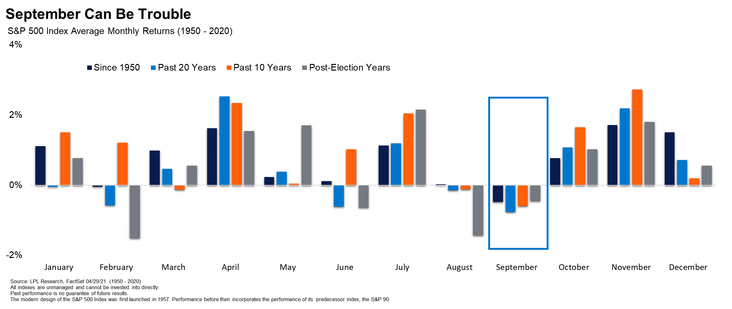
Equity Markets
Notes:
The month of September can be trouble, as it ranks as the weakest month for equities over the last 20 years.
History once again repeated itself this year as investors saw a difficult September for both the S&P 500 and the Dow Jones Industrial Average (DJIA).

Slide 6
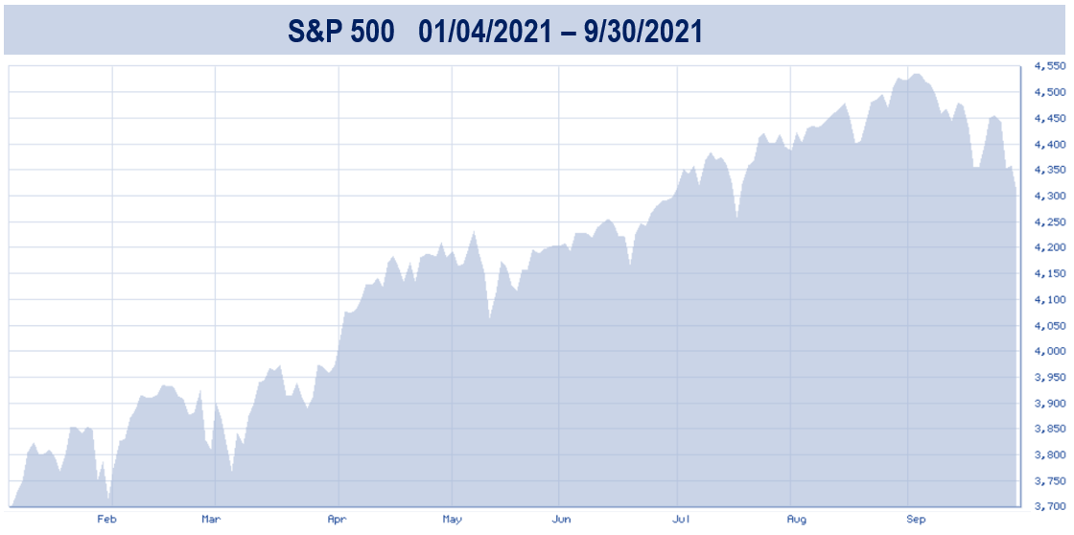
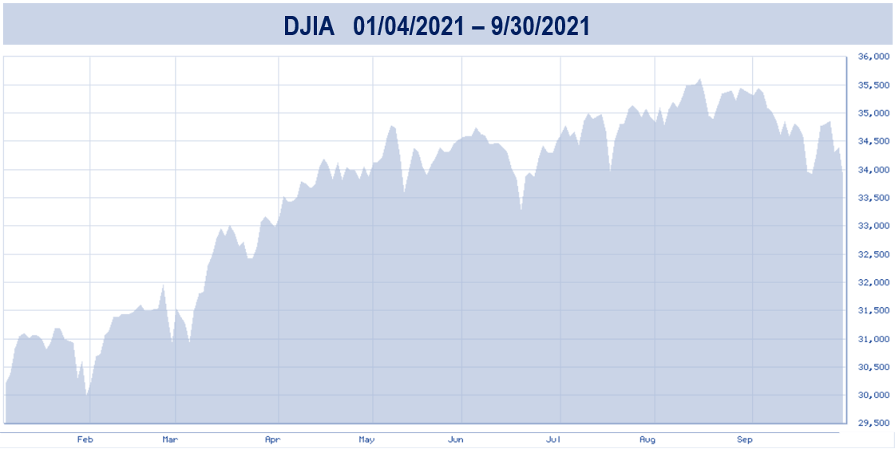
Equity Markets
Q3
Q3
Source: bigcharts.com
Notes:
The third quarter started with strong earnings reports lifting many large U.S. stocks during the summer and ended with the Federal Reserve (Fed) striking a dovish tone, confirming its hesitance to tighten policy too fast.
During the third quarter the S&P 500 experienced its worst monthly performance in September since March of 2020. It closed the quarter at 4,307 after dropping 4.8% in September. Even with this drop, it still experienced its sixth consecutive quarter gain, up 0.2%. It is still up for 2021.
The Dow Jones Industrial Average (DJIA) ended the third quarter lower than it started, finishing at 33,843 after dropping 4.3% in September. For the third quarter, it ended down almost 2%, marking the first quarterly loss for the DJIA since the first quarter of 2020. The Dow is also still positive for 2021.

Slide 7

Equity Markets
Market Concerns:
Rising inflation expectations
impending interest rate changes
monetary policy changes (including tax law proposals)
continued COVID-19 concerns
Notes:
A combination of factors continues to influence the direction of equity markets.
Some major Market Concerns currently are:
Rising inflation expectations,
impending interest rate changes,
monetary policy changes (including tax law proposals),
and continued COVID-19 concerns,
All of these items could continue to be, major factors in determining the future direction of the economy.
These themes could potentially cause market volatility for investors in the near future.

Slide 8
Inflation and Interest Rates
Federal Reserve Met in September
Fed funds rate remains at 0 – 0.25%
Expected to remain at this rate until the Fed sees employment and inflation numbers appropriate
Tapering could commence in November and conclude “around middle of next year”
Notes:
The Federal Reserve’s committee met in September.
During this meeting they announced that the Fed funds rate will remain at 0 – 0.25% and they expect to keep this range until labor market conditions improve. They share that, “the committee's assessments of maximum employment and inflation has risen to a sustainable 2% and is on track to moderately exceed 2% for some time.” (Source: federalreserve.gov, 9/22/2021)
Fed Chairperson Jerome Powell suggested that tapering, or the reduction in their purchasing of bonds, could begin in November and conclude around the middle of next year and that could cause interest rates to rise. (Source: www.cnbc.com 9/22/21)
Inflation is a real concern for savers because it eats into purchasing power and lifestyle. It is always a good idea for investors to try to at least keep pace or exceed inflation rates. We are keeping an eye on inflation and interest rates and any changes that may affect our clients.

Slide 9
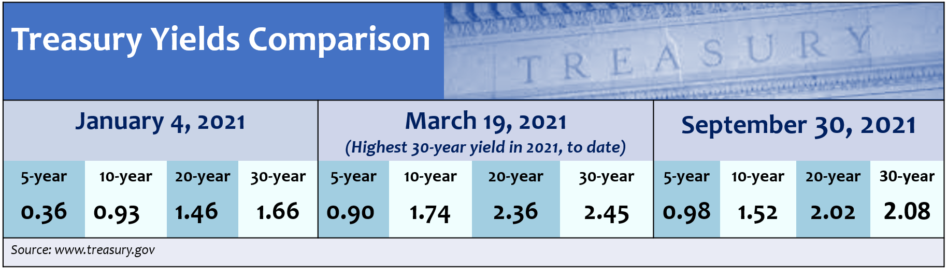
Treasury Yields
The 10-year Treasury yield finished the quarter at 1.52%.
The 30-year Treasury yield hit a 2021 high on March 19 at 2.45%.
Notes:
The 10-year treasury yield finished out the quarter at 1.52%.
This is a slight rise from the beginning of this year when it opened at 0.93%.
In March of this year, we saw some Treasury yield highs for 2021, when the 30-year yield reached 2.45% and the 10-year hit 1.74%.
By the end of the third quarter, we saw these slightly lower as the 30-year ended at 2.08% and again the 10-year ended at 1.52%.
With a 2% long-term inflation rates expected, a resurgence of higher-yields like we saw in March could be a possibility.

Slide 10
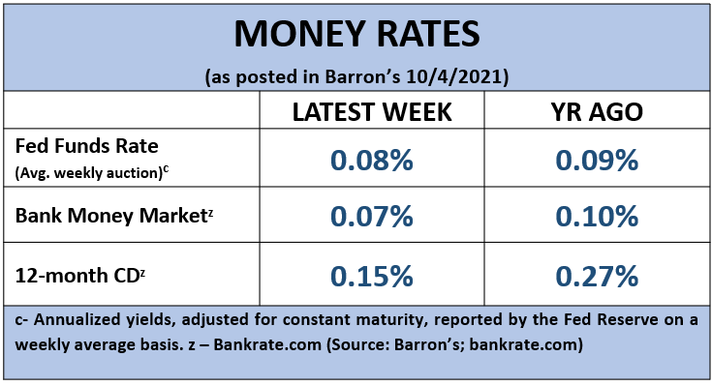
Cost of Safety
Notes:
Safety comes with a cost.
Have you seen what interest rates banks are currently offering to savers?
According to Barron’s, the average bank money market rates on October 4, 2021, were 0.07% and the average 12-month CD rate was 0.15%.
At a rate of 0.15%, without taxes, it would take over 350 years to double your money!
For many investors, today’s ultra-low rates of might not help them reach their goals.
Therefore, equities could be a part of your diversified portfolio.

Slide 11
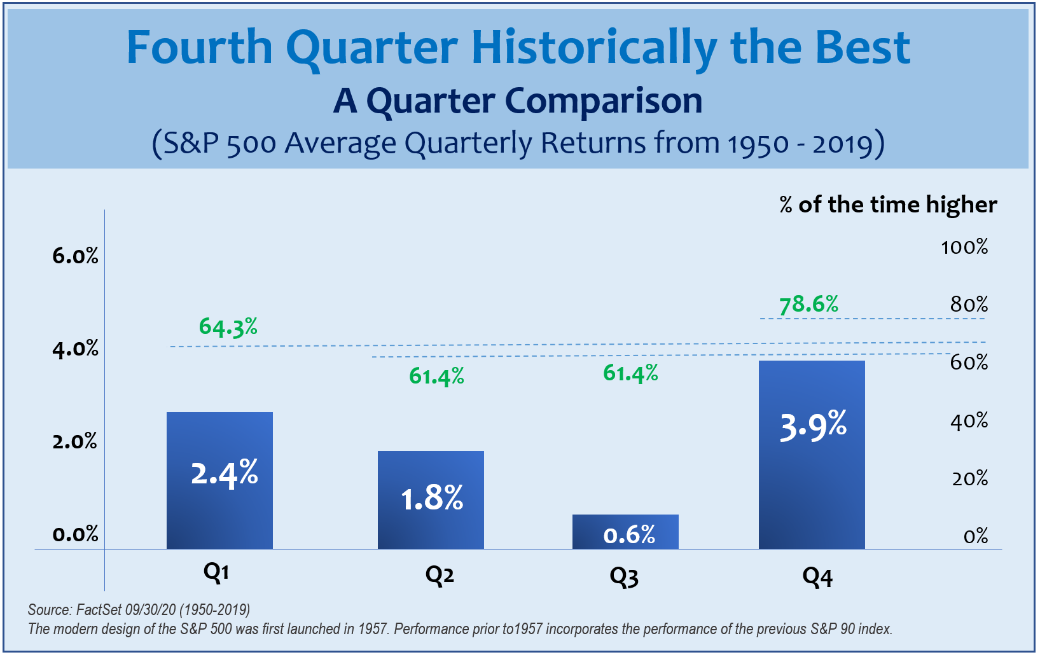
Outlook
Notes:
As this chart shows, since 1950, the fourth quarter of the year has empirically been the best quarter for equity markets.
However, investors need to remember that prior performance , never indicates future performance and there are still many key factors that could affect what direction we see equity markets move in the fourth quarter.
Rising inflation expectations, impending interest rate changes, monetary policy changes - including tax laws, and continued COVID-19 concerns, will continue to be major factors in the direction of the economy.

Slide 12

Outlook
Historical results are no indication of future results, and we still believe that caution should be the principal notion for investors.
Notes:
Overall, 2021 has been a positive year for equity investors, and historically, a positive first half of the year has traditionally brought a positive second half.
However – once again, historical results are no indication of future results, and we still believe that caution should be the principal notion for investors.

Slide 13
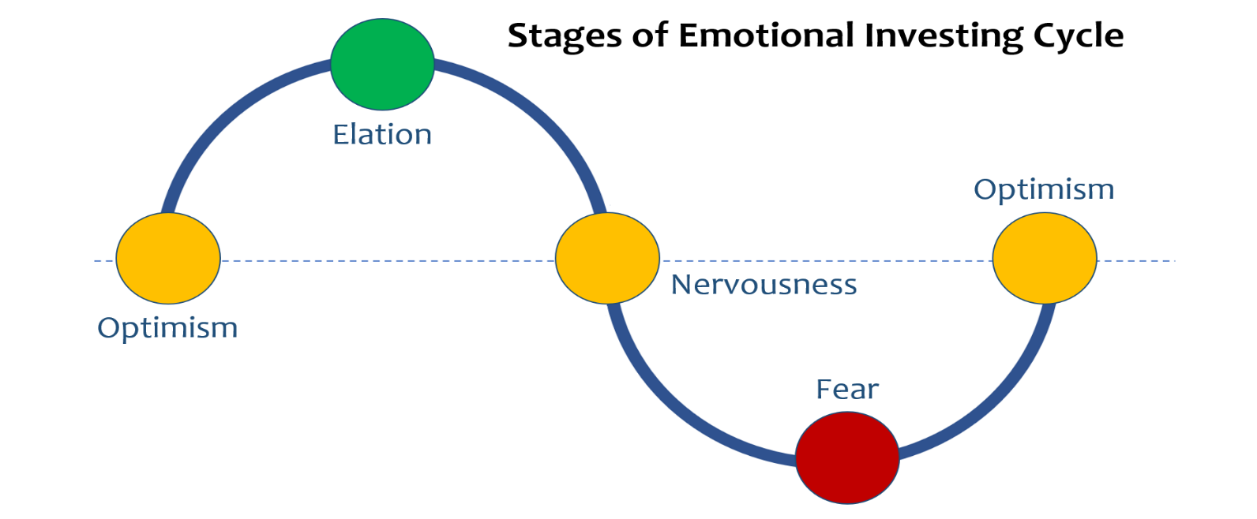
Emotional Investing Cycle
Notes:
Being cautious is natural, healthy and smart.
Investors should seek to become aware of their behavior in times of volatility, as well as opportunity.
Being too fearful or overly optimistic can many times lead to rash or poor decisions. Your emotions can make you a reactive, instead of a proactive, investor.
Knowing your investing behavior and how to effectively control it is an important tool to help navigate not only volatile times, but it can also assist you in avoiding impulsive investing on “too good to be true” opportunities.
A key to becoming successful at your goals is staying focused on your personal situation.

Slide 14
Emotional Investing Cycle
Your risk tolerance or appetite
Your time horizon
Your behavior
Your overall strategy
Notes:
There are four major things you should have a grasp of that can help you maintain discipline and direction toward your goals. Those four things are:
Your risk tolerance or appetite. By this, I mean how much risk are you willing to take, or better yet, how much can you afford to take?
Your time horizon – or the amount of time you want to be invested in any situation, which can help you determine your entry and exit points.
Your behavior. Market volatility is a part of the investing experience. This can create anxiety and stress when volatility occurs. Do you know how well you can emotionally endure the potential ups and downs of your investments?
Your overall strategy. Are you looking at something that doesn’t quite fit with your overall strategy? Perhaps the media is influencing you to make a rash decision on a trending investment. If it isn’t congruent with your overall strategy, the odds are there is more risk involved. Pressure can create more risk and potentially cause setbacks in your goals. New opportunities may arise, but not all with be the right opportunity for your overall strategy.

Slide 15


Emotional Investing Cycle
Entry
Exit
Notes:
Having pre-determined entry and exit points can be a helpful investing strategy.
The major factors that will help you determine your overall approach will be: risk tolerance, your time horizon, and your investing behavior.

Slide 16
Key Takeaways
Caution is still the principal notion for investors.
Interest rates are still near zero but may rise sooner than expected.
Inflation continues to be a concern.
The Fed has suggested that tapering may occur as soon as November.
Having a predetermined entry and exit strategy can help you save time, money, and help you reduce risk and stress.
We are here to help YOU!
Notes:
Here are the key items we hope you take away from our brief review:
Caution is still the principal notion for investors.
Interest rates are still near zero, but they may rise sooner than expected.
Inflation continues to be a concern.
The Fed has suggested that tapering may occur as soon as November.
Having a predetermined entry and exit strategy can help you save time, money, and help you reduce risk and stress.
And, always, we are here to help you!

Slide 17

Proactive Year-end Tax Planning
Ideas for 2021
Including Key Pending Tax Law Changes
A “Proactive” approach to your tax planning instead of a “Reactive” approach could produce better results!
Notes:
Now let’s shift to proactive tax planning for 2021 and some new key pending tax proposals.
We believe that taking a proactive approach to your tax planning instead of a reactive approach could produce better results.
Now let’s shift to Proactive tax planning for 2021 and some new key pending tax proposals.
We feel that taking a PROACTIVE approach to your Tax Planning instead of a REACTIVE approach could produce better results.

Slide 18



Tax Planning in 2021
Notes:
Tax planning for 2021 became a little more complicated because the passing of some new rules and laws from The SECURE Act, which signed into law in December of 2019, and the 2020 CARES Act also added some new laws and rules for taxpayers.
With the recent proposal of new tax laws from The Build Back Better and other potential tax law proposals, it is helpful to review some of the tax changes that are being discussed so that you can plan in an informed way.

Slide 19


Tax Planning vs. Tax Preparation
“By failing to prepare, you are preparing to fail.”
Benjamin Franklin
Notes:
Let’s start by quickly distinguishing the difference between tax planning and tax preparation.
Tax planning is looking ahead before year end, whereas tax preparation is filling out your tax forms after year end.
This workshop is about tax planning, not tax preparation. It is about hearing some proactive ideas that you can consider now to potentially reduce your taxes.
One of our Founding Fathers, Benjamin Franklin is credited with saying, “By failing to prepare, you are preparing to fail.”

Slide 20
Tax Brackets for 2021
For 2021, there are still seven tax rates.
They are 10%, 12%, 22%, 24%, 32%, 35%, and 37%.
Under current law this seven-rate structure is scheduled to phase out on January 1, 2026.
Notes:
For 2021, there are still seven tax rates. They are 10%, 12%, 22%, 24%, 32%, 35%, and 37%.
Under current law this seven-rate structure which was created by the Tax Cuts and Jobs Act is scheduled to automatically phase out on January 1, 2026.

Slide 21
Evaluate the use of itemized deductions
versus the standard deduction.
2021 STANDARD DEDUCTION Amounts
Single | MFJ/QW | MFS | HOH
$ 12,550 | $ 25,100 | $ 12,550 | $ 18,800
Notes:
For 2021, the standard deduction amounts for those who do not itemize are:
$12,550 for individuals
$25,100 for married couples filing jointly and surviving spouses.
$12,550 for married couples filing separately, and
$18,800 for heads of households.

Slide 22
Tax Planning in 2021
How to View Itemized Deductions
THE OLD RULE WAS TO
ACCELERATE DEDUCTIONS
THE NEW RULE IS TO
TIME or PLAN DEDUCTIONS
Notes:
So, how should you view itemized deductions if you do not take the standard deduction..
The old “rule” was to accelerate or realize deductions and take them as soon as possible.
With the higher standard deductions, the new “rule” is to time or plan deductions.

Slide 23
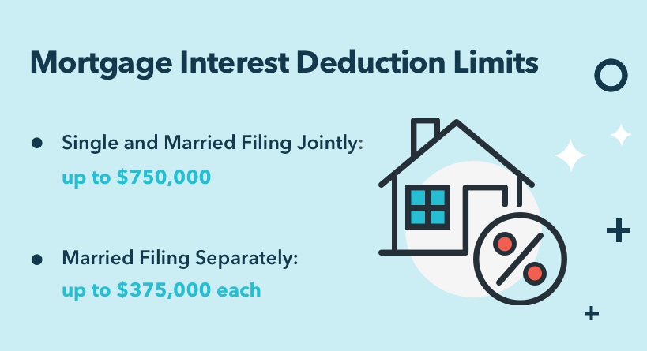

Understand your ability to deduct mortgage interest
& state and local taxes (SALT)
Mortgage Interest Deduction Limits:
Single and Married Filing Jointly: up to $750,000
Married Filing Separately: up to $375,000 each
State and Local Tax (SALT) Deductions:
Currently limited to $10,000
Notes:
Two of the more widespread deductions that taxpayers look at if they choose to itemize and not use the standard deduction are mortgage interest and State and Local taxes, known as SALT.
Under the new rules, for mortgages taken out after October 13, 1987, and before December 16, 2017, mortgage interest is fully deductible up to the first $1,000,000 of mortgage debt.
That threshold has been lowered to the first $750,000 or $375,000 (married filing separately) on homes purchased after December 15, 2017.
For those of you with mortgages, please check with your tax preparer for how much of a deduction you could take.
The TCJA act also limited state and local income, sales, and real and personal property taxes (SALT) to a maximum deduction of $10,000. There has been discussions about changing this, but currently the $10,000 limit is in place.

Slide 24
Charitable Giving Tax Planning for 2021
Qualified Charitable Distributions(QCD)
are still a strategy for retirement savers.
RMDs were changed to 72.
QCDs are still allowed at 70½.
Many retirement savers like to use their RMDs or part of them for QCDs.
70 ½
Minimum Age
$100k
Annual Maximum
IRA
Gift to Charity
Notes:
Qualified Charitable Distributions (QCD) are still a strategy for retirement savers.
As part of the SECURE Act Required Minimum Distributions or RMD’s were changed to start at age 72 instead of age 70½.
Qualified Charitable Distributions are a tax law provision that allows retirement savers over age 70½ to directly distribute up to $100,000 to eligible charities straight from their retirement accounts and not pay tax on this distribution.
One idea that experts suggest is if you are charitably inclined, consider using part or all of your Required Minimum Distribution or “RMD” for a Qualified Charitable Distribution.
Like many of the other strategies we are discussing today, this is one you should see us about if you are interested in evaluating your situation.

Slide 25
Capital Gains Rates for 2021
Notes:
In 2021, Long-term capital gains still receive a tax break.
Here are the three tax rates of 0%, 15% and 20% for Long-term capital gains.

Slide 26

Tax Gains & Loss Harvesting
Notes:
One planning item that many taxpayers think about is Tax Gains and Loss Harvesting.

Slide 27
Harvesting Capital Losses
Selling assets at a loss to offset capital gains.
Reduces or eliminates tax on current capital gain.
On the surface, loss harvesting produces an economic benefit equal to the tax saved, however it could only provide a timing benefit.
  Tax deferral could be valuable!
Notes:
Harvesting capital losses is a strategy that has a taxpayer selling assets that are at a loss to offset capital gains.
This reduces or eliminates tax on current capital gains.
On the surface, loss harvesting produces an economic benefit equal to the tax saved. However, sometimes, it could only provide a timing benefit.
This is a tax deferral strategy that could be valuable.

Slide 28
Harvesting Capital Losses
Capital losses are highly tax effective if they can be used to offset income taxed at higher rates.
Warning: Watch out for the wash sale rule, which prevents taxpayers from repurchasing a substantially similar security within 30 days of selling at a loss.
KEY FACT:
Taxpayers can use up to $3,000 capital loss
above capital gains to offset ordinary income!
Notes:
Capital losses are highly tax effective if they can be used to offset income taxed at higher rates.
A key fact to remember is you can use up to $3,000 in capital loss above capital gains to offset ordinary income.
Also, as a warning: watch out for the wash sale rule, This rule prevents taxpayers from repurchasing a substantially similar security within 30 days of selling at a loss.
If you have any questions on Loss or Gain Harvesting call us or your tax professional.

Slide 29

Harvesting Capital Gains
On the surface, it might appear that taxpayers should always harvest gains.
However, harvesting gains introduces a tradeoff between lower tax rates versus the loss of tax deferral.
Remember although tax is paid at a lower rate, it might be paid sooner.
Notes:
Capital gains harvesting means taking capital gains in the current tax year.
On the surface, it might appear that taxpayers should always harvest gains because of favorable rates. However, harvesting gains introduces a tradeoff between lower tax rates versus the loss of tax deferral.
Remember, when taking a gain for tax purposes, although the tax is paid at a lower rate, it is paid sooner.

Slide 30

Retirement Contribution Planning for 2021
Review Your Retirement Savings
Strategy Before Year-end!
Notes:
Remember to review your year end retirement contribution planning.

Slide 31
Retirement Contribution Planning for 2021
Retirement Contribution Plan Limits
IRA/ROTH IRA CONTRIBUTION LIMIT | $6,000
IRA/ROTH IRA “CATCH UP” | $1,000
401K ELECTIVE DEFERRAL | $19,500
401K ELECTIVE DEFERRAL “CATCH UP” | $6,500
SIMPLE IRA CONTRIBUTION LIMIT | $13,500
SIMPLE IRA “CATCH UP” | $3,000
SEP IRA EMPLOYEE PERCENTAGE MATCH LIMIT | 25%
SEP IRA SELF-EMPLOYED PERCENTAGE MATCH LIMIT | 20%
OVERALL LIMIT ON COTRIBUTIONS TO Defined Contribution Plans (DCPs) | $58,000
Notes:
Here are some contribution plan maximums that could be applicable if you are participating in one of these plans.

Slide 32
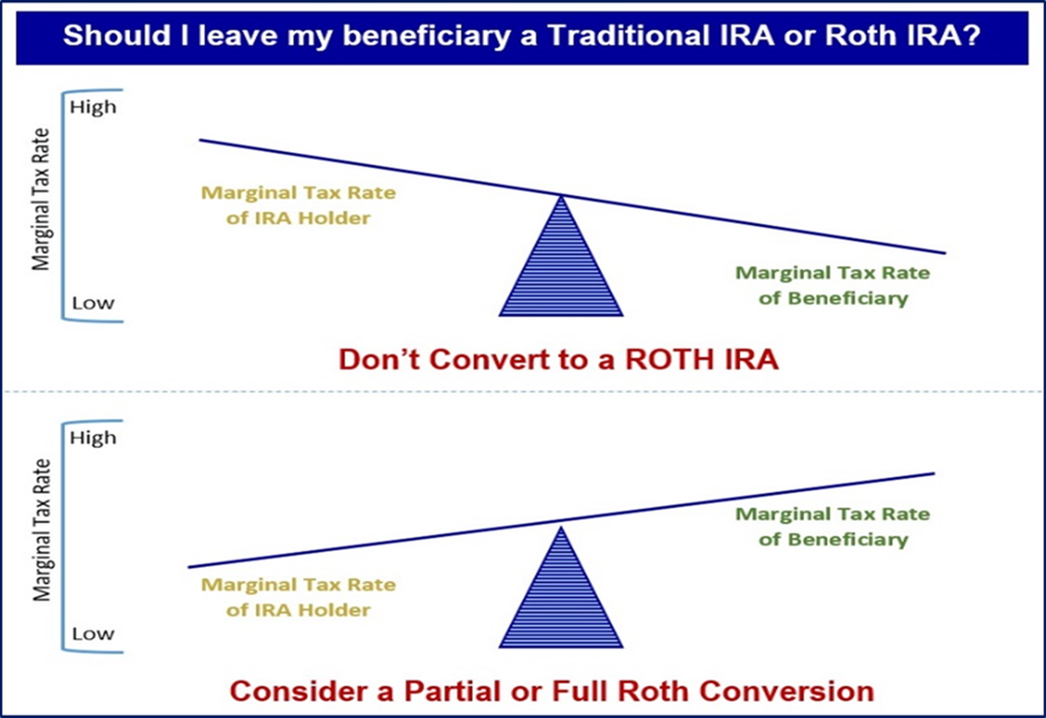
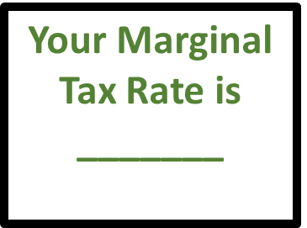
Proactive Tax Planning with the SECURE ACT
A critical area to review is overall Family Tax Bracket Management ©
Your Beneficiaries Marginal Tax Rate(s) is/are
_______
Notes:
Another critical area to review before year end because of the SECURE Act is what we refer to as overall Family Tax Bracket Management©.
Logically speaking, if you are in a higher tax bracket than your beneficiaries, then it might make sense to let them take distributions after your death in their tax bracket rather than you in yours.
However, if your beneficiaries are in a higher tax bracket, then it might make sense to take distributions in your tax bracket before death and then to convert these accounts to Roth IRAs and leave your beneficiaries an account that still must be taken out in 10 years but can grow tax free.
An annual step to consider is to review your marginal tax rate and your beneficiaries marginal tax rate(s) each year.

Slide 33
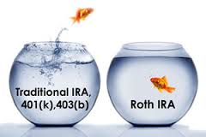
Proactive Tax Planning with the SECURE ACT
Explore Roth IRA Conversion Benefits
Lowers overall taxable income long-term
Tax-free compounding
No RMDs (at age 72)
Tax-free withdrawals for beneficiaries
*Withdrawals from Roth IRA may be tax free, as long as they are considered qualified. Limitations and restrictions may apply. Withdrawals prior to age 59 ½ or prior to the account being opened for five years, whichever is later, may result in a 10% IRS penalty tax. Future tax laws can change at any time and may impact the benefits of Roth IRAs. Their tax treatment may change.
Notes:
Some benefits from Roth IRA Conversions include:
They could lower your overall taxable income long-term.
ROTH IRAs enjoy tax-free compounding.
ROTH IRAs have no RMDs (at age 72).
ROTH IRAS allow tax-free withdrawals for beneficiaries.
Traditional IRA account owners have considerations to make before performing a Roth IRA conversion. These primarily include income tax consequences on the converted amount in the year of conversion, withdrawal limitations from a Roth IRA, and income limitations for future contributions to a Roth IRA. In addition, if you are required to take a required minimum distribution (RMD) in the year you convert, you must do so before converting to a Roth IRA.

Slide 34

Consider Qualified Tuition Plans
Notes:
Qualified tuition plans, also named 529 plans, are a great way to tax efficiently plan the financial burden of paying tuition for children or grandchildren.
Originally, earnings in a 529 plan originally could be withdrawn tax-free only when used for qualified higher education at colleges, universities, vocational schools or other post-secondary schools. However, the rules changed that so now 529 plans can also be used to pay for tuition at an elementary or secondary public, private or religious school, up to $10,000 per year.
Unlike IRAs, there are no annual contribution limits for 529 plans. Instead, there are maximum aggregate limits, which vary by plan. Under federal law, 529 plan balances cannot exceed the expected cost of the beneficiary's qualified higher education expenses. 529 Plan limits vary by state, ranging from $235,000 to $529,000. Some states even offer a state tax credit or deduction up to a certain amount.
Contributions to a 529 plan are considered completed gifts for federal tax purposes, so in 2021 up to $15,000 per donor, per beneficiary, qualifies for the annual gift tax exclusion. Excess contributions above $15,000 must be reported on IRS Form 709 and will count against the taxpayer’s lifetime estate and gift tax exemption amount (currently $11.7 million in 2021).
There is also an option to make a larger tax-free 529 plan contribution, if the contribution is treated as if it were spread evenly over a 5-year period. For example, a $75,000 lump sum contribution to a 529 plan can be applied as though it were $15,000 per year, as long as no other gifts are made to the same beneficiary over the next 5 years. Grandparents sometimes use this 5-year gift-tax averaging as an estate planning strategy.
If you want to explore using or setting up a 529 plan, it can be confusing so call us and we would be happy to assist you.

Slide 35

Annual Gifting Tax Planning for 2021
Gift Tax Exclusion for 2021 is $15,000 (per Donee)
A payment made directly to a medical institution to pay for the medical bills of someone else does not count as a gift for gift tax purposes.
A payment made directly to an educational institution to pay for the tuition of a student does not count as a gift to the student for gift tax purposes.
Notes:
Let’s talk about annual gifting now.
You may gift up to $15,000 tax-free to each donee in 2021. These “annual exclusion gifts” do not reduce your lifetime gift tax exemption. This annual exclusion gift is doubled to $30,000 per donee for gifts made by married couples.
You can also help someone with medical or education expenses without incurring gift taxes.
There are opportunities to give unlimited tax-free gifts when you pay the provider of the services directly. The medical expenses must meet the definition of deductible medical expenses. Qualified education expenses are tuition, books, fees, and related expenses, but not room and board. You can find the detailed qualifications in IRS Publications 950 and the instructions for IRS Form 709 at www.irs.gov.

Slide 36
Wealth Transfer Planning for 2021
Exemption amounts for gift, estate, and generation-skipping taxes for 2021
are $11.7 million ($23.4 million for married couples).
 | 2021-2025 | 2026
Estate & Gift Tax Exemption Amount | $11.7 million is current exemption (indexed or inflation each year) | SUNSET to approximately $6 million ($5.6 million adjusted for inflation).
Generation-skipping Transfer Tax Exemption Amount | $11.7 million is current exemption (indexed or inflation each year) | SUNSET to approximately $6 million ($5.6 million adjusted for inflation).
Estate, Gift, and GST Tax Rate | 40% | 40%
Notes:
A wealth transfer planning item to think about is the exemption amounts for gift, estate, and generation-skipping taxes for 2021 is $11.7 million ($23.4 million for married couples). Any amount over that is subject to 40% Federal taxes. This high amount provides high net worth individuals a significant planning window to make gifts and set up irrevocable trusts.
As a reminder, as of now, in 2026, the estate tax exclusion will return to approximately $5.6 million (which is $6 million adjusted for inflation). On November 26, 2019, the Treasury Department and the Internal Revenue Service issued final regulations under IR-2019-189 confirming that individuals who take advantage of the increased gift tax exclusion or portability amounts in effect from 2018 to 2025 will not be adversely impacted when TCJA sunsets on January 1, 2026.
If you have a large estate, please call us to discuss this.

Slide 37


Current Framework of the
The Build Back Better Act
As of 11/03/2021
Notes:
Now let’s review the most recent key tax law proposals from the November 3 Build Back Better Act framework released by the White House.

Slide 38
2021 Tax Reform Proposal – Individuals
3.8% Net Investment Income Tax (NIIT) expansion
  Expands the NIIT to cover income derived in the ordinary course of a trade or business for high income taxpayers
  Does not apply to income on which FICA is already imposed
  Applies after 12/31/21
Notes:
Another proposal is to expand the 3.8 percent net investment income tax to apply to all net income derived in the ordinary course of trade or business for taxpayers with taxable income greater than $500,000 for joint filers and $400,000 for single filers.

Slide 39
2021 Tax Reform Proposal – Individuals
New High Income Taxpayer Surcharge
  A surcharge on high income taxpayers (over $10 million dollars of AGI) that increases at $25 million dollars of AGI
Notes:
The Bill also calls for a new high-income taxpayer surcharge on the top .02% of taxpayers, which is thought to mean individuals with modified adjusted gross income over $10,000,000 increasing on incomes over $25,000,000.
Note : This does NOT INCLUDE STATE TAXES!

Slide 40

Proactive Tax Planning
Notes:
Although it is not yet certain which tax changes, if any, will be passed into law, we will try to update you as new laws are passed.

Slide 41

2021 Year-end Tax Planning
Summary Checklist
Bracket Management
Itemized Deduction Timing
Gain &Loss Harvesting
Retirement Planning
Education Planning
Charitable Planning
Estate Tax Planning
Planning for Major Financial or Life Events Next Year/Future
Planning for Any Other Personal Situational Concerns
Notes:
In summary, Here are some items that you should review prior to year end for tax time:
What is your anticipated tax bracket?
Will you take Standard or Itemized Deduction for timing purposes?
Capital Gain & Loss Harvesting
Retirement Planning Contributions
Education Planning Opportunities
Charitable Gifting Planning, and
Estate Tax Planning Opportunities
Its also helpful to think about tax planning for any major financial or life events next year or in the future as well as tax planning for any other personal situational concerns.

Slide 42
What Can You Expect From Us?
Regular review of changes that may affect you.
Regular communication.
More frequent discussions.
Review of economic, tax, estate and investment issues for our clients.
Notes:
So – what can you expect from us?
One of our main focuses is to review changes for our clients on an ongoing basis.
You can expect regular communication, more frequent discussions, and you can expect that we are continuously reviewing economic, tax, estate and investment issues for our clients.
In fact, we will be offering other workshops that highlight tax changes and planning ideas.

Slide 43

Client Benefit
As a client of our firm, you can
add names to our mailing lists !
Notes:
We appreciate our clients!
As a client benefit, you can add names to our mailing list for information.
We hope you will take advantage of this and add two names or more to our list.

Slide 44

Help Us
Help Others!
Please share!
Notes:
One of our goals is to continue to help others!
Some of our best clients were referred to us by existing clients. So, please feel comfortable letting us know the names of anyone who you feel could benefit from our services or information.
Again, one of our primary goals is to keep clients informed and we appreciate you attending our session.
Please call us if you have any questions.

Slide 45
The views stated in this workshop are not necessarily the opinion of broker/dealer and should not be construed, directly or indirectly, as an offer to buy or sell any securities mentioned herein. Information is based on sources believed to be reliable; however, their accuracy or completeness cannot be guaranteed. Please note that statements made may be subject to change depending on any revisions to the tax code or any additional changes in government policy. Please note that individual situations can vary. Unless certain criteria are met, Roth IRA owners must be 59½ or older and have held the IRA for five years before tax-free withdrawals are permitted. Additionally, each converted amount is subject to its own five-year holding period. Investors should consult a tax advisor before deciding to do a conversion.
Rules and laws governing 529 plans are varied and subject to change. As with other investments, there are generally fees and expenses associated with participation in a 529 plan. There is also a risk that these plans may lose money or not perform well enough to cover college costs as anticipated. Most states offer their own 529 programs, which may provide advantages and benefits exclusively for their residents. Investors should consider, before investing, whether the investor's or the designated beneficiary's home state offers any tax or other benefits that are only available for investment in such state's 529 college savings plan. Such benefits include financial aid, scholarship funds, and protection from creditors. The tax implications can vary significantly from state to state. Tax laws and provisions may change at any time. Please consult a qualified tax professional to discuss tax matters. Contents provided by the Academy of Preferred Financial Advisors, Inc.
Investing involves risk including the potential loss of principal. No investment strategy can guarantee a profit or protect against loss in periods of declining values. Past performance is no guarantee of future results. Diversification and strategic asset allocation do not ensure a profit or protect against a loss. The process of rebalancing may carry tax consequences. This information is not intended to be a substitute for specific individualized tax, legal, or investment planning advice. You should discuss any tax, legal or investment planning matters with the appropriate professional.
All indexes are unmanaged and cannot be invested into directly. Unmanaged index returns do not reflect fees, expenses, or sales charges. Index performance is not indicative of the performance of any investment. Economic forecasts set forth may not develop as predicted and there can be no guarantee that strategies promoted will be successful. International investing involves special risks such as currency fluctuation and political instability and may not be suitable for all investors.
The S&P 500 is an unmanaged index of 500 widely held stocks that is generally considered representative of the U.S. Stock market. The Dow Jones Industrial Average (DJIA) commonly known as “The Dow”, is an index representing 30 stocks of companies maintained and reviewed by the editors of the Wall Street Journal. Index performance does not include transaction costs or other fees, which will affect actual investment performance. Individual investor’s results will vary.
Contents provided by:
The Academy of Preferred Financial Advisors, Inc. © 2021. All rights reserved.
Reviewed by Keebler & Associates.
Insert Approved BD Disclaimer here
Insert registered branch address, contact information
The S&P 500 is an unmanaged index of 500 widely held stocks that is generally considered representative of the U.S. Stock market. The Dow Jones Industrial Average (DJIA) commonly known as “The Dow”, is an index representing 30 stocks of companies maintained and reviewed by the editors of the Wall Street Journal. Index performance does not include transaction costs or other fees, which will affect actual investment performance. Individual investor’s results will vary.
Show less

Slide 46

Thank You!
We appreciate the opportunity to assist
you with your financial needs!
Your health and
well-being is always our highest priority!
Notes:
We are thankful for the opportunity to assist you with your financial needs.
Remember, at our firm clients come first and your health and well-being is our highest priority.

