Slide 1
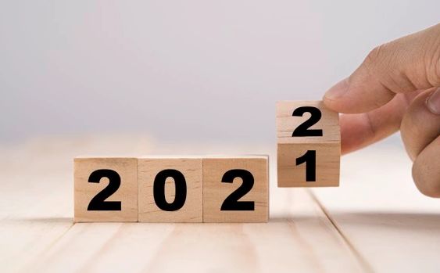
Economic Review
and 2022 Outlook
Presented By:
Your Name
Company
Notes:
Hello clients and friends. This is ___________________ from __________________ and it’s my pleasure to welcome you to our economic review and 2022 outlook.

Slide 2

Agenda
Equity Market Update
2022 Outlook
Notes:
Today we will be providing a brief review of the fourth quarter of 2021 and then we will discuss our economic outlook for 2022.

Slide 3

Five Key Areas of Financial Planning
Preservation Planning
Retirement Planning
Tax Planning
Estate Planning
Investment Planning
Notes:
Before we begin, it is always important to review that there are five key areas of financial planning.
They are:
Preservation Planning,
Retirement Planning,
Tax Planning,
Estate Planning, and
Investment Planning
As a comprehensive financial services firm, we try to always consider the impact of any recommendation we make on not just one, but all these areas for our clients.
Today's presentation will be primarily focused on investment planning and equity markets.

Slide 4
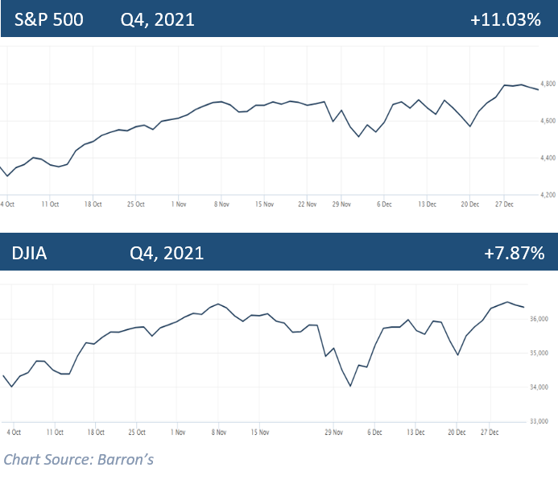
Equity Market Review
Source: Barron’s
Notes:
The U.S. stock market ended 2021 just shy of all time highs.
The S&P 500 closed the quarter at 4,766, ending the quarter up 11% and the year up 27%. This marks the 3rd consecutive year the S&P ended the year with double-digit gains.
The Dow Jones Industrial Average closed at 36,338, ending the quarter up almost 8% and the year up 19%.

Slide 5

Equity Market Review
Record closes in 2021
S&P 500 – 70 record closes
DOW – 45 record closes
Notes:
Since the quick but sharp fall of equity markets in early 2020, post-pandemic equity markets have been primarily robust. Despite many potentially detrimental events, the equity markets showed resilience and prevailed, rewarding investors with notable gains.
2021 saw many new records broken. The S&P 500 had 70 record closes and the Dow also saw some significant gains, with 45 record closes.
Stock valuations have soared and many analysts are crediting ultra-low interest rates and a healthy economic recovery for this surge.

Slide 6
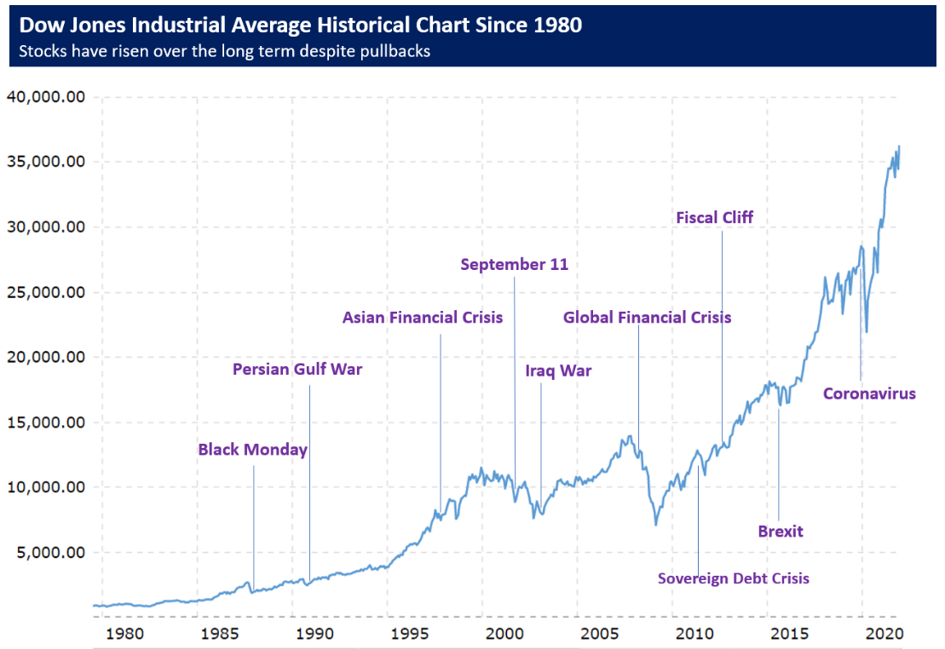
2021 Review
Notes:
As you look at this 40 plus year chart of the Dow, you can easily see that stocks have increased over the long-term, notwithstanding market pullbacks and dips.
The sharp decline of 2020 looks a lot less threatening as you look at long term results.
That’s why having a solid investment strategy is an integral part of a well-devised, long term financial plan.
Staying disciplined, not getting emotional and following your strategy during times of volatility can be crucial and is important.

Slide 7
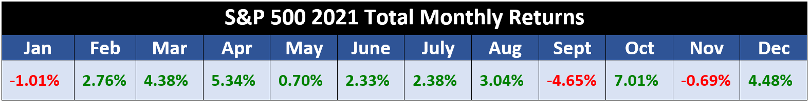
2022 Outlook
Notes:
While investors enjoyed an overall strong return in 2021, as the monthly S&P 500 returns chart shows, monthly returns were very inconsistent.
Equity markets do not move in a straight line and the past few years have been an excellent reminder for investors to be prepared for anything that could affect the economic environment and their own personal situation.
Volatility is a part of the investment experience and seasoned investors understand that.

Slide 8
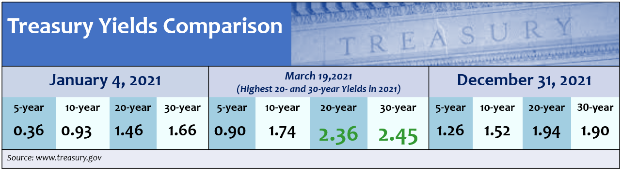
Equity Market Review
Treasury Yields
Notes:
Bond yields for 2021 were low.
In mid-March, we saw the highest 20- and 30-year yields on U.S. Treasuries for 2021. Subsequently, they dropped back down, ending the year at 1.52%, 1.94%, and 1.9% for 10-, 20-, and 30-year yields, respectively.
2021 was not a great year for bond holders. While today’s interest rates are still historically low, the Fed is expecting to raise interest rates several times in the next two years. When interest rates rise, the demand for bonds typically falls, reducing their prices and raising their yields. Thus, 2022 will be an interesting year for bonds.
Research is indicating that Treasury yields could go up, ending 2022 with a 1.5% to 2.0% yield on 10-year U.S. Treasuries.
(Source: russellinvestments.com 12/1/2021)

Slide 9
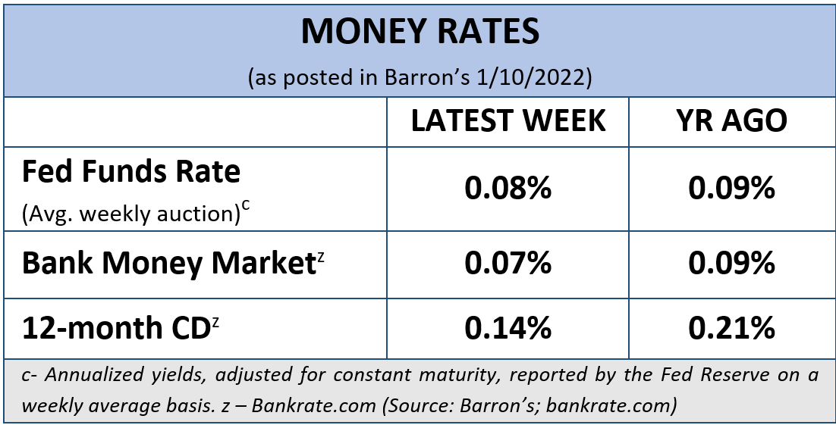
Equity Market Review
The cost of safety
Notes:
As I mentioned earlier, interest rates continued to be ultra low throughout 2021.
These rates clearly are undesirable for income seeking investors.
Bank money markets and the average 12-month CD rate were both less than 2/10 of 1% which is very unattractive to savers and investors.

Slide 10
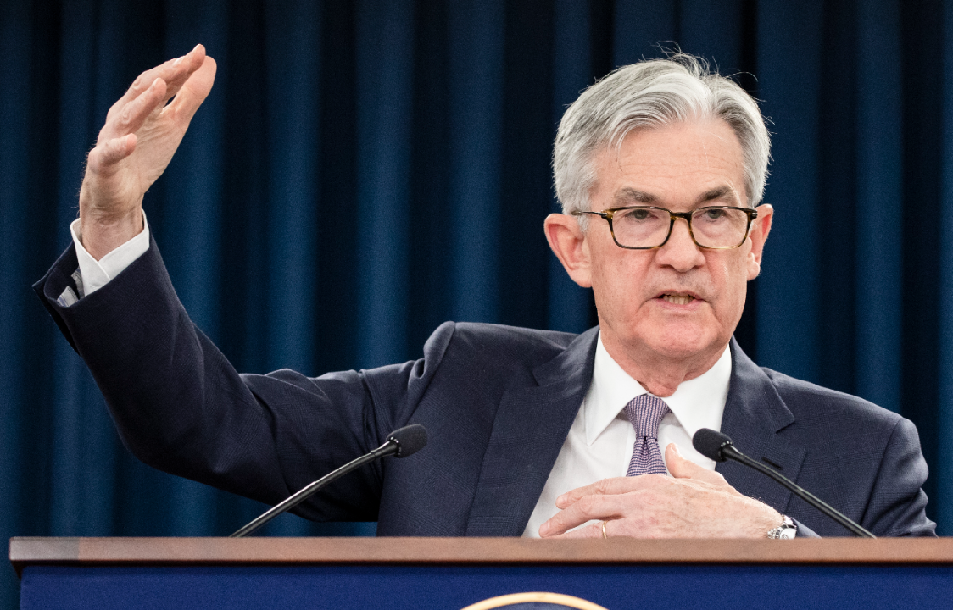
Equity Market Review
The Federal Reserve announced it will begin increasing the Federal Funds Rate range in 2022.
Fed’s Projected Rate Increases in next 24 months
2022 – Three rate increase
2023 – Three rate increase
Notes:
During the Federal Open Market Committee’s meeting in December, it was announced that federal funds rates will increase in 2022, and the Fed expects three rate hikes this year, following by three more in 2023. They project that by the end of 2023 the federal funds rate will rise to 1.6% and in 2024, end the year at approximately 2.1%.
(Source: www.marketwatch.com, 12/15/2021)

Slide 11
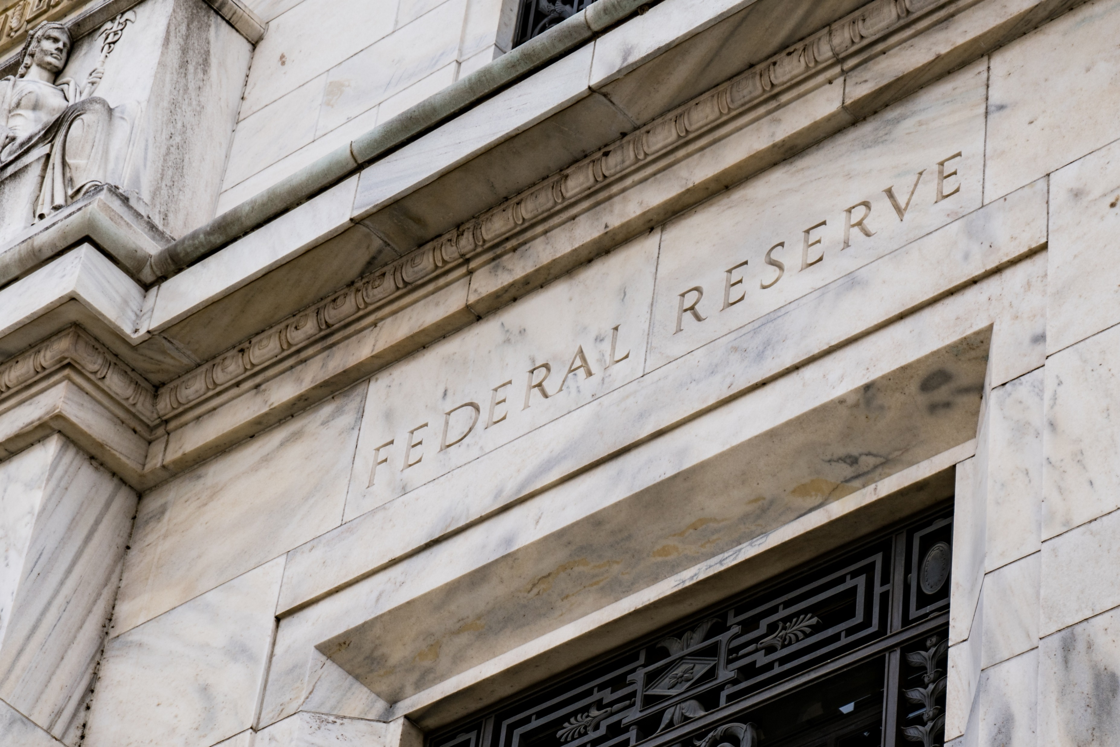
Equity Market Review
Tapering Timeline
Fed to double pace of reduction mid-January
March goal of complete phase-out of bond-buying stimulus program
Notes:
The Fed has been making lots of moves.
They also began the tapering process this past fall, with the ultimate goal of ending the pandemic-driven stimulus by mid-March of this year, several months earlier than their original goal of November 2022. In December, due to the elevated labor market and inflation pressures, the Fed decided to double the pace of reduction of asset purchase beginning in mid-January.

Slide 12
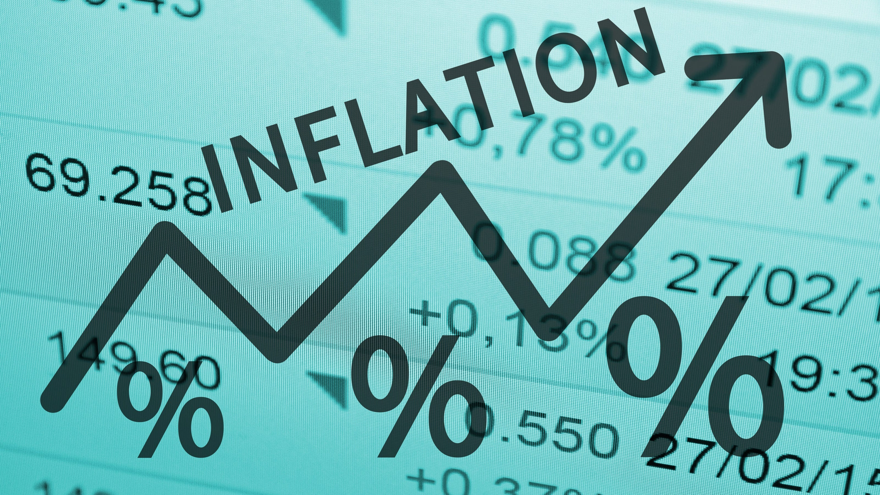
Equity Market Review
Inflation surges 7% in December -
highest rate in 40 years
Notes:
Inflation rose at the fastest pace in nearly four decades in December of 2021. The number reported was 7% versus the prior year.
Seema Shah, chief strategist at Principal Global Investors, stated, “Inflation at 7% is no joke. It’s the highest annual number since 1982 and was driven not by energy prices, but by just about everything else.“
While analysts feel December's number could mark the peak for annual inflation readings amid signs that supply strains are easing, other experts suggested the rampant spread of the omicron variant could bring about new difficulties for the global supply chain. Many analysts feel the tapering process of the Fed could slow inflation down.
Inflation is clearly on our watchlist for 2022.

Slide 13
2022 Outlook
For 2022, there are many uncertainties.
COVID
Rising interest rates
Continued inflation
Tapering
Economic growth
Public Policy/New Tax Laws
Notes:
So, what are analysts forecasting for 2022?
2022 could be a volatile year and our goal is to keep our clients apprised of any potential activity that may affect their financial situation. In addition to continued COVID concerns, 2022 is projected to bring rising interest rates, continued but hopefully lower inflation, stimulus tapering and a slowdown of the global economy.
Also, let’s not forget any public policy and new tax laws will bring changes to monetary policy.
What does this all mean for investors?
The returns we have enjoyed the last few years were well above average and the typical median of the past twenty years.
However, there are still many economists that feel with rates still low, we should be optimistic and could be still looking at favorable returns, just in more moderation.

Slide 14

2022 Outlook
COVID is still a central figure for investors in 2022.
Notes:
While the most recent variant of the coronavirus, Omicron, is being seen as much less of a threat as its predecessors, and vaccines are now widely distributed, it is still a central figure in the direction of the economy and its recovery.
We were reminded in November when news of Omicron was released, that the markets are still very vulnerable to the trajectory of the coronavirus and the introduction of new variants, as it directly affects supply chain disruptions, labor shortages, and further downward pressure.

Slide 15
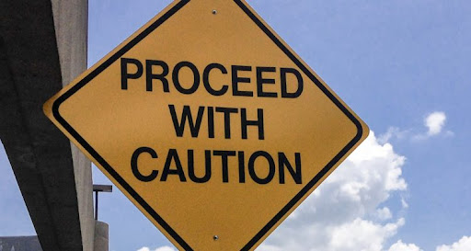
2022 Outlook
Notes:
Even though the equity markets have seen impressive returns, complacency should not settle into investor’s attitudes toward their investment strategies.
We are still standing by our mantra of, “proceed with caution”.

Slide 16
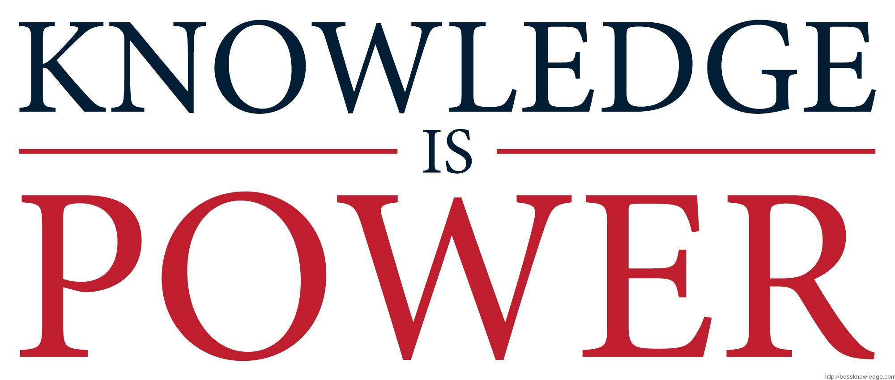
2022 Outlook
Notes:
We also still maintain that an educated client is our best client!

Slide 17
2022 Outlook
Review all your income-producing investments.
Lock in your mortgage rates or consider refinancing.
Maintain liquidity for all near-term needs.
Re-evaluate and confirm your cash flow needs.
Conduct a full review of your financial plan with us.
Notes:
So here are some things we are looking at:
With interest rates on the rise, we feel it is beneficial to :
Review all your income-producing investments.
Lock in your mortgage rates or consider refinancing to get a better rate if you haven’t already done so.
Maintain liquidity for all near-term needs.
Re-evaluate and confirm your cash flow needs.
Some time this year, conduct a full review of your financial plan with us. During this review, we can look at risk management, how well diversified your plan is, and revisit your time horizons to make sure all these items are still compatible with your goals.

Slide 18
2022 Outlook
Downturns are normal.
Create and commit to a sound, long-term plan.
Avoid emotional investing.
Don’t try to time the market.
Revisit your personal investment plan.
Notes:
Remember, if volatility returns this year, it is part of the investment experience. Market pullbacks and downturns are not uncommon.
Having a long-term strategy and staying away from emotional investing decisions can help you ride the pullback waves and stay on track toward your financial goals.
As a reminder, focus on your time in the market, not timing the market. For example, selling equities during a downturn can help you retain your gains, but if you are still on the sidelines during an upswing, it could prove disadvantageous to the overall performance of your portfolio.
If you have questions or concerns, now is a good time to revisit your financial plan with us, including your time horizon and risk tolerance.

Slide 19
Key Takeaways
Equity markets ended on a high note despite many potentially negative variables.
Inflation is still expected to be prominent in 2022.
Expect three rate hikes in 2022.
Tapering efforts of the Fed will double beginning mid-January.
Notes:
As a quick recap:
Equity markets ended on a high note in 2021 despite many potentially negative variables.
Inflation is still expected to be prominent in 2022.
The Fed announced we should expect three rate hikes in 2022.
Tapering efforts of the Fed will double starting in mid-January.

Slide 20
Key Takeaways
Volatility could be on the horizon. Caution and vigilance are critical.
Focus on your own personal goals and objectives.
Call us with any concerns!
Notes:
Volatility could be on the horizon. Caution and vigilance are critical.
You should focus on your own personal goals and objectives.
And, as always, call us with any concerns!

Slide 21
What Can You Expect From Us?
Regular review of changes that may affect you.
Regular communication.
Review of economic, tax, estate and investment issues for our clients.
Notes:
So – what can you expect from us?
As your financial professional, we are here to help you pursue your goals. One of our main focuses is to review potential changes for our clients on an ongoing basis. Prior to making any financial decisions, we highly recommend you contact us so we can help determine the best strategy. There are often other factors to consider, including tax ramifications, increased risk, and time horizon fluctuations when changing anything in your financial plan.
You can also expect regular communication and the confidence that we are continuously reviewing economic, tax, estate, and investment issues for our clients.
In fact, we will be offering other workshops that focus on tax changes and planning ideas.

Slide 22

Client Benefit
As a client of our firm, you can add names to our viewing list for these workshops!
Notes:
We appreciate our clients!
As a client benefit, you can add names to our viewing list for the workshops we present.
We hope you will take advantage of this and add two names to our list.

Slide 23

Help Us
Help Others!
Please share!
Notes:
One of our goals in 2022 is to help more people just like you! Some of our best clients were referred to us by existing clients. Please feel comfortable sharing the names of anyone who you feel could benefit from this information.
We believe the best client in an educated client. Our goal is to keep you informed and we thank you for watching our update.
Best wishes for a great and healthy 2022.
Please call us if you have any questions.

Slide 24
Insert registered branch office address and phone number, as well as broker-dealer identification/disclosure
The views expressed are not necessarily the opinion of Insert Broker-dealer name. Information is based on sources believed to be reliable, however, their accuracy or completeness cannot be guaranteed.
Investing involves risk including the potential loss of principal. No investment strategy can guarantee a profit or protect against loss in periods of declining values. Past performance is no guarantee of future results. Diversification and strategic asset allocation do not ensure a profit or protect against a loss. The process of rebalancing may carry tax consequences.
This information is not intended to be a substitute for specific individualized tax, legal, or investment planning advice. You should discuss any tax, legal or investment planning matters with the appropriate professional.
All indexes are unmanaged and cannot be invested into directly. Unmanaged index returns do not reflect fees, expenses, or sales charges. Index performance is not indicative of the performance of any investment. Economic forecasts set forth may not develop as predicted and there can be no guarantee that strategies promoted will be successful. International investing involves special risks such as currency fluctuation and political instability and may not be suitable for all investors.
The S&P 500 is an unmanaged index of 500 widely held stocks that is generally considered representative of the U.S. Stock market. The Dow Jones Industrial Average (DJIA) commonly known as “The Dow”, is an index representing 30 stocks of companies maintained and reviewed by the editors of the Wall Street Journal. Index performance does not include transaction costs or other fees, which will affect actual investment performance. Individual investor’s results will vary.
Contents provided by: The Academy of Preferred Financial Advisors, Inc. © 2022. All rights reserved.

Slide 25

Thank You!
We appreciate the opportunity to assist
you with your financial needs!
Your health and well-being is our highest priority!
Notes:
Thank you for listening to this workshop.
We appreciate the opportunity to assist you with your financial needs.
Please let us know your preference on meeting format – whether you like them in person or virtually.
Remember, at our firm clients come first and your health and well-being is our highest priority.

