Slide 1

Quarter 2 2022
Economic Review
Presented By: You Name
Insert Company Name
Notes:
Hello clients and friends. This is ___________________ from __________________ and it’s my pleasure to welcome you to our second quarter economic review.

Slide 2


An Educated Client Is Our Best Client!
Notes:
At our firm, we partner with clients and believe an educated client is our best client. While we will always try our best to help you, when it comes to your finances, we believe that knowledge is power. One of our missions is to share with you any knowledge that can better help you make an informed decision.

Slide 3
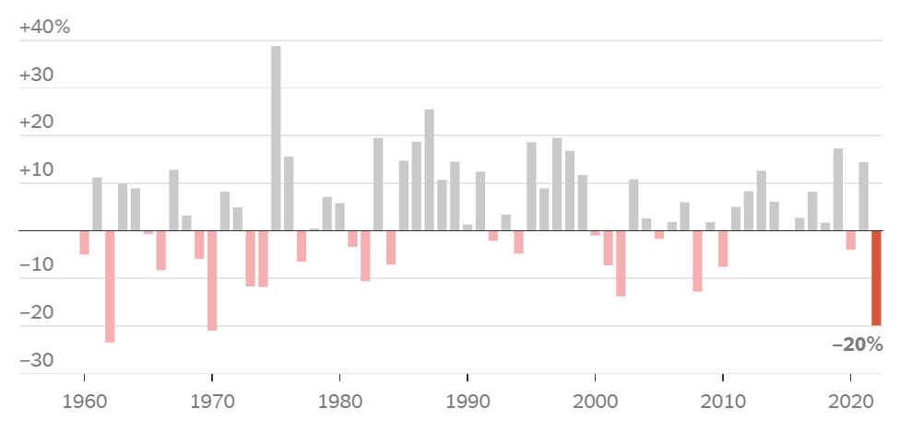
Equity Markets
(Chart depicts: 1960 – June 29, 2022; Source: nytimes.com 6/30/22)
Notes:
Let’s address the elephant in the room up front – or should we say bear. Investors have seen multiple record highs over the last few years in the stock market, and we knew at some point, a market correction was inevitable.
The Dow Jones Industrial Average just registered its worst half of a year since 1962 and the S&P 500 had its worst first-half drop since 1970.
This type of market movement is unpleasant to watch and can make even the most patient of investors uncomfortable.
Source: https://www.marketwatch.com/story/whats-next-for-the-stock-market-after-the-worst-1st-half-since-1970-heres-the-history-11656503671
Chart Source: https://www.nytimes.com/2022/06/30/business/stock-market-worst-start-50-years.html

Slide 4
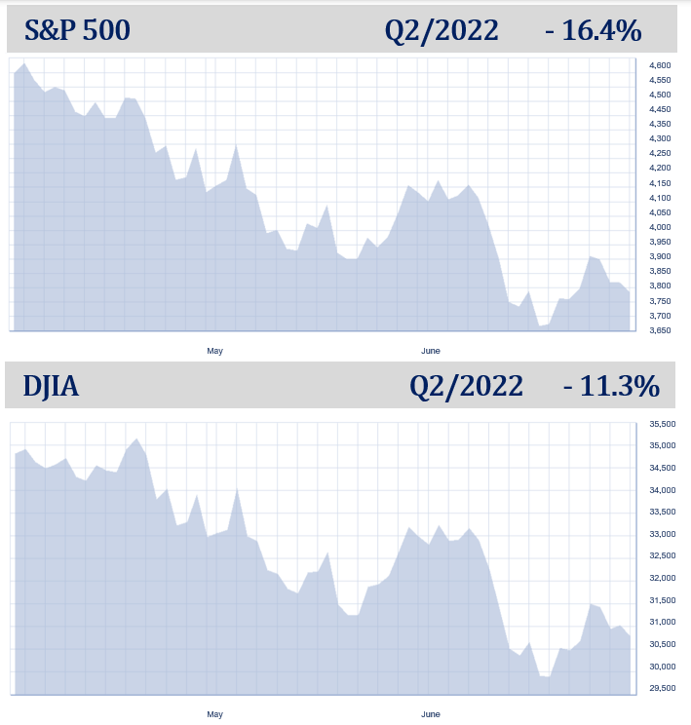
Equity Markets
Chart Source: Bigcharts.com
Notes:
The brunt of the downturn was this quarter when the Dow ended down 11.3% and the S&P 500 closed the quarter down 16.4%.
This is a far cry from the bull market where investors were treated to equity markets that more than doubled between the March 2020 lows until January of this year.
Chart Source: Bigcharts.com

Slide 5
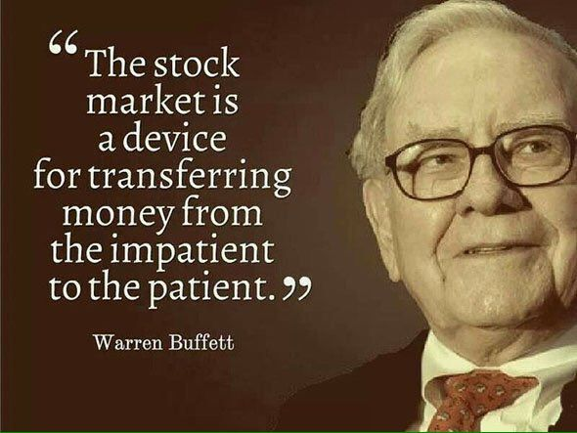
Notes:
This is a time to remember one of Warren Buffett famous quotes, “The stock market is a device for transferring money from the impatient to the patient.”
It’s key for investors to remember that equities are long term investments and any panic-driven, impromptu moves that deviate from your plan could be costly.

Slide 6
Equity Market Review –
Quarter 2 a Bumpy Ride!
S&P 500 officially in a bear market.
The Fed raised interest rates 0.75% in June – the biggest rate hike since 1994. Expectations of more big increases this year are high.
Inflation still an issue for consumers.
Continued global unrest.
COVID still in play.
Notes:
So, let’s review this quarter’s bumpy ride.
The second quarter continued this year’s theme of heavy volatility and the S&P 500 is officially in a bear market.
The Federal Reserve raised interest rates by 0.75%. This is the biggest rate hike since 1994. Their narrative said we should expect additional rate hikes this year.
Inflation is still an issue for consumers and we have yet to see if the Fed’s defense of raising rates will work to cause a retreat in the inflation rate.
The world continues to see unrest, particularly with the war in Ukraine.
Also, let’s not forget about COVID. China, the second largest economy in the world and a manufacturer of mass products still holds a “Zero COVID” policy and could have lockdowns that affect the supply chain at any moment.
In summary, this has been an unrestful quarter.

Slide 7
Equity Markets
Chart Source: Bigcharts.com
Notes:
This is a good time for investors to keep in mind that even though we have experienced a downturn, the S&P 500 is still well above the 2020 low caused by the pandemic.
Once again, equities are mostly for long term investments.
Chart Source: Bigcharts.com

Slide 8
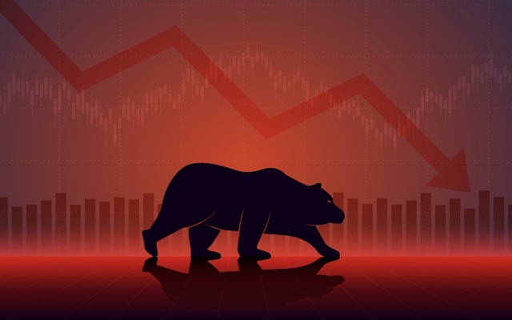
Bear Markets
Bear markets a normal part of the investment experience.
Bear markets last for significantly less time than bull markets.
The long-term average frequency between bear markets is 3.6 years.
Does a bear market mean a recession is coming? Not necessarily!
Notes:
As we mentioned, the S&P 500 is officially in a bear market. Bear markets are defined as when the market drops 20% below a previous high and they are a normal part of the investment experience.
The good news is historically, they have lasted for significantly less time than bull markets. Bears last an average of 9.6 months while bulls last an average of 2.7 years.
The long-term average frequency between bear markets is 3.6 years. This means an investor could see about 14 bear markets in a 50-year investment window. Since 1930, the market has been bearish for a total time period equal to 20.6 years. This means that stocks have been on the rise the other 71.4 years!
Many reports are saying that recessions usually follow bear markets. However, facts share that of the 26 recorded bear markets, a little more than half came with a recession.
(Source: cnbc.com; 6/13/22)

Slide 9

Are we in a recession?
Not yet…
Labor statistics lowest since pandemic at 3.6% in May.
Consumer spending still strong despite inflation.
Equity markets still well above pandemic-driven declines.
Notes:
Recession can be a scary word, so let’s quickly address recessions.
The actual definition of a recession is defined by the National Bureau of Economic Research’s Business Cycle Dating Committee. They explain that “a recession involves a significant decline in economic activity that is spread across the economy and lasts more than a few months.”
While we now have two consecutive quarters of declining Gross Domestic Product (or GDC), the U.S. Department of Labor statistics show unemployment at 3.6% in May, the lowest since the pandemic, and consumers spending is still strong despite inflation. Remember, equity markets are still well above pandemic-drive declines.
While possible, numerous experts believe we will not see a recession in the near future. However, there is cause for concern and we are keeping a very close eye on the economic environment and indicators of a recession.
https://www.forbes.com/sites/billconerly/2022/07/05/already-in-recession-close-but-not-quite-in-july-2022/?sh=1357cdd3c1bf

Slide 10
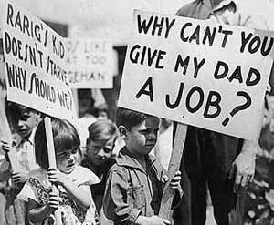
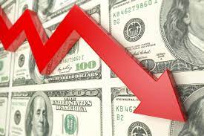
Remember –
A Recession is not the Great Depression!
Notes:
Please also understand that even if we do go into a recession, this does not mean that investors will get wiped out!
Please remember, a recession does not equal the Great Depression!

Slide 11




Inflation
Notes:
Although there is no established formal inflation target, the Federal Reserve generally believes that an approximately 2% rate of inflation is acceptable. The annual inflation rate for the U.S. was 8.6% for the 12 months that ended this May. Where are we seeing it the most?
Gas prices, grocery stores and housing prices all saw heavy increases in the last year.
(Source: cnbc.om; 6/10/2022)

Slide 12
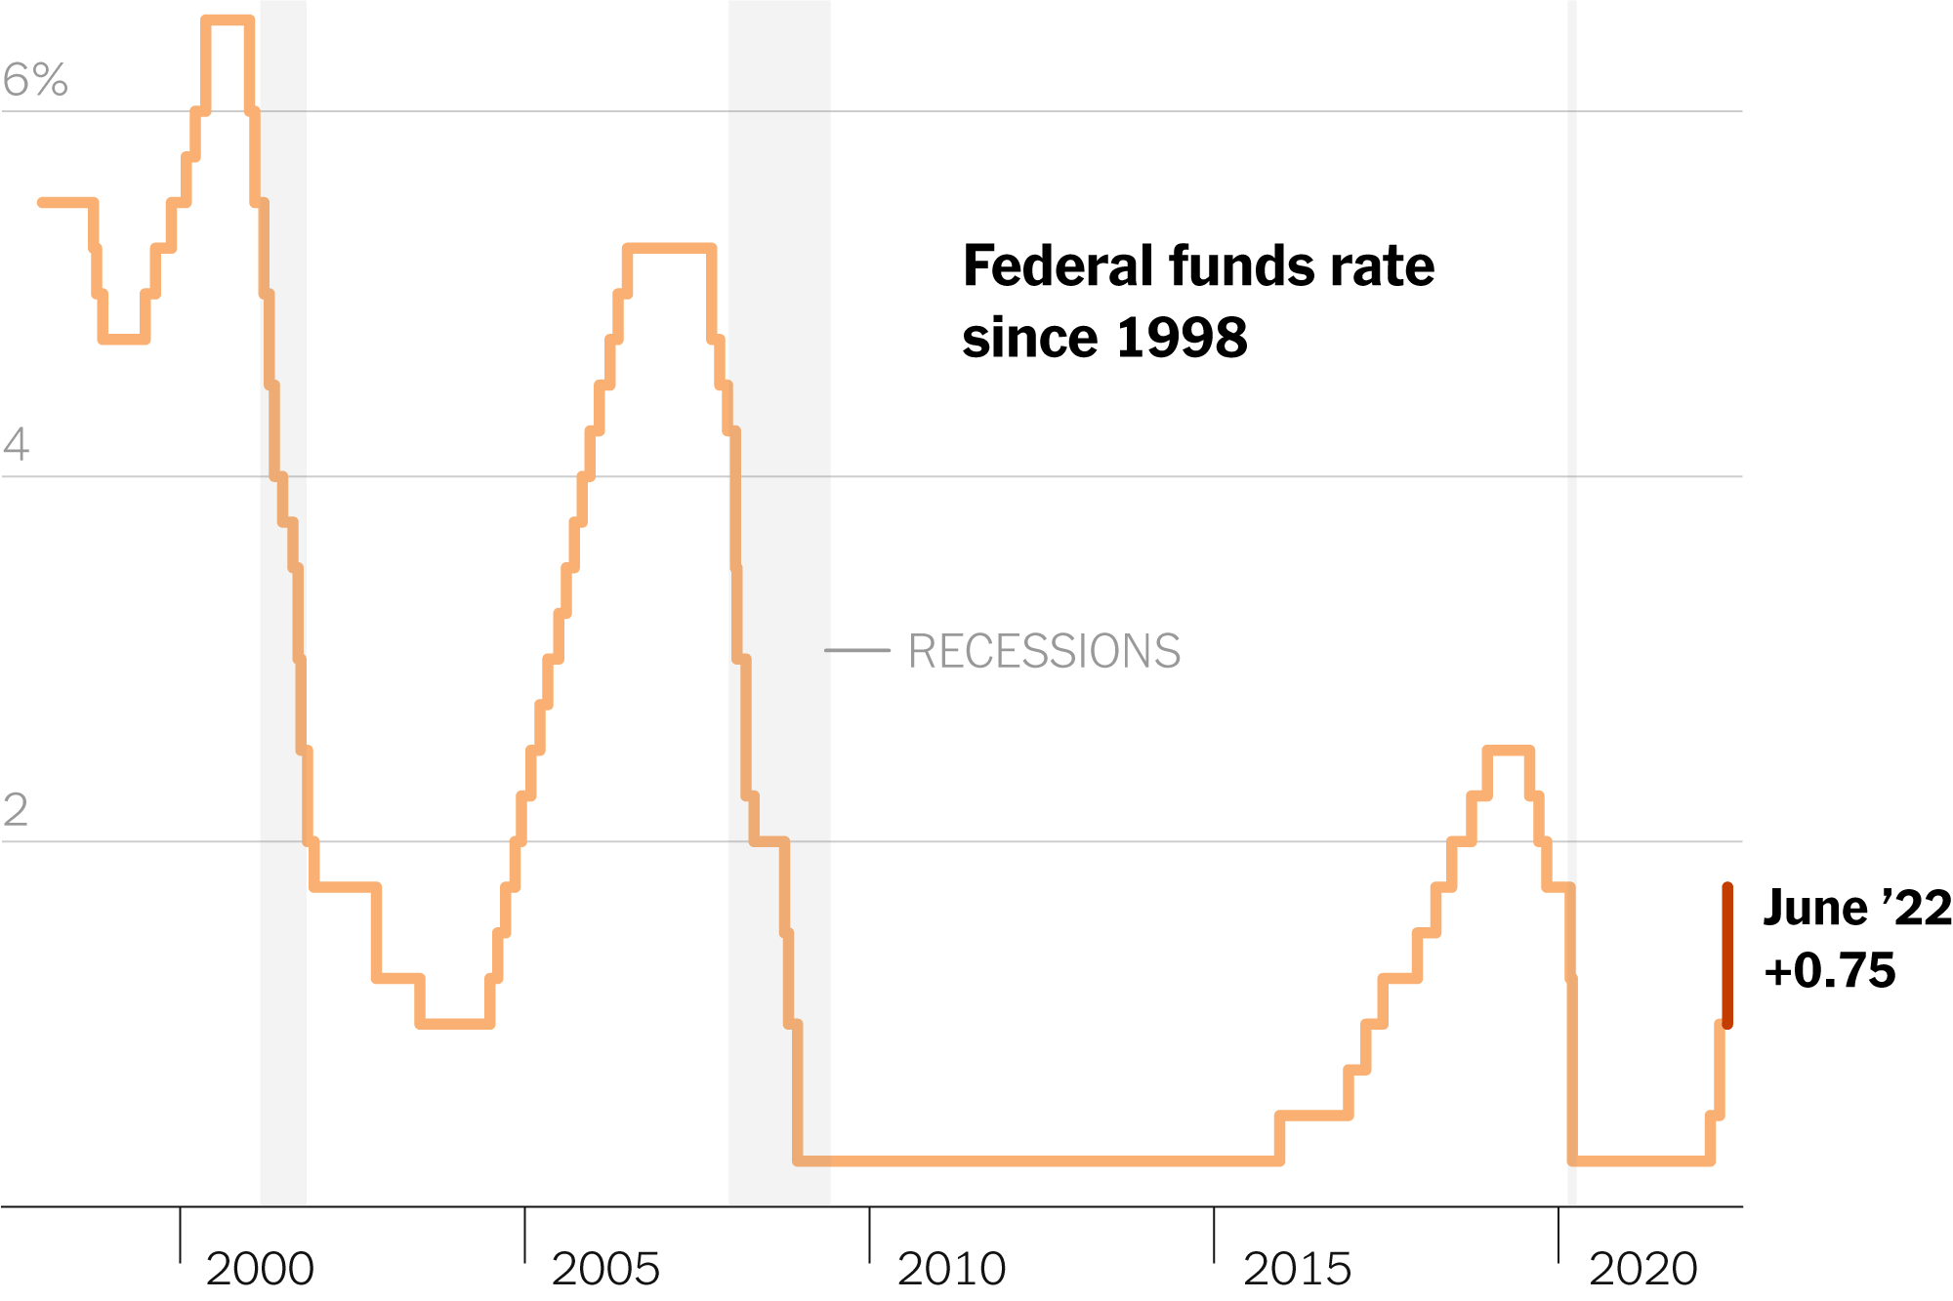
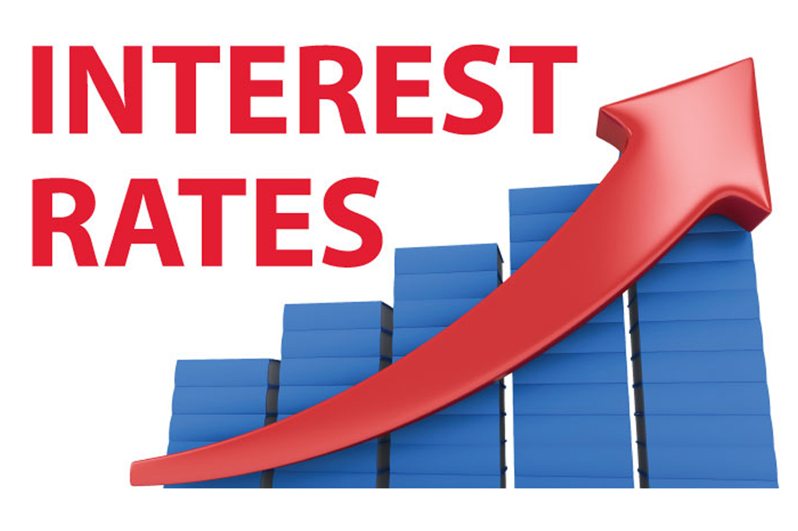
Interest Rates
1.5 – 1.75%
(Chart Source: nytimes.com; Federal Reserve)
Notes:
Standing by its commitment to fight inflation, on June 15, the Federal Reserve again raised interest rates, this time by 75 basis points, or 0.75%, the biggest single rate hike since 1994. Add that to the 0.75% increase already implemented this year, this brings the Federal Funds Rate to a target range of 1.50 – 1.75%. Wall Street responded with selloffs, taking the S&P 500 officially into a bear market. In late June, the DJIA dropped below 30,000 for the first time since January 2021.
Chart Source: nytimes.com; Federal Reserve (https://www.nytimes.com/2022/06/15/business/economy/fed-interest-rates.html)

Slide 13
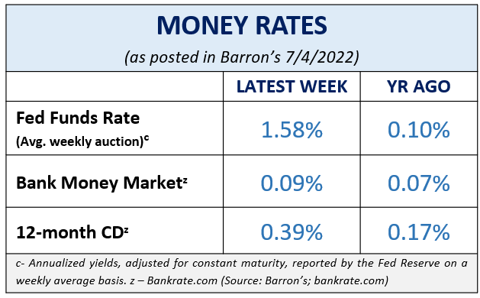
Cost of Safety
Notes:
Safety comes with a cost.
Have you seen what interest rates banks are currently offering to savers?
According to Barron’s, the average bank money market rates on July 4 were 0.09% and the average 12-month CD rate was 0.39%.
For many investors, today’s ultra-low rates might not help them reach their goals.
Therefore, equities should still be considered for a part of a diversified portfolio.

Slide 14
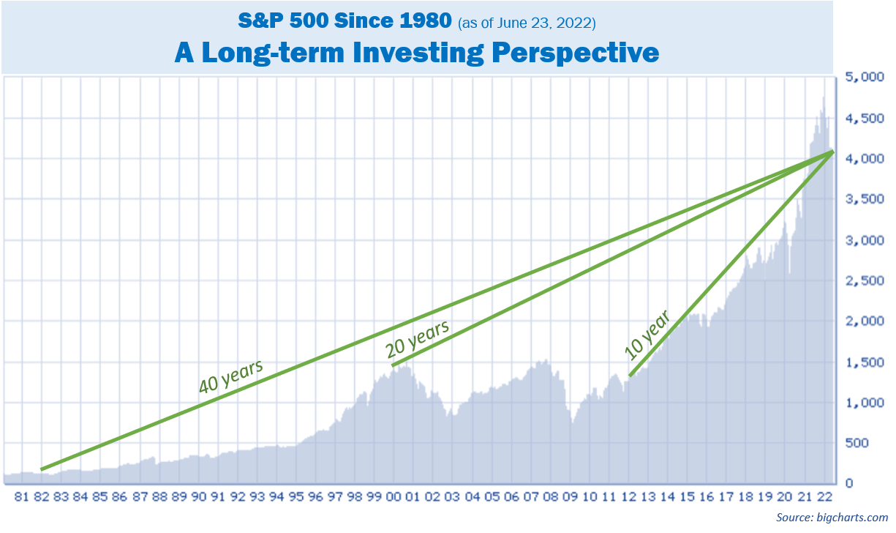
Keep Things In Perspective
Notes:
We feel that volatility isn’t likely to go away in the coming months, so investors need to be prepared. Remember, if you have a well-diversified, long-term financial plan, abandoning ship is probably not in your best interest.
As you can see from this chart, even with the downturn, long term investors who have stayed in the market over 10, 20 or 40 years were rewarded with considerable gains.

Slide 15
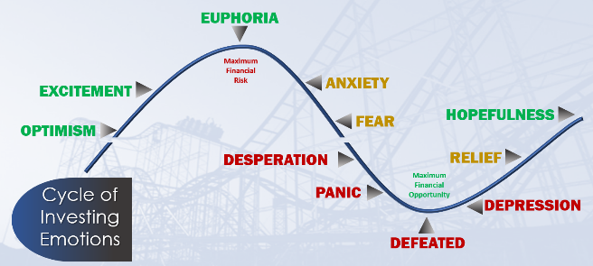
Avoid Emotional Investing
Notes:
Being knowledgeable of the cycle of emotional investing is wise. It is a theory every investor should understand.
This current market environment is most certainly testing the discipline of investors. Some investors panic and jump ship during times of volatility while others choose to ride it out and wait for calmer waters. Which mindset do you have?
Having a comprehensive financial plan takes into consideration how you will react to each cycle before it happens. This helps you make the best, non-emotional decision, non-hasty decisions for your hard-earned money.

Slide 16
Outlook
Watch out for more interest rate hikes.
Borrowing has become more costly.
There are many variables that could affect the speed and direction of the economy.
Notes:
Now let’s review our outlook for the upcoming months.
In the approaching months, we expect to see more interest rate hikes from the Feds.
The cost of loans are higher, most notably, mortgage rates. If you’re planning on any large interest-bearing purchases, you may want to consider having liquidity for any purchases.
As we mentioned earlier, there are still many variables like geopolitical unrest and continuing health concerns that could affect the speed and direction of the economy.
We are keeping a watchful eye on events or changes that may affect your personal situation.

Slide 17
Outlook
Review all your income-producing investments.
Lock in your mortgage rates or consider refinancing.
Maintain liquidity for all near-term needs.
Re-evaluate and confirm your cash flow needs.
Conduct a full review of your financial plan with us.
Notes:
Here are some things we feel would be beneficial to do in light of rising interest rates:
Review all your income-producing investments.
Lock in your mortgage rates or consider refinancing to get a better rate if you haven’t already done so.
Again, maintain liquidity for all near-term needs.
Re-evaluate and confirm your cash flow needs.
Some time this year, conduct a full review of your financial plan with us. During this review, we can look at risk management, how well diversified your plan is, and revisit your time horizons to make sure all these items are still compatible with your goals.

Slide 18

Notes:
The last few years have reminded us that “anything can happen.” That is why we always abide by our mantra of “proceed with caution.”
These are challenging times for investors, and we want you to be comfortable knowing that we are staying apprised of any situations that may affect you. Having a proactive approach to your financial goals and a solid investment strategy is part of the holistic offerings we provide our clients.

Slide 19

Client Benefit
As a client of our firm, you can add names to our list to receive newsletters and presentations!
Notes:
We appreciate our clients!
As a client benefit, you can add names to our distribution list to receive newsletters and presentations!
We hope you will take advantage of this and add two names or more to our list.

Slide 20
Insert registered branch office address and phone number, as well as broker-dealer identification/disclosure
The views expressed are not necessarily the opinion of Insert Broker-dealer name. Information is based on sources believed to be reliable, however, their accuracy or completeness cannot be guaranteed.
Investing involves risk including the potential loss of principal. No investment strategy can guarantee a profit or protect against loss in periods of declining values. Past performance is no guarantee of future results. Diversification and strategic asset allocation do not ensure a profit or protect against a loss. The process of rebalancing may carry tax consequences.
This information is not intended to be a substitute for specific individualized tax, legal, or investment planning advice. You should discuss any tax, legal or investment planning matters with the appropriate professional.
All indexes are unmanaged and cannot be invested into directly. Unmanaged index returns do not reflect fees, expenses, or sales charges. Index performance is not indicative of the performance of any investment. Economic forecasts set forth may not develop as predicted and there can be no guarantee that strategies promoted will be successful. International investing involves special risks such as currency fluctuation and political instability and may not be suitable for all investors.
The S&P 500 is an unmanaged index of 500 widely held stocks that is generally considered representative of the U.S. Stock market. The Dow Jones Industrial Average (DJIA) commonly known as “The Dow”, is an index representing 30 stocks of companies maintained and reviewed by the editors of the Wall Street Journal. Index performance does not include transaction costs or other fees, which will affect actual investment performance. Individual investor’s results will vary.
Contents provided by: The Academy of Preferred Financial Advisors, Inc. © 2022. All rights reserved.

Slide 21

Help Us
Help Others!
Please share!
Notes:
One of our goals for 2022 is to continue to help others!
Some of our best clients were referred to us by existing clients. So, please feel comfortable letting us know the names of anyone who you feel could benefit from our services or information.
Again, one of our primary goals is to keep clients informed and we appreciate you watching our update.
Please call us if you have any questions.

