Slide 1
Quarter 2 2024 Economic Review
Presented By: Your Name Company
Notes:
Hello, clients and friends. This is ___________________ from __________________ and it’s my pleasure to present our second quarter economic review.

Slide 2
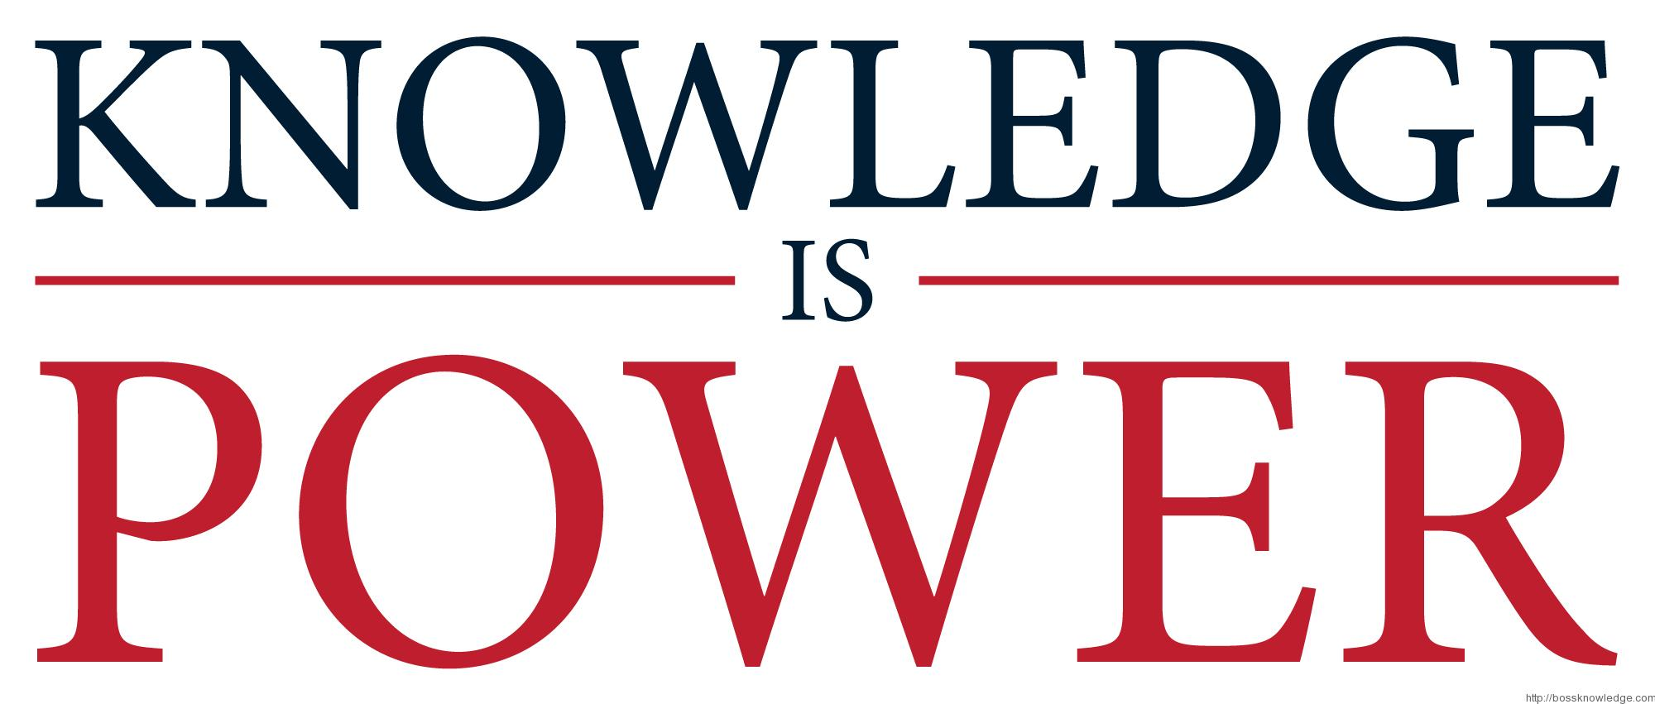
An Educated Client Is Our Best Client!
Notes:
At our firm, we partner with clients and believe an educated client is our best client. While we will always try our best to help you with your finances, we believe that knowledge is power. One of our missions is to share any knowledge with clients to help them make an informed decision.

Slide 3
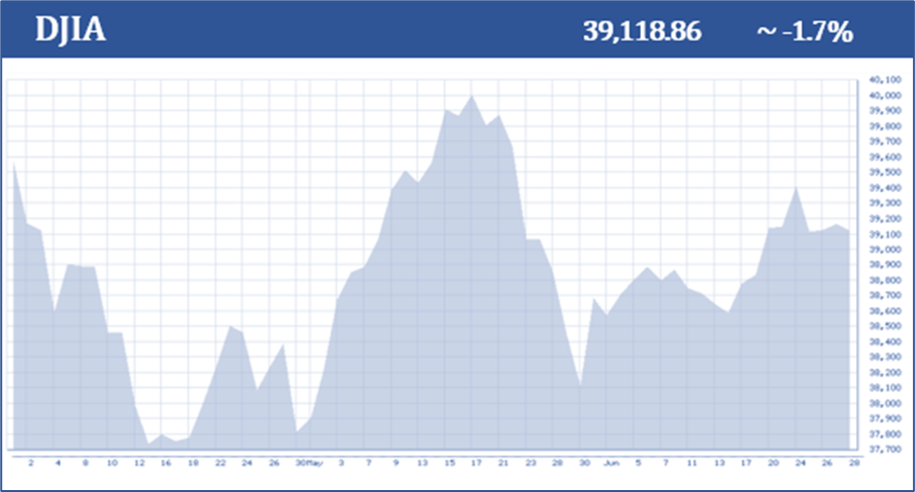
Equity Markets Quarter 2 (April 1, 2024 – June 28, 2024)
2024 S&P 500
2nd Quarter + 4%
First Half + 14%
2024 DJIA
2nd Quarter - 1.7%
First Half + 4%
Chart Source: bigcharts.com
(www.cnbc.com; 6/28/2024)
Notes:
After a strong first quarter of 2024, equity markets began the second quarter with a rough start, largely attributed to the Federal Reserve’s decision not to reduce interest rates because we were still experiencing stubbornly higher than their desired inflation rates. As the quarter progressed, strong performances from companies tied to artificial intelligence and a more favorable outlook on inflation numbers changed that perspective. By the quarter’s end, investors saw multiple all-time-high days, and many records were set for equities.
The broad-based S&P 500 returned nearly 4% for the second quarter and closed at 5,460.48. The Dow Jones Industrial Average, which does not have as much of a tech influence, made new highs in the quarter but finished down about 1.7%.
(www.cnbc.com; 6/28/2024)
Following the strongest first quarter since the pre-pandemic days of 2019, the equity markets continued to build on their positive momentum in the second quarter and the S&P 500 is up over 14% for the year. The Dow is up 4% year-to-date. This ongoing bull run is a testament to the market's resilience.

Slide 4
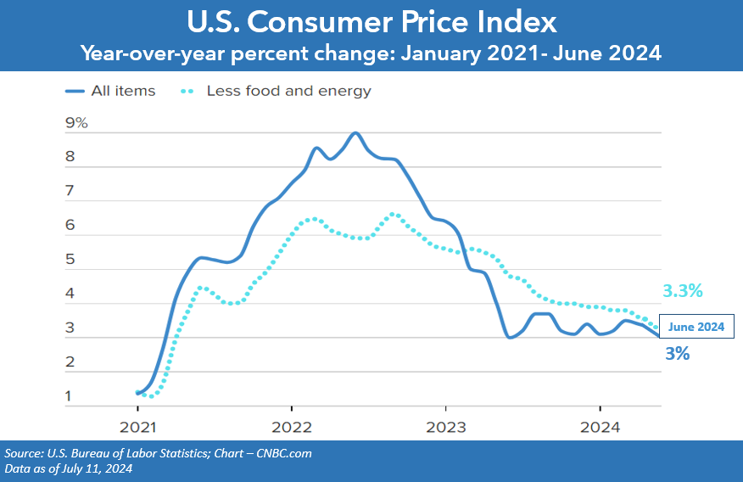
Inflation
June 2024 Overall + 3.0%
Notes:
Starting the quarter, inflation was still a concern for investors. The Fed closely monitors the Consumer Price Index (CPI), which is a broad measure of goods and services costs, as one of the indicators for interest rate adjustments. The good news is that inflation showed signs of slowing down in April, May, and June. In May, the Consumer Price Index (CPI) was 3.3%. In June, the CPI was 3.0%. Based on the June results, many economists feel that the Fed may have done enough to keep current inflation down from the challenging rates of the last few years.

Slide 5
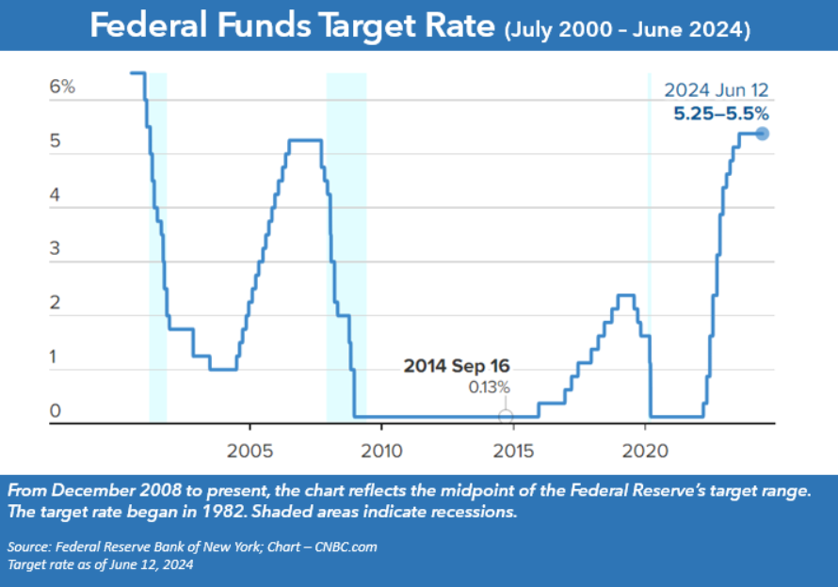
Interest Rates
Notes:
The Fed did not raise the Federal Funds Rate in the second quarter, and so for the seventh session in a row they kept the target rate range of 5.25 – 5.50%. The Fed meets eight times a year and for the second half of 2024, there are four more meetings left. Most analysts still project that we will see a rate reduction before the end of the year.

Slide 6
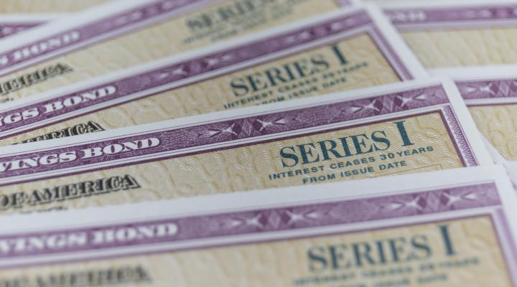
Bond Market & Treasury Yields
Notes:
The news of improved inflation numbers and the Fed’s continued commitment to cut interest rates in 2024 helped bond markets in the second quarter.
We still have an inverted yield curve, meaning shorter-term bonds yield more than longer-term bonds.
As of June 28, 5-year Treasury notes yielded 4.36%, 10-year notes yielded 4.36%, 20-year notes yielded 4.61%, and 30-year notes reached 4.51%.
This inverted yield curve has been long-running, beginning in July 2022—nearly seven consecutive quarters. While economists typically see this as a warning sign of a potential recession or poor market performance in the near future, we have yet to see this come to fruition.
Right now investors can receive some interest on fixed income holdings. We will continue to monitor closely how the Fed’s movements and interest rates are affecting bond yields. With the Feds anticipating lowering interest rates this year, the opportunity to get lower-risk, higher-yielding bonds may narrow.
(Sources: Deutsche Bank; www.morningstar.com)

Slide 7
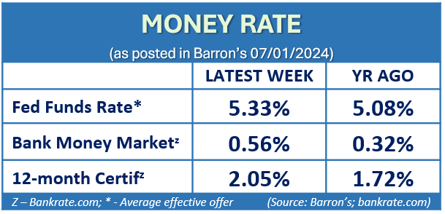
Cost of Safety
Notes:
Safety comes with a cost, and even though interest rates have risen, many major banks are still offering low interest rates to savers.
According to Barron’s, the average bank money market rate on July 1, 2024, was only 0.56%, and the average 12-month CD rate was 2.05%. While they have increased in the last twelve months, many savers are still seeing lower returns. If you are interested in exploring better interest rates, please contact our office.

Slide 8
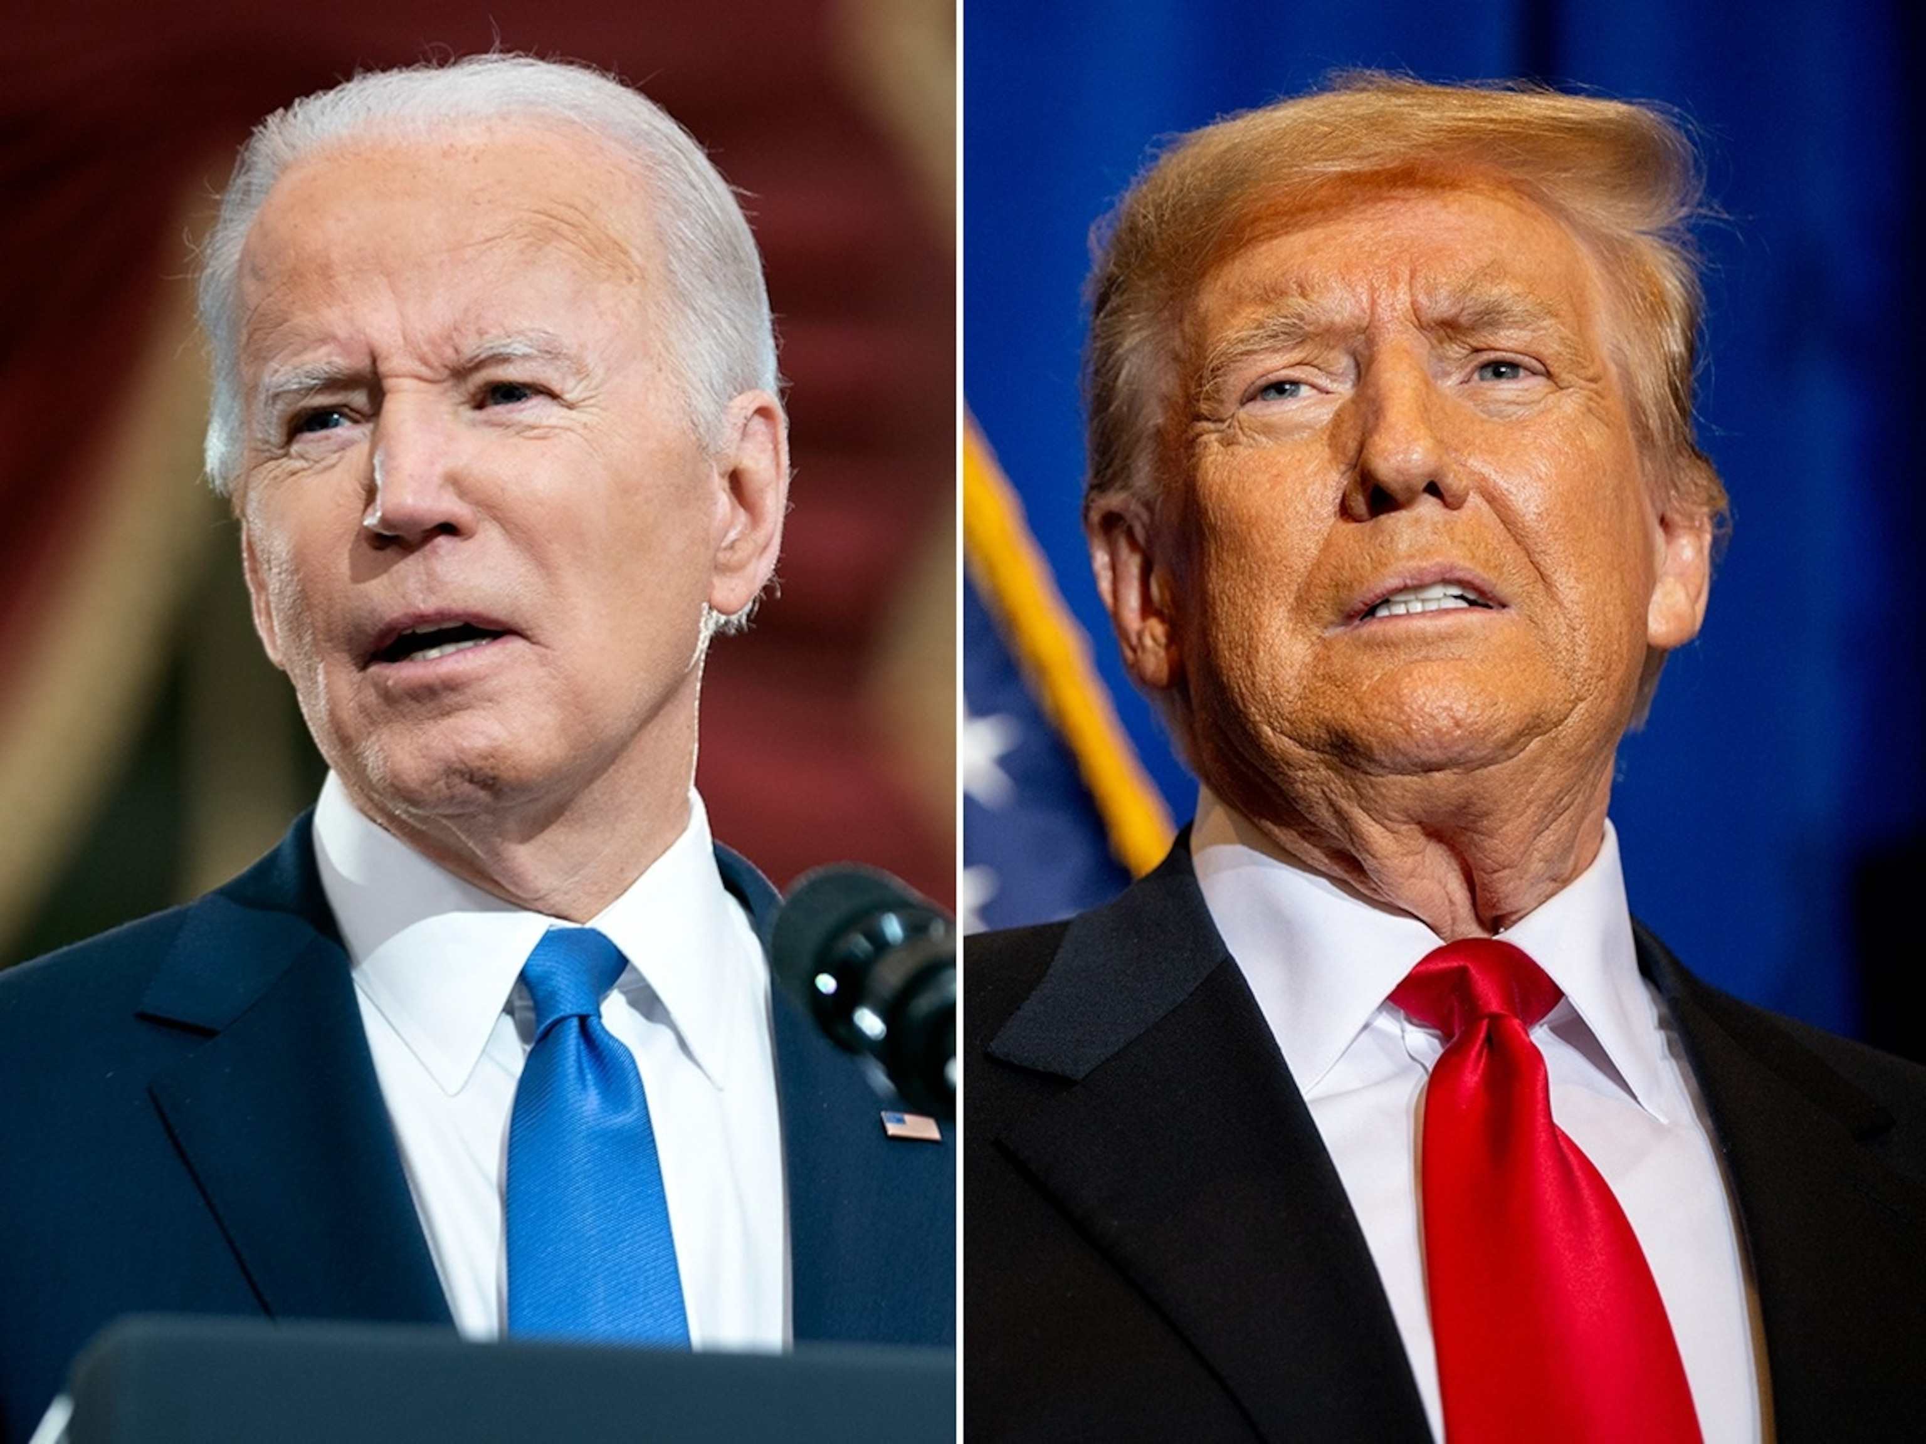
Geopolitical Unrest and a U.S. Election
Notes:
The global economy experienced continued uncertainty during the second quarter.
Global tensions persisted, including conflicts in the Middle East and the ongoing Russia-Ukraine war.
Also, this is a presidential election year, and that typically creates headlines. In addition there are some key races for the Senate and House of Representatives. The outcomes of these elections could impact policy and tax law, leaving much uncertainty.
While earnings and the economy are the main drivers of financial markets, one of our roles is to keep a close watch on how these events may impact the equity markets.

Slide 9
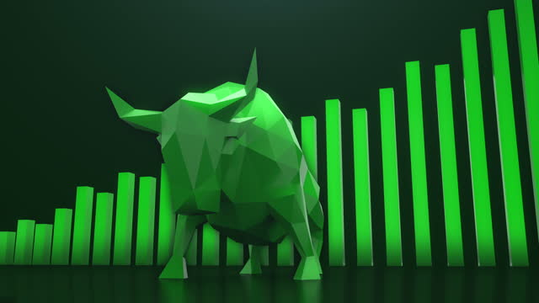
Possible Correction on the Horizon?
Notes:
We are currently experiencing a bull market, and the question is how long it can last.
While the U.S. economy continues showing signs of strength and resilience, positive inflation numbers will be key to the Fed being confident enough to start cutting rates. Should the economy maintain a healthy status, we may see the soft landing the Fed has aimed for. However, should the economy experience a slowdown, recession concerns could increase.
Will we experience an overdue pullback? For the first half of 2024, investors have not seen any large market pullbacks, but as a reminder, they are part of a normal investment experience.
We believe that speculation is not a good strategy. Instead, staying vigilant and focused on your own well-devised, long-term personal situation is a wiser investment strategy.

Slide 10
Could we experience stagflation?
Notes:
Talk of “stagflation” is emerging in the news. Stagflation is the nickname for an economic cycle wherein we experience slow economic growth, a high unemployment rate, and increased inflation. This can be a precarious situation to fix for policymakers, as attempting to correct one factor could aggravate another.
For the record, Fed Chair Jerome Powell is confident that we are not in a state of stagflation, stating that he sees neither the “stag, nor the ‘flation,” and that he didn’t “really understand where talk of stagflation scenario is coming from,” in remarks after the release of the May 1 FOMC meeting. (Source: nbcnews.com; 5/1/24)

Slide 11
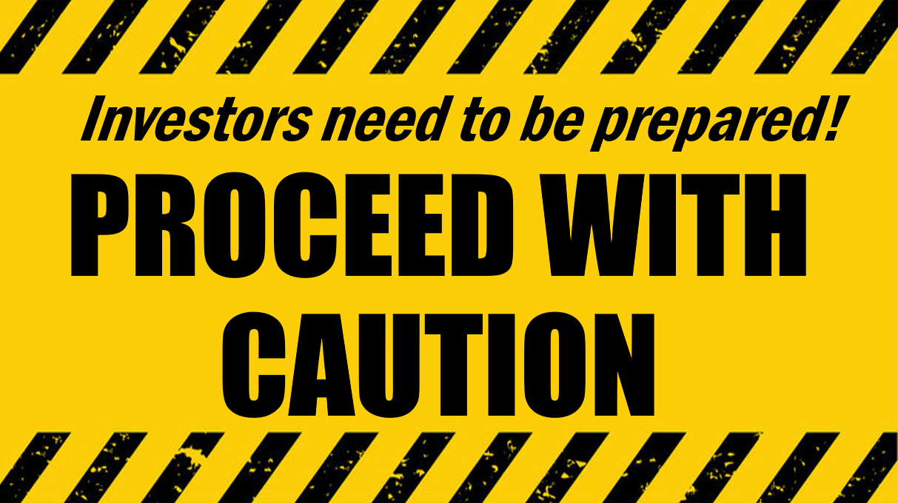
Equities Are a Long-term Commitment
Equity Markets
Strategy: Long-term Investing
Notes:
It's important to consider equity investments from a long-term perspective.
It's a good time to review your investments and ensure they align with your goals. Vigilantly monitor expenses and make smart investment decisions.
We believe in proactive preparation and providing clients with a resilient financial strategy.

Slide 12
Key Takeaways
Equity markets closed out the second quarter with solid results.
The Federal Funds rate remained at 5.25 – 5.50%.
An inverted yield curve remains.
The Fed is no longer anticipating three rate cuts as previously anticipated.
Both the economy and equity markets remained strong.
Volatility remains.
Stay the course and focus on the long-term.
Be well-prepared.
Notes:
As a recap, here are some things to remember:
Equity markets closed out the second quarter with solid results.
The Federal Funds rate remained at 5.25 – 5.50%.
An inverted yield curve remains, with short-termer rates more attractive than longer-term rates.
The Fed is no longer anticipating three rate cuts as previously anticipated.
Both the economy and equity markets ended the quarter strong.
Volatility remains. Remember, one of the goals of having a well-balanced portfolio is to design it with the understanding that volatility is always possible.
Staying the course and maintaining the consistency of a well-devised, long-term focused plan has historically served investors well.
Be well-prepared. Recent history has shown us that anything can happen. So, once again, caution should still be the principal notion for investors.

Slide 13
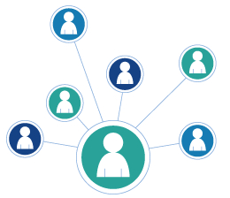
We appreciate you!
The best compliment is a referral!
Add someone to our mailing list
Invite them to attend a presentation
Thank you!
Notes:
We are grateful for our clients and value the opportunity to accompany you on your financial journey.
Our goal is to assist more people like you!
The greatest compliment we can receive is a referral. Many of our most satisfied clients were introduced to us by existing clients. If you know someone who could benefit from our services, please consider sharing this video or adding a friend to our mailing list. We would be honored if you could provide us with their contact information so that we can add them to our distribution list, enabling them to receive our newsletters and inviting them to watch or attend our presentations.
Once again, thank you for your trust in us. One of our main objectives is to keep our clients informed, and we appreciate you taking the time to watch this update. Please feel free to call us if you have any question.

Slide 14
Insert registered branch office address and phone number, as well as broker-dealer identification/disclosure
The views expressed are not necessarily the opinion of Insert Broker-dealer name. Information is based on sources believed to be reliable, however, their accuracy or completeness cannot be guaranteed.
Investing involves risk including the potential loss of principal. No investment strategy can guarantee a profit or protect against loss in periods of declining values. Past performance is no guarantee of future results. Diversification and strategic asset allocation do not ensure a profit or protect against a loss. The process of rebalancing may carry tax consequences.
This information is not intended to be a substitute for specific individualized tax, legal, or investment planning advice. You should discuss any tax, legal or investment planning matters with the appropriate professional.
All indexes are unmanaged and cannot be invested into directly. Unmanaged index returns do not reflect fees, expenses, or sales charges. Index performance is not indicative of the performance of any investment. Economic forecasts set forth may not develop as predicted and there can be no guarantee that strategies promoted will be successful. International investing involves special risks such as currency fluctuation and political instability and may not be suitable for all investors.
The S&P 500 is an unmanaged index of 500 widely held stocks that is generally considered representative of the U.S. Stock market. The Dow Jones Industrial Average (DJIA) commonly known as “The Dow”, is an index representing 30 stocks of companies maintained and reviewed by the editors of the Wall Street Journal. Index performance does not include transaction costs or other fees, which will affect actual investment performance. Individual investor’s results will vary.
Contents provided by: The Academy of Preferred Financial Advisors, Inc. © 2024. All rights reserved.

