Slide 1

Equity Market Update
and
Year-End Proactive Tax Planning for 2024
Presented By:
Your Name
Company
Notes:
Hello clients and friends. This is ___________________ from __________________ and it’s my pleasure to present our economic and market update and year-end proactive tax planning for 2024 workshop.

Slide 2


An Educated Client Is Our Best Client!
Notes:
At our firm, we partner with clients and believe an educated client is our best client. While we will always try our best to help you, when it comes to your finances, we believe that knowledge is power. One of our missions is to share with clients any knowledge that can help them make an informed decision.

Slide 3
Agenda
Economic and Market Update
Proactive Tax Planning for 2024
Notes:
Our agenda is very straightforward.
First, we will share with you a brief economic and market update.
Then, we will discuss some proactive tax planning for 2024.

Slide 4

Five Key Areas of Financial Planning
Preservation Planning
Retirement Planning
Tax Planning
Estate Planning
Investment Planning
Notes:
As a reminder, it is always important to review that there are five key areas of financial planning.
They are:
Preservation Planning,
Retirement Planning,
Tax Planning,
Estate Planning, and
Investment Planning
As a comprehensive financial services firm, we try to always consider the impact of any recommendation we make on not just one, but all these areas for our clients.

Slide 5







Equity Markets Concerns
Notes:
2024 has brought some interesting dynamics for investors. In 2024 investors had to worry about Market volatility, political unrest and fighting, interest rate changes, more inflation- but at lower rates, and a contentious presidential election atmosphere.

Slide 6
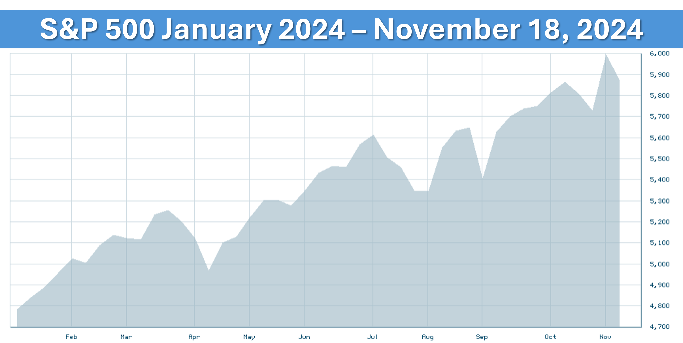
Equity Markets 2024
Source: bigcharts.com
Notes:
So, how have equity markets performed? As this chart shows, year to date, the broad-based S&P 500 index has advanced and made multiple new highs.
Source: bigcharts.com

Slide 7

Equity Market Concerns
Major Market Concerns:
Direction of inflation
Interest rate changes
Recession concerns
Geopolitical unrest
U.S. Presidential election
Notes:
While there are many factors that can continue to affect the movement of equity markets, some major equity market concerns we still need to monitor are the ones we have already mentioned, including:
The direction of inflation rates,
Further interest rate changes,
Recession concerns;
Geopolitical unrest;
And, the recent elections.
These items could be major factors in determining the future direction of the equity markets.

Slide 8
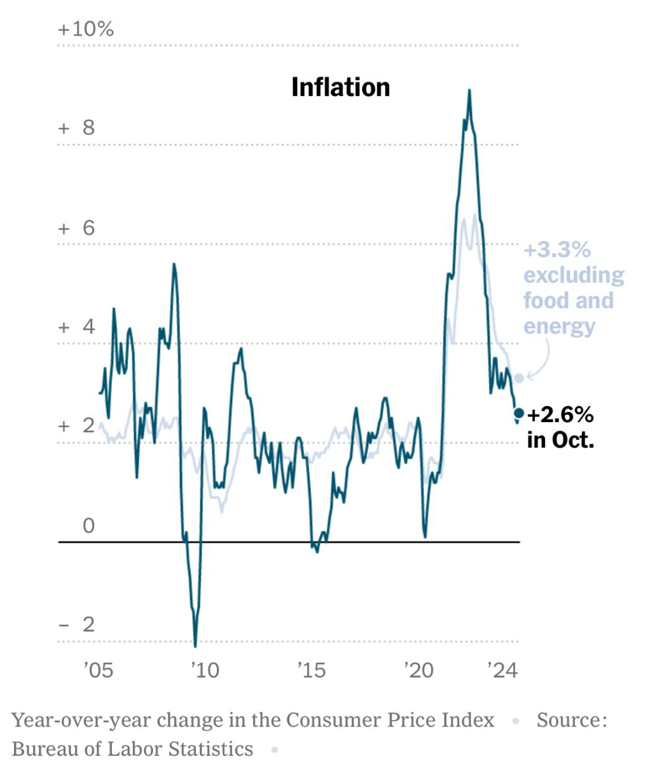
Inflation
Notes:
As this graph shows, the inflation rate for October 2024 was 2.6%. This is way down from 2022 highs, but inflation remains an ongoing concern.

Slide 9
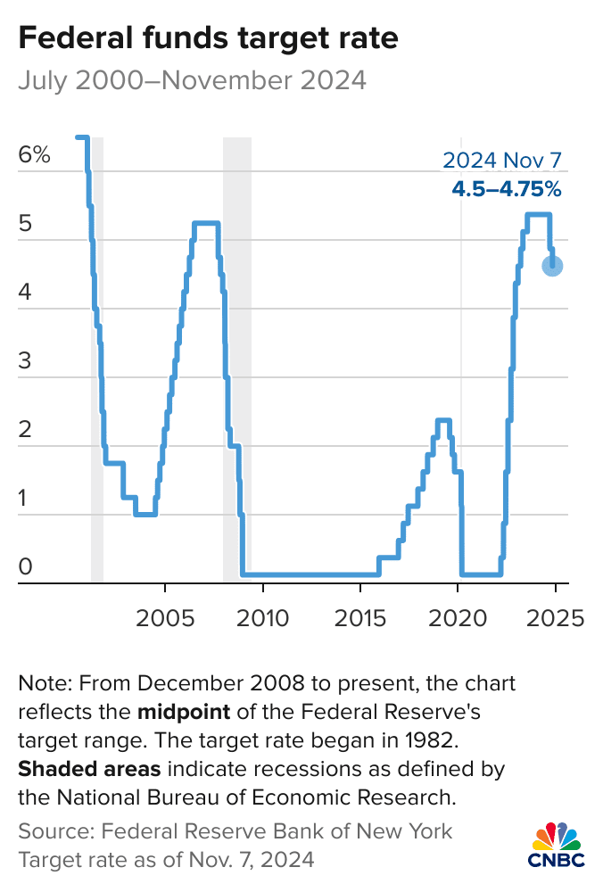
Interest Rates
Notes:
After 11 interest rate increases over a very short period, with the federal funds rate rising from near 0% to over 5% and then pausing, at their September meeting, the Fed chose to reduce rates by 50 basis points and then by another 25 Basis points in November. They meet again in December and their minutes reflect that this may be the first of several interest rate cuts that we could see over the next year and a half.

Slide 10
Inflation and Interest Rates
Fed still looking into reducing rates even further.
Fed officials watching key indicators to assess what they will need to do to continue reducing inflation.
Notes:
Although inflation has shown signs of slowing and interest rates have been reduced, Fed officials said in their policy statement that they were giving themselves time to assess how the economy was reacting to what has been a rapid campaign to slow demand and wrestle fast inflation under control.
Fed officials are watching key indicators to assess what they will need to do to continue reducing inflation, including labor statistics, and the consumer price index.

Slide 11


Recession Concerns
Notes:
Recession fears or a decrease in economic activity are always concerning. However, currently, many analysts think we are out of the woods for a recession.
While others think we still could see a recession, currently that is not the case.
The economy and jobs are still showing that their numbers are relatively satisfactory, but that doesn’t mean the coast is clear. Regardless of if or when we could see a recession, the likelihood of it being severe is low.

Slide 12

Geopolitical Unrest
Notes:
The global economy is still in a vulnerable position. Many issues, including the ongoing war between Russia and Ukraine and conflicts in the Middle East coupled with trade concerns with China, are contributing to geopolitical unrest. Equity markets do not like the uncertainty this brings. We will keep an eye on how geopolitical issues may affect the markets here in the U.S.

Slide 13

U S Presidential Elections
Notes:
Not to get political, this was a presidential election year and in 2025 we will have a new president. Regardless of whether or not your chosen candidate won the election, I think we can all breathe a sigh of relief that this particularly tumultuous election year has come to an end.
History has shown that equities are non-partisan!
Historically, equity markets have been more concerned about the end of an election than about who won it. Equity market performance is more closely linked to company earnings and overall corporate health than to political outcomes

Slide 14
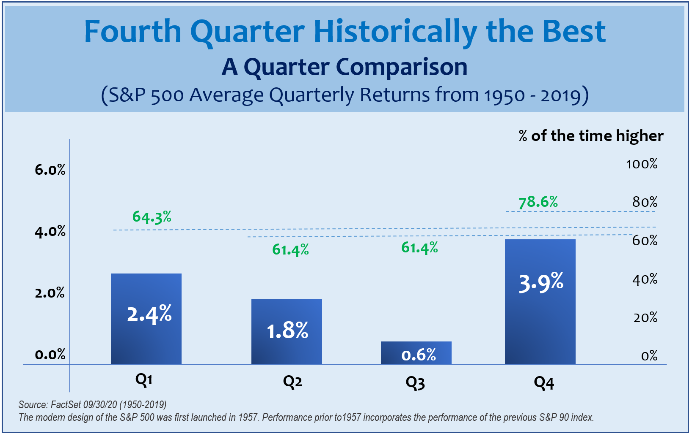
Equity Market Outlook
Notes:
As financial professionals, we try to provide proactive long-term planning for clients.
While no one has a crystal ball, historically the fourth quarter of the year is a good one for investors.
This chart of 70 years includes several very difficult 4th quarters, including October of 1987 when the market collapsed and had its worst single day in history. When studying 70 years of returns, 78.6% of the time, Q4 ended the respective year on a high note.
As we head into the end of the year, we will keep a very watchful eye on equity markets.

Slide 15

Equity Markets
Strategy:
Long-term Investing
Notes:
This reinforces our thought that when it comes to equities, we believe that long-term investing is a great strategy.

Slide 16
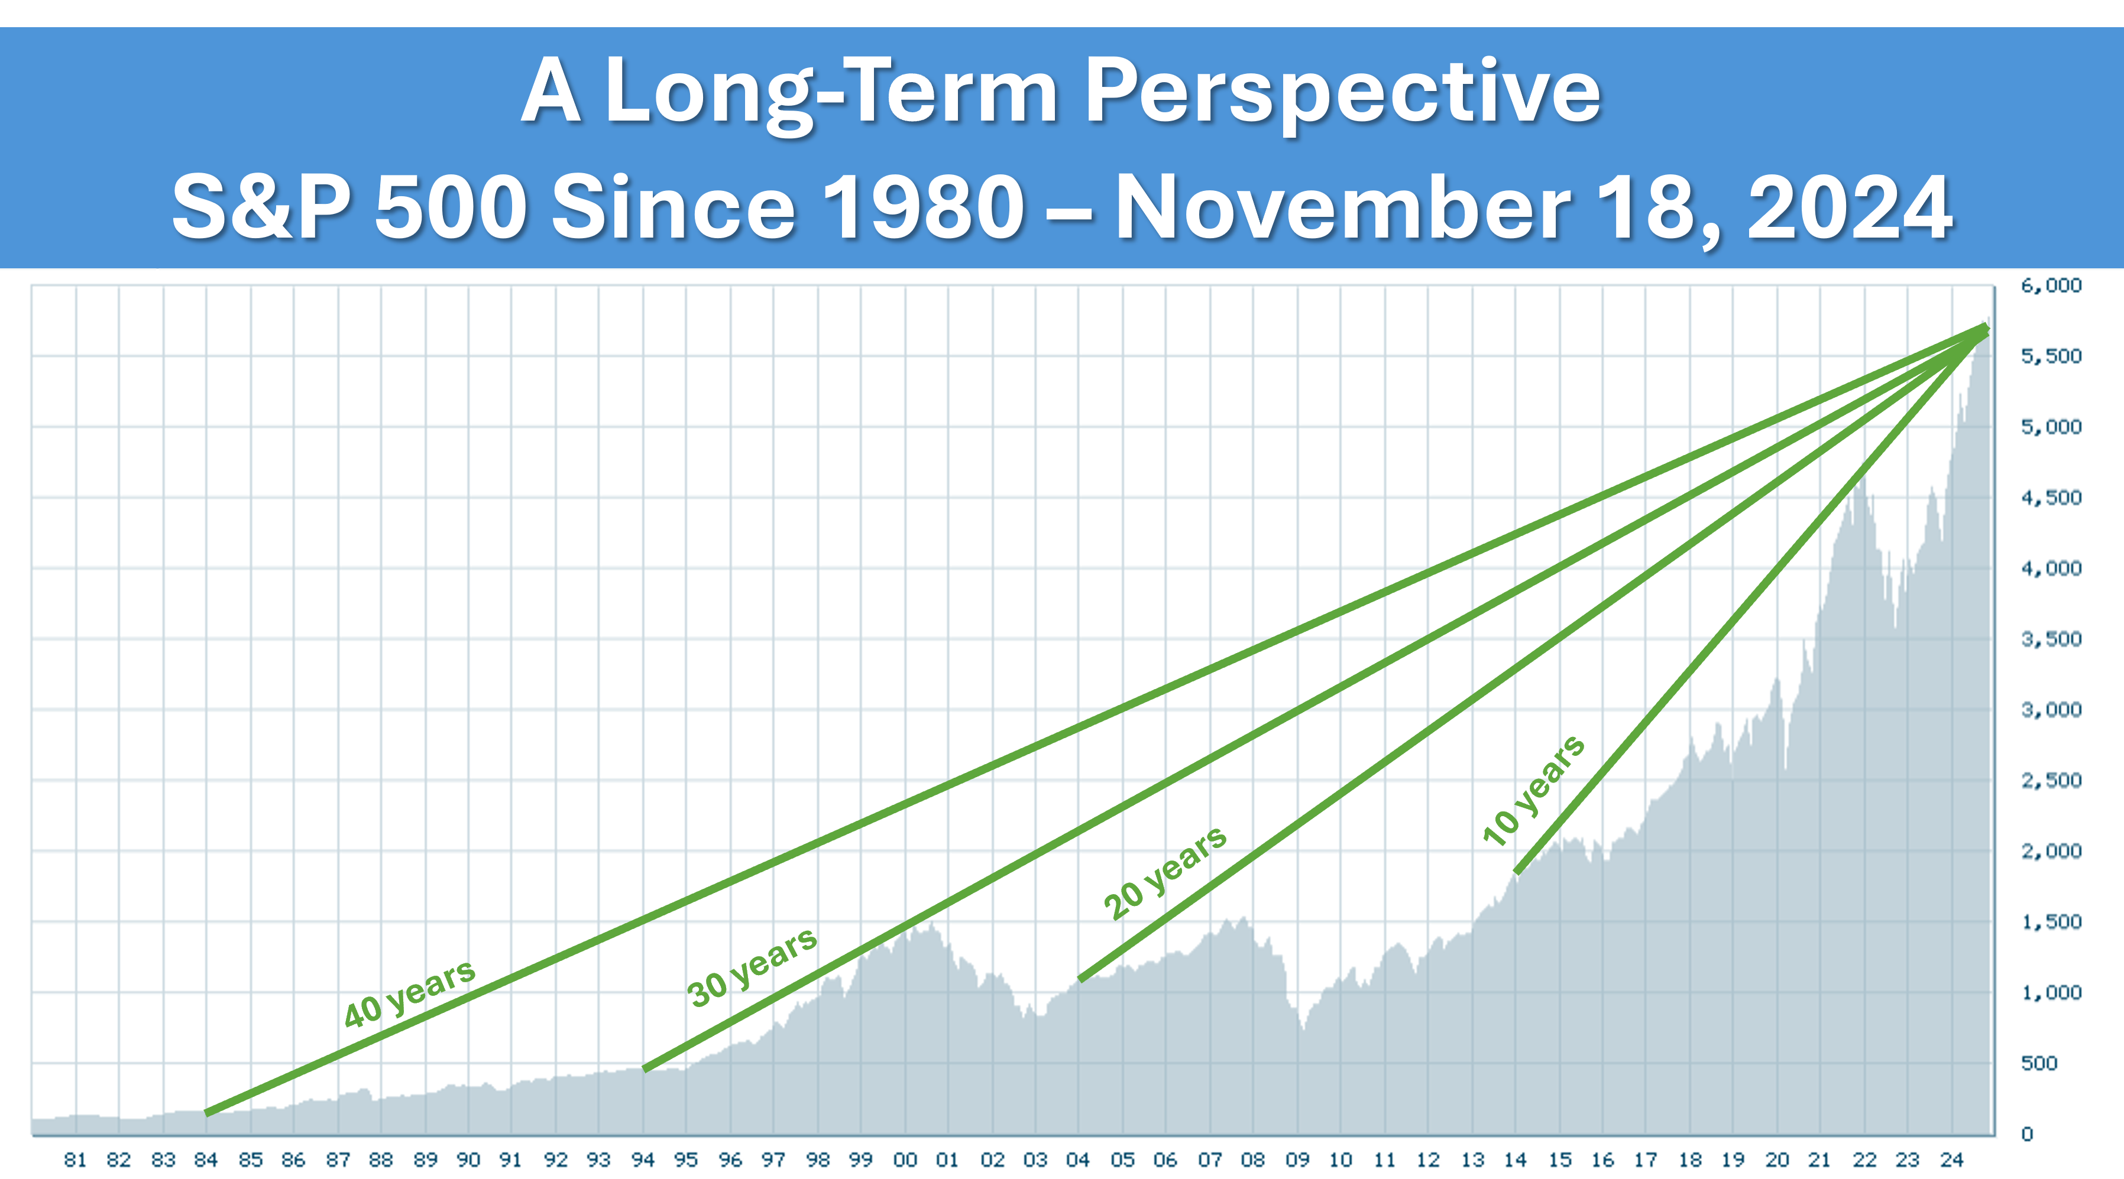
Equity Markets
Source: bigcharts.com
Notes:
As you can see from another view, once again, those investors who focus on a long-term strategy were historically rewarded with significant returns.
While ups and downs are a part of the investment experience, the 40, 30, 20, and even 10-year investment timeframes have shown a healthy upward path.

Slide 17

Outlook
Historical results are no indication of future results, and we still believe that caution should be the principal notion for investors.
Notes:
2024 has already been an interesting year.
We stand firm by our mantra of “proceed with caution.” Please remember, we will be watching all areas of the economy we feel may affect our clients and we are here for you and any concerns you may have.

Slide 18
Things Investors Control
Your risk tolerance or appetite
Your time horizon
Your behavior
Your overall strategy
Notes:
We would like to remind you of these four things that can help us approach your investments with discipline and focused direction.
Your risk tolerance or appetite. By this, we mean how much risk can you take, or better yet, how much can you afford to take?
Your time horizon – or the amount of time you want to be invested in any situation, which can help you determine your entry and exit points.
Your behavior. Market volatility is a part of the investing experience. This can create anxiety and stress when volatility occurs. Do you know how well you can emotionally endure the potential ups and downs of your investments?
Your overall strategy. Are you looking at something that doesn’t quite fit with your overall strategy? Perhaps the media is influencing you to make a rash or impulsive decision on your investments. We want your holdings to be congruent with your overall strategy. Panic can create more risk and potentially cause setbacks in your goals. Our main goal is to stay focused on your overall strategy.

Slide 19
Words of Wisdom
Notes:
This might be an ideal time to remember these words of wisdom from the legendary Warren Buffet.
“Successful investing takes time, discipline and patience.”

Slide 20
Key Takeaways
Caution is still the principal notion for investors.
Inflation continues to be a catalyst for concern.
Interest rates could continue to fall.
Recession is still a possibility.
Long-term investing is a key strategy with equity markets.
We are here to help YOU!
Notes:
Here are some of the key items we hope you take away from our equity market review:
Caution is still the principal notion for investors.
Inflation, while slowing down, continues to be a concern.
Interest rates look like they will continue to fall.
A recession is still a possibility.
Long-term investing is a key strategy with equity markets.
And, as always, we are here to help you!

Slide 21

Proactive Year-end Tax Planning
Ideas for 2024
A “Proactive” approach to your tax planning instead of
a “Reactive” approach could produce better results!
Notes:
Now let’s shift to proactive tax planning for 2024.
We believe that taking a proactive approach to your tax planning instead of a reactive approach could produce better results.

Slide 22


“
Tax “Planning” vs. Tax “Preparation”
Tax Preparation looks backwards,
whereas Tax Planning looks ahead!
Notes:
Let’s start by quickly distinguishing the difference between tax planning and tax preparation.
Tax planning is looking ahead before year end, whereas tax preparation is filling out your tax forms after year end.

Slide 23

Three Categories of Federal Tax Brackets
First
10%, 12%
Lower
Brackets
Next
22%, 24%
Should Calculate
Last
32%, 35%, 37%
Tax Sensitive
Notes:
Our strategy is to be proactive not reactive.
Everyone's situation is different and therefore, everyone’s situation needs to be considered! We find that taxpayers are in one of three major categories of federal tax brackets.
The first two brackets, 10, and 12% are the lower brackets, the next two, 22 and 24 percent, are ones where investors should at least think about calculating the tax impact of decisions, and for those in the 32, 35 or 37 percent brackets we call those “tax sensitive” because those are high brackets.

Slide 24
Three Categories of Federal Tax Brackets
Immediate
Short-Term
Long-Term
Notes:
As financial professionals, we are always thinking about taxes and their impact immediately, short term, and over the long term.

Slide 25
Tax Brackets for 2024
For 2024, there are currently seven income tax rates.
They are 10%, 12%, 22%, 24%, 32%, 35%, and 37%.
Under current law this seven-rate structure is scheduled to phase out on January 1, 2026.
Tax Rate | Single | Married/Joint & Widow(er) | Married/Separate | Head of Household
10% | $0 to $11,600 | $0 to $23,200 | $0 to $11,600 | $0 to $16,550
12% | $11,601 to $47,150 | $23,201 to $94,300 | $11,601 to $47,150 | $16,551 to $63,100
22% | $47,151 to $100,525 | $94,301 to $201,050 | $47,151 to $100,525 | $63,101 to $100,500
24% | $100,526 to $191,950 | $201,051 to $383,900 | $100,526 to $191,950 | $100,501 to $191,950
32% | $191,951 to $243,725 | $383,901 to $487,450 | $191,951 to $243,725 | $191,951 to $243,700
35% | $243,726 to $609,350 | $487,451 to $731,200 | $243,726 to $365,600 | $243,701 to $609,350
37% | $609,351 or more | $731,201 or more | $365,601 or more | $609,350 or more
Notes:
As stated earlier, for 2024, there are currently seven income tax rates. They are 10%, 12%, 22%, 24%, 32%, 35%, and 37%.
Under current law this seven-rate structure which was created by the Tax Cuts and Jobs Act is scheduled to automatically phase out on January 1, 2026.

Slide 26
Evaluate the use of itemized deductions
versus the standard deduction.
2024 STANDARD DEDUCTION Amounts
Single | MFJ/QW | MFS | HOH
$ 14,600 | $ 29,200 | $ 14,600 | $ 21,900
Notes:
For 2024, the standard deduction amounts for those who do not itemize has slightly increased. Those amounts are:
$14,600 for individuals and married couples filing separately;
$29,200 for married couples filing jointly and surviving spouses; and
$21,900 for heads of households.

Slide 27

Tax Planning in 2024
How to View Itemized Deductions
THE OLD RULE WAS TO
ACCELERATE DEDUCTIONS
THE NEW RULE IS TO
TIME or PLAN DEDUCTIONS
Notes:
So, how should you view itemized deductions if you do not take the standard deduction?
The old “rule” was primarily to try to accelerate or realize deductions and take them as soon as possible.
With the higher standard deductions, the new “rule” is to time or carefully plan deductions.

Slide 28
Capital Gains Rates for 2024
Long-term Capital Gains Tax Rates for 2024
Filing Status | 0% | 15% | 20%
Single | Up to $47,025 | $47,026 - $518,900 | Over $518,900
Married Filing Jointly | Up to $94,050 | $94,051 - $583,750 | Over $583,750
Head of Household | Up to $63,000 | $63,001 - $551,350 | Over $551,350
 |  |  | Source: www.irs.gov
Notes:
In 2024, long-term capital gains still receive a substantial Federal Income tax break.
There are still three tax rates of 0%, 15% and 20% for long-term capital gains, which are for assets and investments you have held for a year or more.

Slide 29
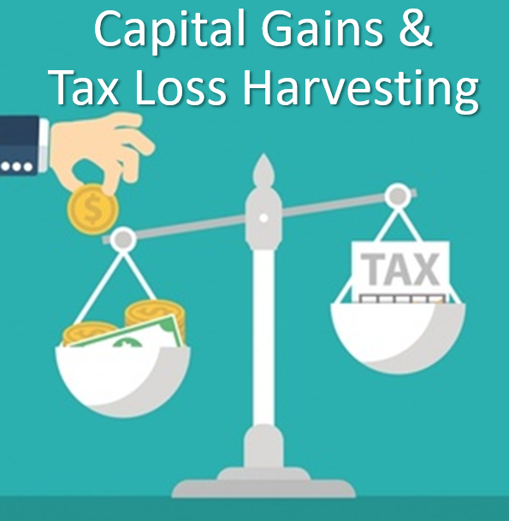
Year-End
Tax Planning Strategies
Notes:
As part of a year-end tax planning strategy, it can be helpful for taxpayers to review Tax Gains and Loss Harvesting.

Slide 30
Harvesting Capital Losses and Gains
Selling assets at a loss to offset capital gains.
KEY FACT:
Taxpayers can use up to $3,000 capital loss
above capital gains to offset ordinary income!
Harvesting gains introduces a tradeoff between lower tax rates versus the loss of tax deferral.
Notes:
Harvesting capital losses is a strategy that has a taxpayer selling assets that are at a loss to offset capital gains.
This is a tax deferral strategy that could be valuable.
A key fact to remember is you can use up to $3,000 ($1,500 if married filing separately) in capital loss above capital gains to offset ordinary income.
Capital gains harvesting means taking capital gains and paying taxes in the current tax year.
Remember, when taking a long-term gain for tax purposes, although the tax is paid at a lower rate, it is paid sooner.

Slide 31

Retirement Contribution Planning for 2024
Review Your Retirement Savings
Strategy Before Year-end!
Notes:
For those who are not fully retired, remember to review your year end retirement contribution planning.

Slide 32
Retirement Contribution Planning for 2024
Retirement Contribution Plan Limits
IRA/ROTH IRA CONTRIBUTION LIMIT | $7,000
IRA/ROTH IRA “CATCH UP” | $1,000
401K ELECTIVE DEFERRAL | $23,000
401K ELECTIVE DEFERRAL “CATCH UP” | $7,500
SIMPLE IRA CONTRIBUTION LIMIT | $16,000
SIMPLE IRA “CATCH UP” | $3,500
SEP IRA EMPLOYEE PERCENTAGE MATCH LIMIT | 25%
SEP IRA SELF-EMPLOYED PERCENTAGE MATCH LIMIT | 25%
OVERALL LIMIT ON CONTRIBUTIONS to Defined Contribution Plans (DCPs) | $69,000 ($76,500 if age 50 or older)
Notes:
Here are some 2024 contribution plan maximums that could be applicable if you are participating in one of these plans.
If you have questions about retirement plans, please call us.

Slide 33
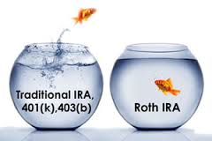
Roth IRA Conversions
Explore Roth IRA Conversion Benefits
Lowers overall taxable income long-term
Tax-free compounding
No RMDs (at age 73)
Tax-free withdrawals for beneficiaries
*Withdrawals from Roth IRA may be tax free, if they are considered qualified. Limitations and restrictions may apply. Withdrawals prior to age 59 ½ or prior to the account being opened for five years, whichever is later, may result in a 10% IRS penalty tax. Future tax laws can change at any time and may impact the benefits of Roth IRAs. Their tax treatment may change.
Notes:
For some people with IRAs that have not been taxed, a partial or full Roth IRA conversion could be something to consider. Some benefits from Roth IRA Conversions include:
They could lower your overall taxable income long-term.
ROTH IRAs enjoy tax-free compounding.
ROTH IRAs have no RMDs (at age 73).
ROTH IRAS allow tax-free withdrawals for beneficiaries.
Roth IRA conversions are not for everyone, but if you would like to explore one then please see us or your tax professional.
Traditional IRA account owners have considerations to make before performing a Roth IRA conversion. These primarily include income tax consequences on the converted amount in the year of conversion, withdrawal limitations from a Roth IRA, and income limitations for future contributions to a Roth IRA. In addition, if you are required to take a required minimum distribution (RMD) in the year you convert, you must do so before converting to a Roth IRA.

Slide 34
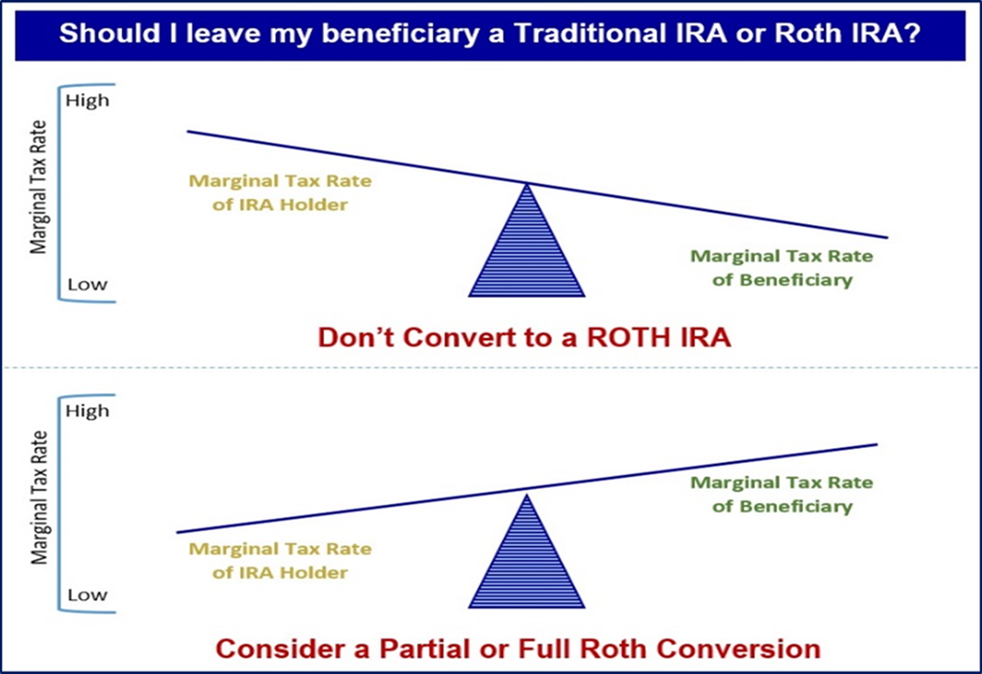
Family Tax Bracket Management
A critical area to review is overall Family Tax Bracket Management ©
Your Beneficiaries Marginal Tax Rate(s) is/are
____________
Your Marginal Tax Rate is
____________
Notes:
As a results of the SECURE Act, overall Family Tax Bracket Management is a critical area for those with untaxed retirement assets to explore each year. One of your choices is always to leave everything the way it currently is.
If you are in a higher marginal tax bracket than your beneficiaries, then it might make sense to let them take distributions after your death in their tax bracket rather than you in yours.
However, if your beneficiaries are in a higher marginal tax bracket, then it might make sense to take distributions in your tax bracket before death and then to convert these accounts to Roth IRAs and leave your beneficiaries an account that still must be taken out in 10 years but can grow tax free.
An annual step to consider is to review your marginal tax rate and your beneficiaries marginal tax rate(s) each year.

Slide 35

Consider Qualified Tuition Plans
Notes:
College savings plans can also bring tax efficiencies.
If you want to explore tax efficient ways to save for college, please give us a call.

Slide 36

Annual Gifting Tax Planning for 2024
Gift Tax Exclusion for 2024 is $18,000 (per Donee)
A payment made directly to a medical institution to pay for the medical bills of someone else does not count as a gift for gift tax purposes.
A payment made directly to an educational institution to pay for the tuition of a student does not count as a gift to the student for gift tax purposes.
Notes:
Let’s talk about annual gifting now.
You may gift up to $18,000 tax-free to each donee in 2024. This is a $1,000 increase from $17,000 in 2023. These “annual exclusion gifts” do not reduce your lifetime gift tax exemption. This annual exclusion gift is doubled to $36,000 per donee for gifts made by married couples.
You can also help someone with medical or education expenses without incurring gift taxes.
There are opportunities to give unlimited tax-free gifts when you pay the provider of the services directly. The medical expenses must meet the definition of deductible medical expenses. Qualified education expenses are tuition, books, fees, and related expenses, but not room and board. You can find the detailed qualifications in IRS Publications 950 and the instructions for IRS Form 709 at www.irs.gov.

Slide 37
Wealth Transfer Planning for 2024
Exemption amounts for gift, estate, and generation-skipping taxes for 2024
are $13.61 million ($27.22 million for married couples).
 | 2021-2025 | 2026
Estate & Gift Tax Exemption Amount | $13.61 million is current exemption (indexed for inflation each year) | SUNSET to approximately $7 million ($5.6 million adjusted for inflation)
Generation-skipping Transfer Tax Exemption Amount | $13.61 million is current exemption (indexed for inflation each year) | SUNSET to approximately $7 million ($5.6 million adjusted for inflation)
Estate, Gift, and GST Tax Rate | 40% | 45%
Notes:
For those of you with larger estates, a wealth transfer planning item to think about is the exemption amounts for gift, estate, and generation-skipping taxes for 2024 is high at $13.61 million ($27.22 million for married couples). Any amount over that is subject to 40% Federal taxes. This high amount provides high net worth individuals a significant planning window to make gifts and set up irrevocable trusts.
As a reminder, as of now, in 2026, the estate tax exclusion will return to approximately $5.6 million (which is $7 million adjusted for inflation). On November 26, 2019, the Treasury Department and the Internal Revenue Service issued final regulations under IR-2019-189 confirming that individuals who take advantage of the increased gift tax exclusion or portability amounts in effect from 2018 to 2025 will not be adversely impacted when this tax law change sunsets on January 1, 2026.
If you have a large estate, this is something to discuss, so please call us.

Slide 38
Charitable Giving Tax Planning for 2024
Qualified Charitable Distributions
are still a strategy for retirement savers.
Required Minimum Distributions (RMDs) were changed to 73.
Qualified Charitable Distributions (QCDs) are still allowed at 70½.
Many retirement savers like to use their RMDs or part of them for QCDs.
70 ½
Minimum Age
$105k
Annual Maximum
IRA
Gift to Charity
Notes:
Qualified Charitable Distributions (QCD) are still a strategy for retirement savers.
As part of the SECURE 2.0 Act Required Minimum Distributions or RMD’s were changed to start at age 73 instead of age 72.
Qualified Charitable Distributions, or QCDs, are a tax law provision that allows retirement savers over age 70½ to directly distribute up to $105,000 to eligible charities straight from their retirement accounts and not pay tax on this distribution.
One idea that experts suggest is if you are charitably inclined, consider using part or all your Required Minimum Distribution or “RMD” for a Qualified Charitable Distribution. If you meet the qualifications to utilize this strategy, the funds must come out of your IRA by December 31, 2023. They must also go directly to an approved charity.
Like many of the other strategies we are discussing today, this is one that needs to be done properly, so please see us or your tax professional about this strategy.

Slide 39

Looking Ahead
Notes:
Now, let’s take a quick look ahead at some scheduled tax law changes.

Slide 40
Tax Law Changes Are Coming
Tax Law Changes Are Coming!
Tax Rates
Deductions
Corporate Taxes
Qualified dividends and capital gains rates
Estate Tax Exemptions
Child Tax Credit
Notes:
Regardless of whether the candidate you voted for won or not, 2025 and 2026 will bring changes to tax laws. The Tax Cuts and Jobs Act (TCJA) is scheduled to sunset on December 31, 2025. Currently, there are many different proposals for extending, expiring, or changing parts of the TCJA. Even if no tax law changes are voted in, tax law changes are scheduled to happen. Here are some of the most talked about tax change items that investors should be aware of:
Income Tax rates: You may find yourself with higher or lower individual tax rates.
Deductions: You could have greater or reduced itemized deductions.
Corporate Taxes: Corporate tax rates could increase or decrease.
Qualified dividends and capital gains rates: There could be higher or lower capital gains rates.
Estate Taxes: Estate tax exemptions could significantly increase or decrease.
Child Tax Credit: There could be a potential expansion of Child tax credits for those with children.
We are keeping a close eye on upcoming tax law changes and how they may affect you. We will guide you when appropriate so that you may plan and strategize according to your unique situation.

Slide 41

Proactive Tax Planning
Notes:
Again, a “Proactive” approach to your tax planning instead of a “Reactive” approach could produce better results!
One of our goals is to keep clients updated when tax laws change so that they can proactively plan. If you’d like to discuss how these sunsetting rules or any tax law changes may affect your situation, please feel free to contact us, and we’d be happy to assess your unique financial situation.

Slide 42
What Can You Expect From Us?
Regular review of changes that may affect you.
Regular communication.
More frequent discussions.
Review of economic, tax, estate and investment issues for our clients.
Notes:
So – what can you expect from us?
One of our main focuses is to review changes for our clients on an ongoing basis.
You can expect regular communication and more frequent discussions, and you can expect that we are continuously reviewing economic, tax, estate, and investment issues for our clients.
In fact, we will be offering other workshops that highlight tax changes and planning ideas.

Slide 43

Client Benefit
As a client of our firm, you can
add names to our mailing lists!
Notes:
We appreciate our clients!
Do you know someone who could benefit from the information we provide? As a valued client, you can add names to our mailing list to receive our newsletters, articles, and reports.
If you’d like to take advantage of this, please let us know and we would be happy to include them in our mailings.

Slide 44

Help Us
Help Others!
Please share!
Notes:
One of our goals is to continue to help others!
Some of our best clients were referred to us by existing clients. So, please feel comfortable letting us know the names of anyone you feel could benefit from our services or information.
Again, one of our primary goals is to keep clients informed, and we appreciate you attending our session.
Please call us if you have any questions.

Slide 45
The views stated in this workshop are not necessarily the opinion of broker/dealer and should not be construed, directly or indirectly, as an offer to buy or sell any securities mentioned herein. Information is based on sources believed to be reliable; however, their accuracy or completeness cannot be guaranteed. Please note that statements made may be subject to change depending on any revisions to the tax code or any additional changes in government policy. Please note that individual situations can vary. Unless certain criteria are met, Roth IRA owners must be 59½ or older and have held the IRA for five years before tax-free withdrawals are permitted. Additionally, each converted amount is subject to its own five-year holding period. Investors should consult a tax advisor before deciding to do a conversion.
Investing involves risk including the potential loss of principal. No investment strategy can guarantee a profit or protect against loss in periods of declining values. Past performance is no guarantee of future results. Diversification and strategic asset allocation do not ensure a profit or protect against a loss. The process of rebalancing may carry tax consequences. This information is not intended to be a substitute for specific individualized tax, legal, or investment planning advice. You should discuss any tax, legal or investment planning matters with the appropriate professional.
All indexes are unmanaged and cannot be invested into directly. Unmanaged index returns do not reflect fees, expenses, or sales charges. Index performance is not indicative of the performance of any investment. Economic forecasts set forth may not develop as predicted and there can be no guarantee that strategies promoted will be successful. International investing involves special risks such as currency fluctuation and political instability and may not be suitable for all investors.
The S&P 500 is an unmanaged index of 500 widely held stocks that is generally considered representative of the U.S. Stock market. Index performance does not include transaction costs or other fees, which will affect actual investment performance. Individual investor’s results will vary.
Contents provided by:
The Academy of Preferred Financial Advisors, Inc. © 2024. All rights reserved.
Reviewed by Keebler & Associates.
Insert Approved BD Disclaimer here
Insert registered branch address, contact information
The S&P 500 is an unmanaged index of 500 widely held stocks that is generally considered representative of the U.S. Stock market. The Dow Jones Industrial Average (DJIA) commonly known as “The Dow”, is an index representing 30 stocks of companies maintained and reviewed by the editors of the Wall Street Journal. Index performance does not include transaction costs or other fees, which will affect actual investment performance. Individual investor’s results will vary.
Show less

Slide 46

Thank You!
We appreciate the opportunity to assist
you with your financial needs!
Your health and
well-being is always our highest priority!
Notes:
We are thankful for the opportunity to assist you with your financial needs.
Remember, at our firm, clients come first, and your health and well-being are our highest priority.

