Slide 1
Quarter 4 2024 Economic Review
Presented By: Your Name Company
Notes:
Hello, clients and friends. This is ___________________ from __________________, and it’s my pleasure to present our fourth quarter economic review.

Slide 2
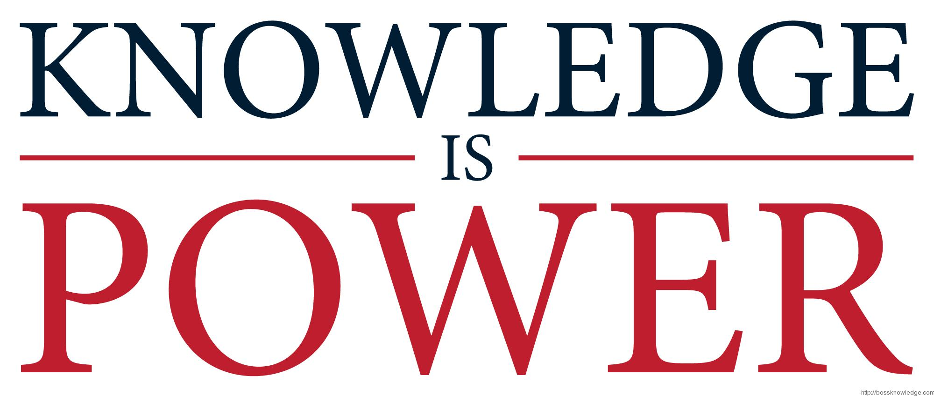
An Educated Client Is Our Best Client!
Notes:
At our firm, we partner with clients and believe an educated client is our best client. While we will always try our best to help you with your finances, we believe that knowledge is power. One of our missions is to share any knowledge with clients to help them make an informed decision.

Slide 3
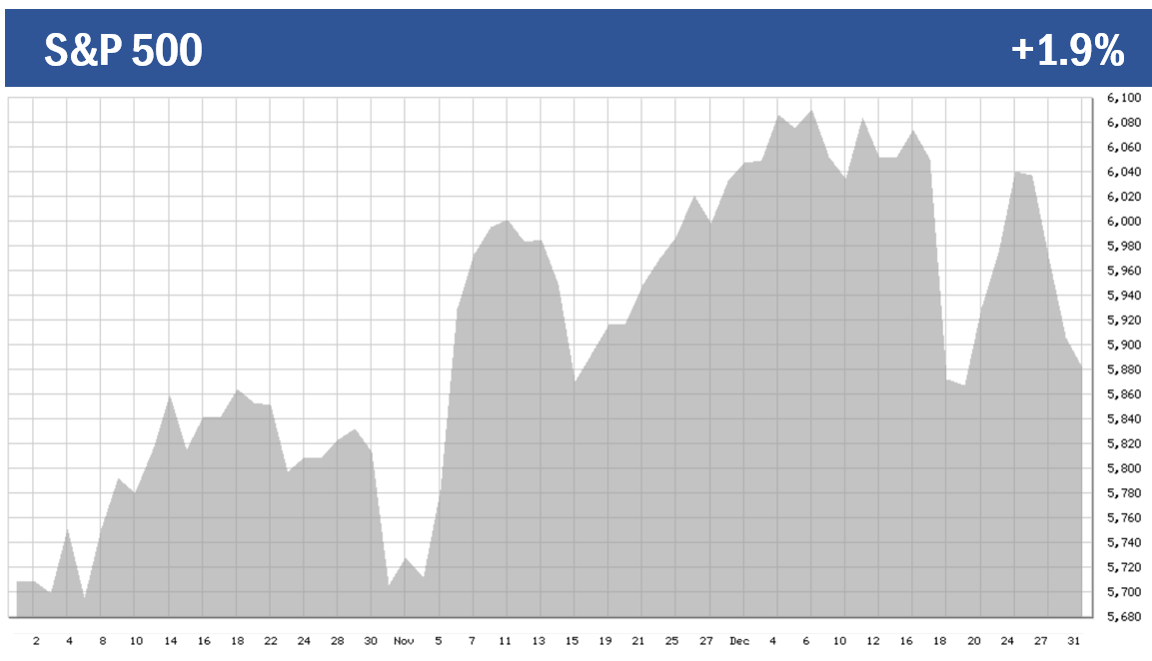
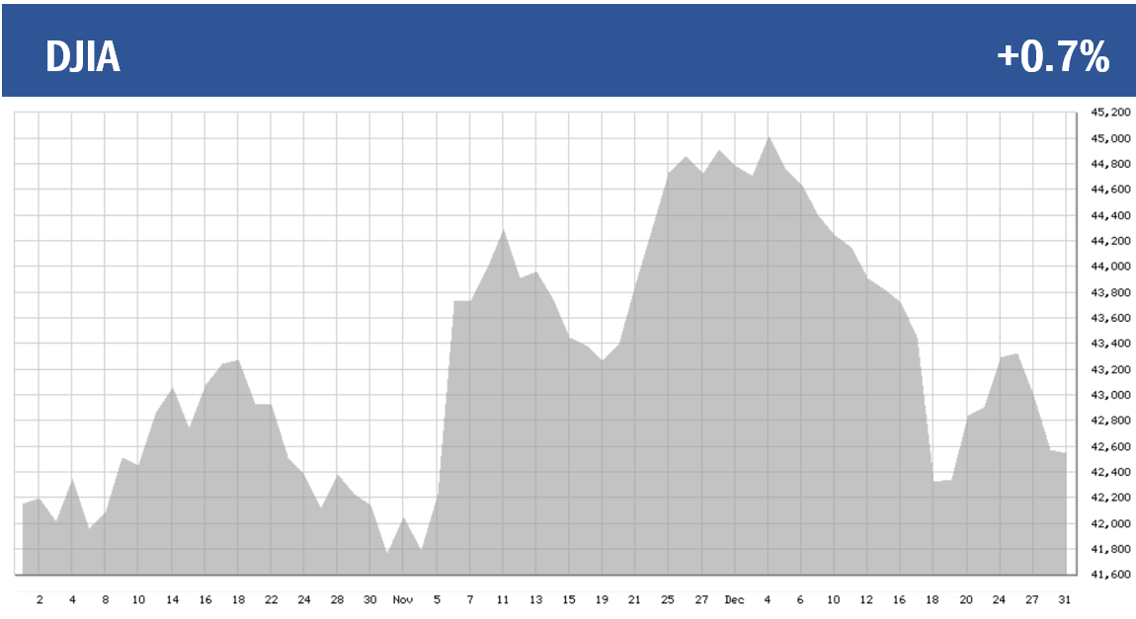
Equity Markets Quarter 4, 2024
Q4: +1.9%
Year-to-Date: +23%
Q4: +0.7%
Year-to-Date: +13%
Chart Source: bigcharts.com
Notes:
As you can see from the charts, the fourth quarter was a roller coaster of a ride for investors. Equities remained highly sensitive to the good news and bad news that kept us on our toes - including lower interest rates, but the potential for the slowing down of monetary easing.
Needless to say, the last quarter of 2024 was not a smooth ride by any means. Volatility remained prevalent for investors.
The S&P 500 ended the quarter up 1.9% and the Dow Jones Industrial Average closed the quarter up 0.7%.
While the fourth quarter was not as sensational as the previous quarters, the S&P 500 ended the year up 23% and the Dow ended the year up 13%.

Slide 4
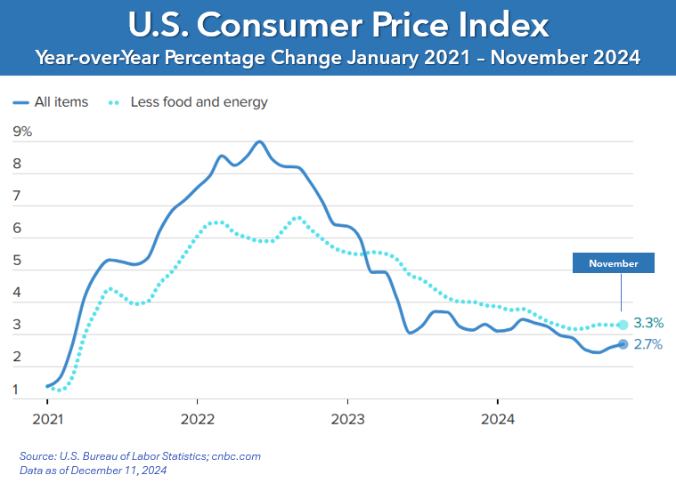
Inflation
November 2024 Overall + 2.7%
Notes:
Inflation remained stubborn. In November, the year-over-year Consumer Price Index (CPI) was 2.7%. The Core CPI (CPI excluding food and energy) was 3.3% year-over- year.
A major contributor to these sticky numbers was the shelter index, which saw a significant increase in the fourth quarter.
While inflation is gradually moving toward the Fed’s 2% target, the persistent nature of inflation and certain proposed economic policies may lead the Federal Open Market Committee to slow its easing efforts in 2025.

Slide 5
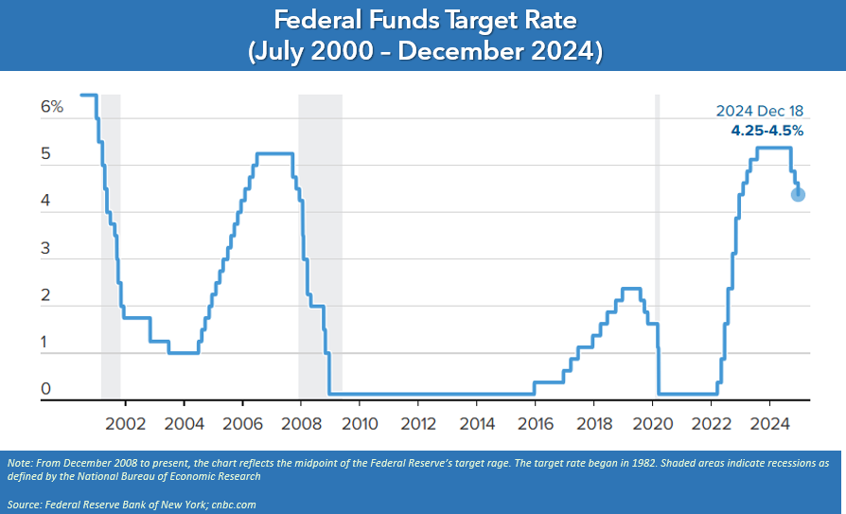
Interest Rates
Notes:
After a 50 basis point reduction in September, The Federal Reserve cut interest rates 25 basis points twice in the fourth quarter of 2024, bringing the total to three cuts for the year. These are the first changes since 11 rate increases from March 2022 to July 2023.
The decision to lower interest rates came in response to key indicators suggesting that economic activity continued to grow at a solid pace, while unemployment rates remained low. Typically, equities respond positively to rate cuts; however, during the December meeting, Fed Chair Jerome Powell indicated that there might be fewer rate cuts in 2025 than were anticipated entering 2024. This cautious outlook led to a quick decline in equity markets.
Interest rates and inflation play a crucial role in investors' financial planning; therefore, we will continue to monitor any changes and stay informed about these key economic indicators.

Slide 6
Bond Market & Treasury Yields
Notes:
As you may know, bonds have an inverse relationship with interest rates—when one goes up, the other usually goes down.
Yields are currently close to multi-decade highs. On December 31, the 10-year note was 4.58%, somewhat higher than the end of the third quarter, when it reached 3.81% and the start of the year when they were at 3.95%. The 20-year treasury ended the fourth quarter at 4.86% and the 30-year note closed at 4.78% (Source: treasury.gov)
The outlook for bonds in 2025 is hazy. Should interest rates continue to fall, bonds should appreciate. However, should inflation start to increase in 2025, interest rates may stagnate or rise.
Bonds can be a part of a well-diversified portfolio because historically they have lower volatility than stocks. With today’s rates they can become more attractive to investors fearful of equity volatility. We typically consider using them bonds for clients based on each client’s unique situation.

Slide 7
Geopolitical Unrest & Changes in the White House
Notes:
The global economy faced ongoing uncertainty during the fourth quarter.
Global tensions remained high, particularly due to the continued Russia-Ukraine war and unrest in the Middle East.
Additionally, a new president was elected during this period, marking the end of a highly contentious campaigning season. Initially, the markets reacted positively to the election results.
With anticipated changes in economic policy and tax laws, there are several key items for us to monitor.
It's important to remember that corporate earnings and the overall economy are the primary drivers of financial markets. We are dedicated to staying informed about any changes that may impact your personal situation.

Slide 8
Continued Bull Market
Notes:
Although there is still a lot of uncertainty in the economy, we are still currently experiencing a bull market. This bull market began in June 2023 after the S&P 500 rose 20% from its low in October 2022.
The past few years have been exceptional for the U.S. stock market. However, inflation is being set up as public enemy #1 for the economy in 2025, and there is a mixed set of outlooks from analysts. Many are optimistic about a continued market rally driven by ongoing AI growth and deregulation, as well as the potential for lower taxes. If interest rates keep going down, this could fuel the stock market forward. However, some are concerned that the U.S. could experience a market correction.
When the S&P index falls more than 10% from a recent high, it is said to have entered "correction" territory. The term “correction” is used because historically the market drop often "corrects" and returns equity prices to their longer-term trend. There have been 24 market corrections since November 1974. They historically happen on average about every 18 months. The S&P 500 did not experience a correction in 2024. Analysts say that corrections are healthy and even necessary for bull markets. They help shake out some of the so-called froth in the stock market, where prices run up too dramatically and get ahead of themselves. Analysts also share that a correction isn’t necessarily something to dread. Most strategists are still predicting solid earnings growth for equities in 2025. With that backdrop, most analysts project stocks will head higher, even if there are some bumps in the road.

Slide 9
Key Takeaways
2024 was a robust year for equities and left investors with positive returns.
The Fed reduced the federal funds rate range three times in 2024, with two being in the fourth quarter.
Inflation pressures remain stubborn.
2025 brings a host of challenges that can create uncertainty and market volatility.
Be well prepared with a long-term perspective.
We are here for you to discuss any questions or concerns you may have.
Notes:
As a recap, here are some things to remember:
2024 was a robust year for equities and left investors with positive returns. The U.S. economy has been strong, and long-term investors were rewarded with significant returns.
The Fed reduced the federal funds rate range three times in 2024, with two being in the fourth quarter.
Inflation pressures are still being stubborn.
2025 brings a host of challenges which are creating uncertainty and market volatility. The key items we will be keeping a close eye on include proposed tax law changes, proposed tariffs, monetary policy changes, stubborn inflation rates, and geopolitical issues.
Be well prepared. Maintaining the consistency of a well-devised, long-term focused plan has historically served investors well.
We are here for you to discuss any questions or concerns you may have.

Slide 10
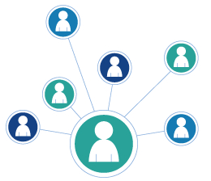
We appreciate you!
The best compliment is a referral!
Add someone to our mailing list
Invite them to attend a presentation
Thank you!
Notes:
We are grateful for our clients and value the opportunity to accompany you on your financial journey.
Our goal is to assist more people like you!
The highest compliment we can receive is a referral. Many of our most satisfied clients were introduced to us by existing clients. If you know someone who could benefit from our services, please consider sharing this video or adding them to our mailing list. We would be honored if you could provide us with their contact information so that we can add them to our distribution list. This will enable them to receive our newsletters and invitations to watch or attend our presentations.
Once again, thank you for your trust in us. One of our main objectives is to keep our clients informed, and we appreciate you taking the time to watch this update. Please feel free to call us if you have any question.

Slide 11
Insert registered branch office address and phone number, as well as broker-dealer identification/disclosure
The views expressed are not necessarily the opinion of Insert Broker-dealer name. Information is based on sources believed to be reliable, however, their accuracy or completeness cannot be guaranteed.
Investing involves risk including the potential loss of principal. No investment strategy can guarantee a profit or protect against loss in periods of declining values. Past performance is no guarantee of future results. Diversification and strategic asset allocation do not ensure a profit or protect against a loss. The process of rebalancing may carry tax consequences.
This information is not intended to be a substitute for specific individualized tax, legal, or investment planning advice. You should discuss any tax, legal or investment planning matters with the appropriate professional.
All indexes are unmanaged and cannot be invested into directly. Unmanaged index returns do not reflect fees, expenses, or sales charges. Index performance is not indicative of the performance of any investment. Economic forecasts set forth may not develop as predicted and there can be no guarantee that strategies promoted will be successful. International investing involves special risks such as currency fluctuation and political instability and may not be suitable for all investors.
The S&P 500 is an unmanaged index of 500 widely held stocks that is generally considered representative of the U.S. Stock market. The Dow Jones Industrial Average (DJIA) commonly known as “The Dow”, is an index representing 30 stocks of companies maintained and reviewed by the editors of the Wall Street Journal. Index performance does not include transaction costs or other fees, which will affect actual investment performance. Individual investor’s results will vary.
Contents provided by: The Academy of Preferred Financial Advisors, Inc. © 2025. All rights reserved.

