Slide 1
Quarter 1 2025 Economic Review
Presented By: Your Name Company
Notes:
Hello, clients and friends. This is ___________________ from __________________, and it’s my pleasure to present our first quarter economic review.
As you watch this, please keep in mind it is a review of the months of January through March. Since then, April has presented some very challenging times for investors, so I (we) will be addressing that at the end of this brief presentation.

Slide 2
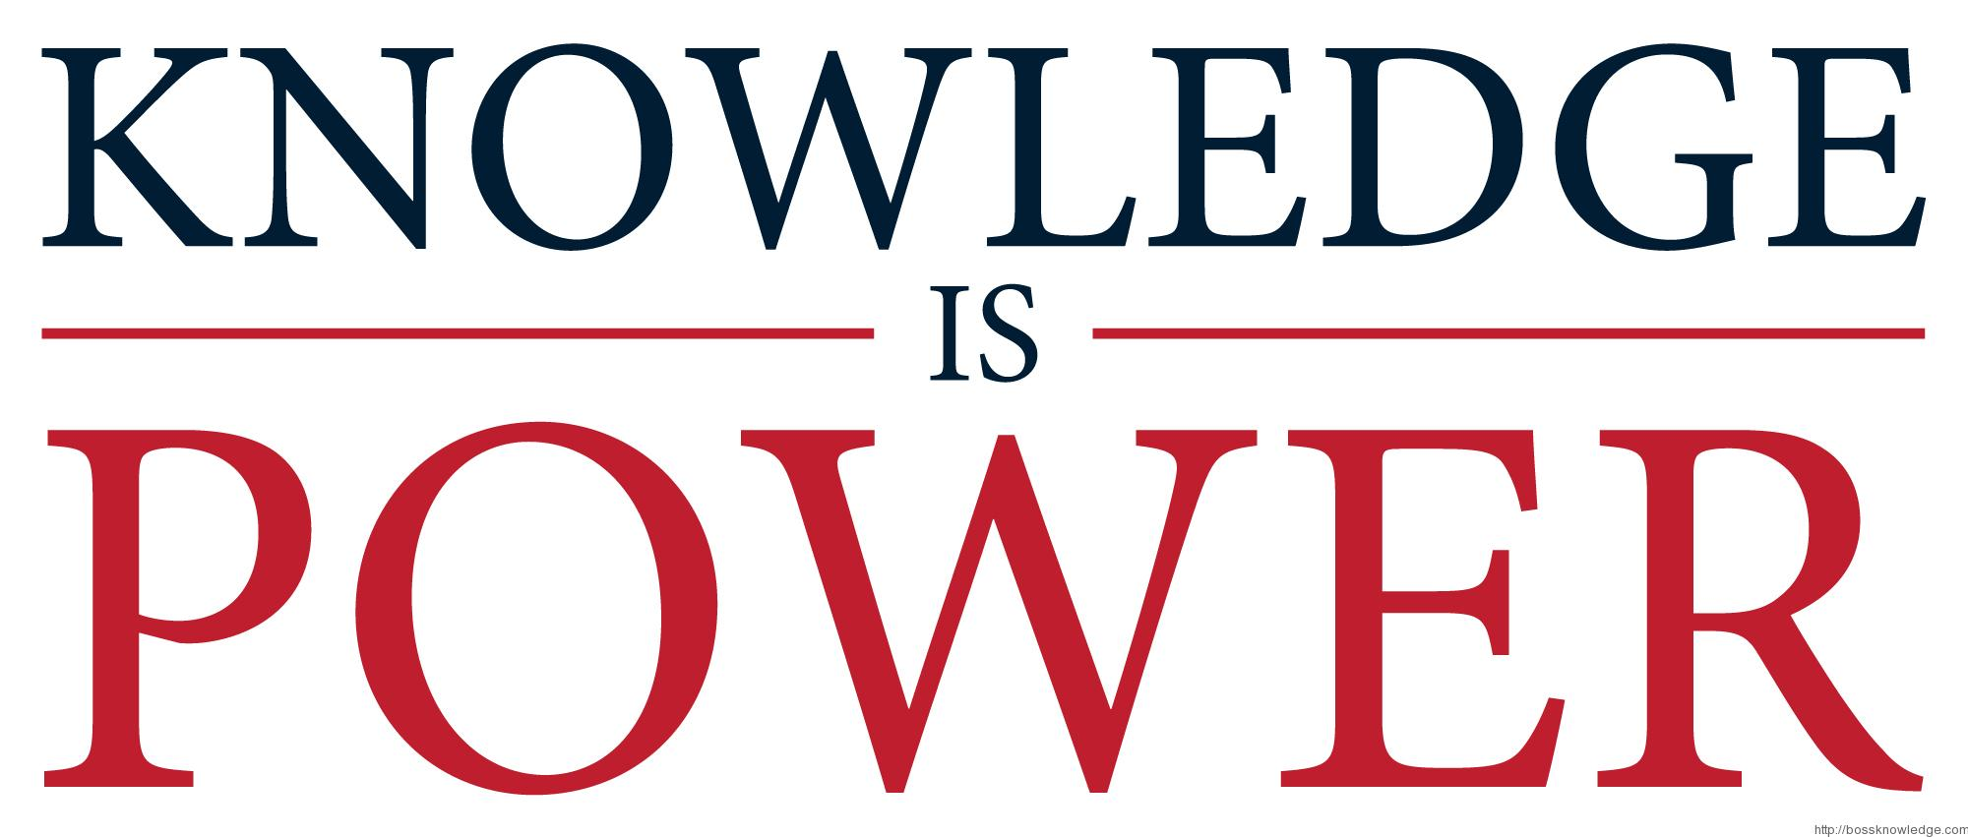
An Educated Client Is Our Best Client!
Notes:
Let’s begin.
At our firm, we partner with clients and believe an educated client is our best client. While we will always try our best to help you with your finances, we believe that knowledge is power. One of our missions is to share any knowledge with clients to help them make an informed decision.

Slide 3
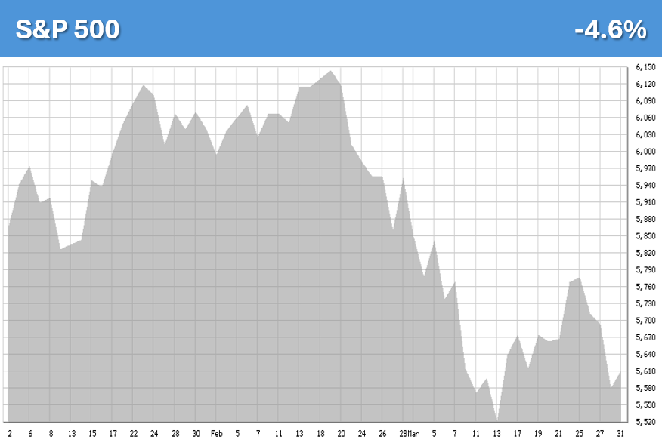
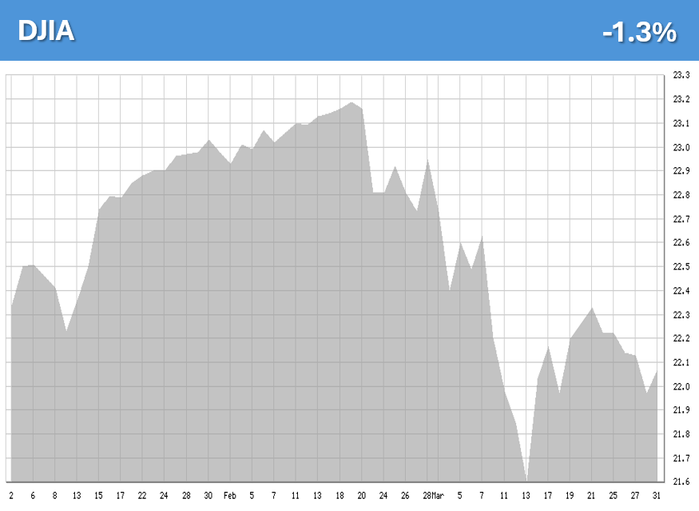
Equity Markets Quarter 1 2025
Q1: -4.6%
Q1: -1.3%
Chart Source: bigcharts.com
Notes:
As you can see from the charts, the first quarter was a rollercoaster ride for investors. We entered 2025 with continued strength from 2024 and in mid-February equity markets made another round of all-time highs, but then after two robust years for equities, investor sentiment quickly did an about-face.
Uncertainties and changes quickly dominated the headlines and equities experienced a quick downfall during the last six weeks of the quarter. The transitional period between new administrations typically brings adjustments and with those changes comes volatility. As promised, the United States’ new administration has an aggressive agenda, and President Trump’s first priority was to implement quick and sweeping changes.
Equities reacted to the uncertainty during the quarter by going near or into correction territory as investors became wary, particularly over global trade wars, new tariffs and their effect on the economy.
At the first quarter’s end the S&P 500 was down 4.6% Year to date and the Dow Jones Industrial Average was down 1.3%

Slide 4
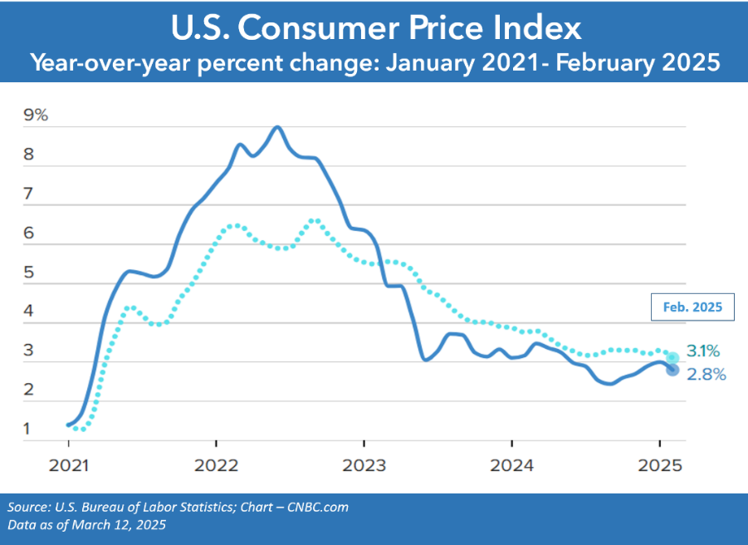
Inflation
February 2025 Overall 2.8%
Core 3.1%
Notes:
Good news arrived with better-than-expected inflation numbers, which showed that U.S. inflation decreased to 2.8% in February, down from 3% in January 2025. The core CPI, which excludes food and energy prices and is often viewed by economists as a better gauge of future inflation, was 3.1%. The increase in shelter costs in February accounted for nearly 50% of the overall CPI rise.
While inflation is gradually moving toward the Fed’s 2% target, we are still not there yet.

Slide 5
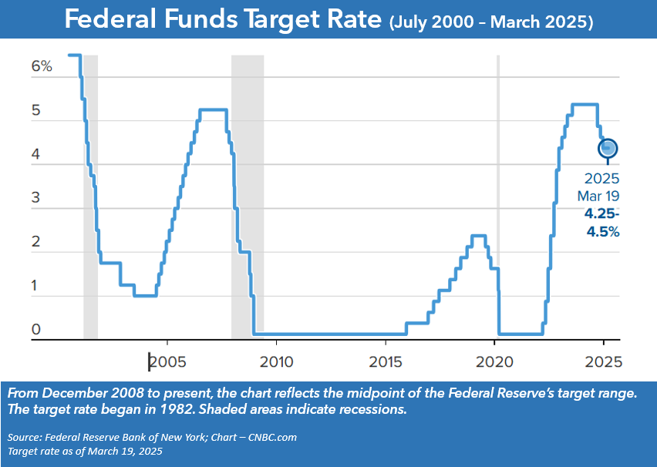
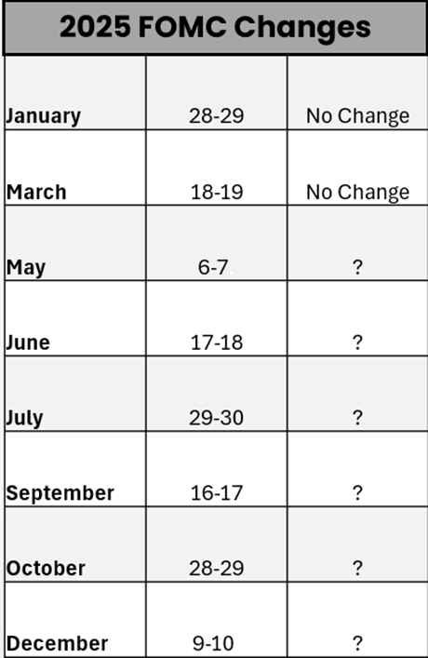
Interest Rates
Notes:
After reducing the federal funds rate three times in 2024, the Feds felt it appropriate to keep rates stagnant at 4.25 – 4.5% at both of their first quarter meetings.
The Fed is vigilant in monitoring key economic indicators, including labor market conditions, inflation pressures and expectations, as well as financial and international developments. With two Fed meetings scheduled for the second quarter and four more planned for the second half of the year, the Fed has indicated that further rate cuts will be contingent upon inflation trends and economic conditions.

Slide 6
Bond Market & Treasury Yields
Notes:
Bonds have an inverse relationship with interest rates—when one goes up, the other usually goes down.
Yields ended the quarter slightly lower than where they started. On March 31, the 10-year note was 4.23%, the 20-year treasury ended the first quarter at 4.62% and the 30-year note closed at 4.59% (Source: treasury.gov)
The current outlook for bonds in 2025 remain unclear. Uncertainty about interest rates, inflation trends, and clarity on tariffs currently remain therefore you can expect bond yields to fluctuate.
Bonds can be a part of a well-diversified portfolio because, historically, they have lower volatility than stocks.

Slide 7
New Administration
Notes:
The transitional time between new administrations typically brings some uncertainty which leads to volatility.
This new administration came in as it indicated it would, and President Trump’s first agenda was to make quick and sweeping change. Optimistic investor sentiment quickly waned as some of the more aggressive campaign promises began to materialize. Towards the second half of the quarter investors become wary, and concerns over global trade wars and the tariffs created very high levels of anxiety.

Slide 8
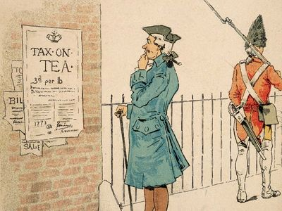
What is a Tariff?
A tariff is a tax imposed on goods imported or exported between countries. Tariffs are a type of trade barrier that can raise prices and reduce the availability of goods and services.
Notes:
Now, let’s briefly address the elephant in the room – tariffs. Right now, you cannot turn on a news report without hearing about tariffs. But what exactly is a tariff? Are they a good thing? Are they a bad thing? Tariffs themselves don’t necessarily cause volatility. It is how they are applied and an investor's reaction to them that can create instability in equity markets.
Tariffs have been used by many countries including the United States for centuries. A tariff is a tax on goods that are imported or exported between countries. They are a type of trade barrier that can raise availability prices and reduce the availability of goods and services.
How do tariffs work? Companies that import foreign goods pay the tariff to the government. Tariffs can be a percentage of the value of the imported product, or they can be a flat tax charged on each imported good.
Why are tariffs used? Tariffs are used to protect domestic industries and jobs. They can also be used to punish or discourage actions a country disapproves of.
What are the effects of tariffs? Tariffs can increase the cost of production and the cost to the consumer. They can also create tensions between countries and lead to trade wars and they can negatively affect the stock prices of companies that rely on imported goods.

Slide 9
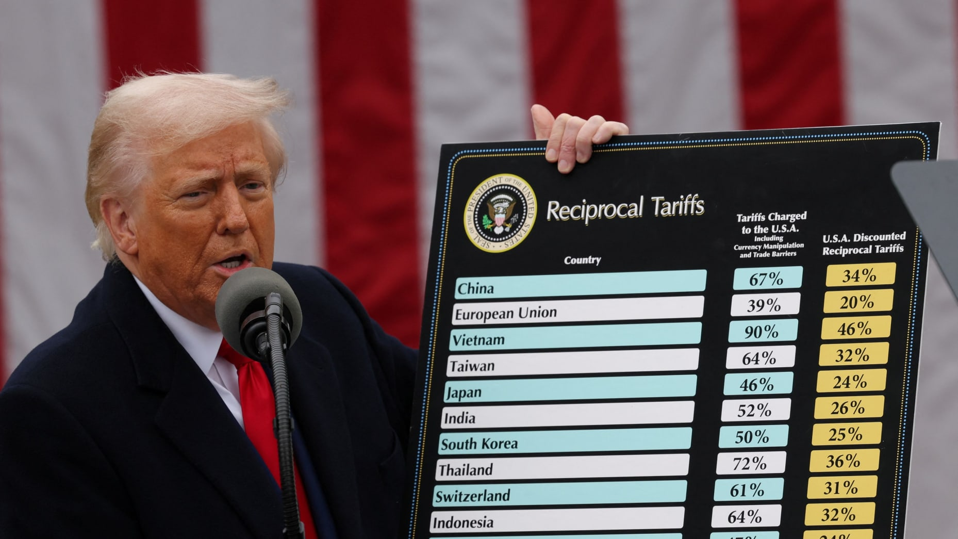
Tariffs and Global Trade Wars
Notes:
The new administration proposed tariffs and they have become a nightly news agenda item and a widely discussed topic, with sizable concerns about their potential impact on the U.S. economy.
The Trump administration announced multiple tariffs. The administration feels it will protect domestic industries and boost sales of American-made products by taxing imports from all countries. The White House has suggested that these tariffs will grow the American economy, help reduce our deficit and create jobs. The administration is claiming that the tariffs are reciprocal and discounted to the tariffs that other countries place on the United States.
During the first quarter, when these tariffs were discussed the S&P 500 dipped into correction territory. As President Trump began getting specific and the administration was announcing enactment of the tariffs, in the first week of April, U.S. and global equities retreated in a quick and alarming way and, as of this update, U.S. market have even reached bear market territory – which is generally defined as a decline of 20% or more from a recent high.
As of now, the level of uncertainty is high and we do not know the specifics as to how much this will affect the economy and inflation moving forward. We remain committed to keeping a watchful eye on these tariffs and their effects on our client’s investment portfolios.

Slide 10
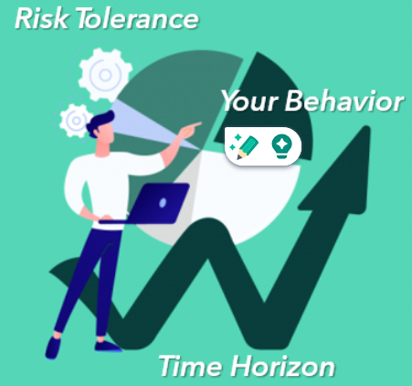
Maintain FOCUS on what you can control!
Notes:
We understand that the recent volatility of the stock mark is very uncomfortable. The combination of a market correction and political uncertainty has been mostly helpful for media outlets who use fright as a method of attracting viewers. Its easy to become concerned and alarmed when equity markets move down swiftly, but focusing on what you can control is important.
The nightly news can become frightening but that’s when you need to stay away from making emotionally based decisions. Three of the major things you can control are your behavior, your risk tolerance or appetite, and your time horizon.
It is often said that investors can lose more money by making bad decisions than they can from market declines. Short-term market movements are nearly impossible to predict so that why we share with clients that we believe in proactive planning with a well-diversified portfolio that considers your risk tolerance and time horizon.
Your equity investments are long-term and you need to be prepared that at any given time they will go down in value. We encourage you to limit your exposure to inflammatory or upsetting media reports and news. Remembering you are invested for the long-term can help you stay well-grounded in times of volatility.

Slide 11
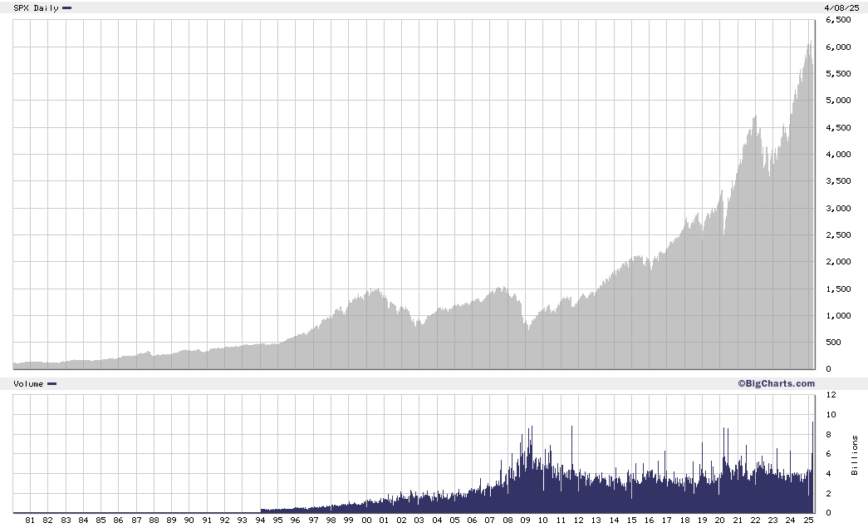
Equities are a long-term investment!
S&P 500 Index 1/1/1980 – 4/9/2025
Green 40 Years
Purple 30 Years
Blue 20 Years
Chart Source: bigcharts.com
Notes:
Once again, we encourage long-term investing, so as you unemotionally look at a 45-year chart of equity returns, we are once again reminded that over a 40, 30 or 20-year timeframe, even with some very severe occurrences and downturns, historically long-term investors have been rewarded.

Slide 12
Key Takeaways
The S&P 500 entered correction territory in the first quarter of 2025.
Tariffs have had a significant impact on equities and investors are experiencing a downfall.
The federal funds rate range remained at 4.25 – 4.5%. As of March, the Feds are still forecasting two rate cuts in 2025.
U.S. inflation decreased to 2.8% in February, down from 3% in January 2025.
Bonds can be a less volatile alternative to equities and an additional option for a well-diversified portfolio.
Focus on what you can control and minimize your exposure to inflammatory news.
Market declines are part of the investment experience.
Maintaining a well-devised, long-term focused plan has historically served investors well.
We are here to discuss any questions or concerns you may have.
Notes:
As a recap, here are some things to remember:
After two robust years for equities, the S&P 500 entered correction territory in the first quarter of 2025.
The new administration brought many changes, including tariffs, which have had a significant impact on equities and investors have experienced a rapid downfall.
The Fed held the federal funds rate range steady at 4.25 – 4.5% and as of March, they are still forecasting possible rate cuts in 2025.
Better than expected inflation numbers came in showing that U.S. inflation decreased to 2.8% in February, down from 3% in January 2025.
Bonds present a less volatile alternative to equities and an additional option for those looking to diversify their portfolio.
Focusing on what you can control and minimizing your exposure to inflammatory news can help you stay well-grounded in times of volatility.
Market declines are part of the investment experience and maintaining the consistency of a well-devised, long-term focused plan has historically served investors well.
And finally remember, We are here for you to discuss any questions or concerns you may have.

Slide 13
Insert registered branch office address and phone number, as well as broker-dealer identification/disclosure
The views expressed are not necessarily the opinion of Insert Broker-dealer name. Information is based on sources believed to be reliable, however, their accuracy or completeness cannot be guaranteed.
Investing involves risk including the potential loss of principal. No investment strategy can guarantee a profit or protect against loss in periods of declining values. Past performance is no guarantee of future results. Diversification and strategic asset allocation do not ensure a profit or protect against a loss. The process of rebalancing may carry tax consequences.
This information is not intended to be a substitute for specific individualized tax, legal, or investment planning advice. You should discuss any tax, legal or investment planning matters with the appropriate professional.
All indexes are unmanaged and cannot be invested into directly. Unmanaged index returns do not reflect fees, expenses, or sales charges. Index performance is not indicative of the performance of any investment. Economic forecasts set forth may not develop as predicted and there can be no guarantee that strategies promoted will be successful. International investing involves special risks such as currency fluctuation and political instability and may not be suitable for all investors.
The S&P 500 is an unmanaged index of 500 widely held stocks that is generally considered representative of the U.S. Stock market. The Dow Jones Industrial Average (DJIA) commonly known as “The Dow”, is an index representing 30 stocks of companies maintained and reviewed by the editors of the Wall Street Journal. Index performance does not include transaction costs or other fees, which will affect actual investment performance. Individual investor’s results will vary.
Contents provided by: The Academy of Preferred Financial Advisors, Inc. © 2025. All rights reserved.

Slide 14
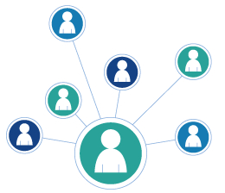
We appreciate you!
Please feel comfortable sharing this update with others!
Thank you!
Notes:
Once again, thank you for your trust in us. One of our main objectives is to keep our clients informed, and we appreciate you taking the time to watch this update.
Please feel comfortable sharing this update with anyone else you think can benefit from it.

