Slide 1

Managing Your Wealth in 2025
Including Proactive Tax Planning Strategies
Presented By:
Your Name
Company
Notes:
Hello clients and friends. This is ___________________ from __________________ and it’s my pleasure to present our Managing Your Wealth in 2025 workshop.

Slide 2

An Educated Client Is Our Best Client!
Notes:
At our firm, we partner with clients and believe an educated client is our best client. While we will always try our best to help you, when it comes to your finances, we believe that knowledge is power. One of our missions is to share with clients any knowledge that can better help them make an informed decision.

Slide 3


Five Key Areas of Financial Planning
Preservation Planning
Retirement Planning
Tax Planning
Estate Planning
Investment Planning
Notes:
Before we begin, it is always important to review that there are five key areas of financial planning.
They are:
Preservation Planning,
Retirement Planning,
Tax Planning,
Estate Planning, and
Investment Planning
As a comprehensive financial services firm, we try to always consider the impact of any recommendation we make on not just one, but all these areas for our clients.
Today's presentation will be focused on investment planning and equity markets, and we will also share with you some proactive tax planning strategies.

Slide 4


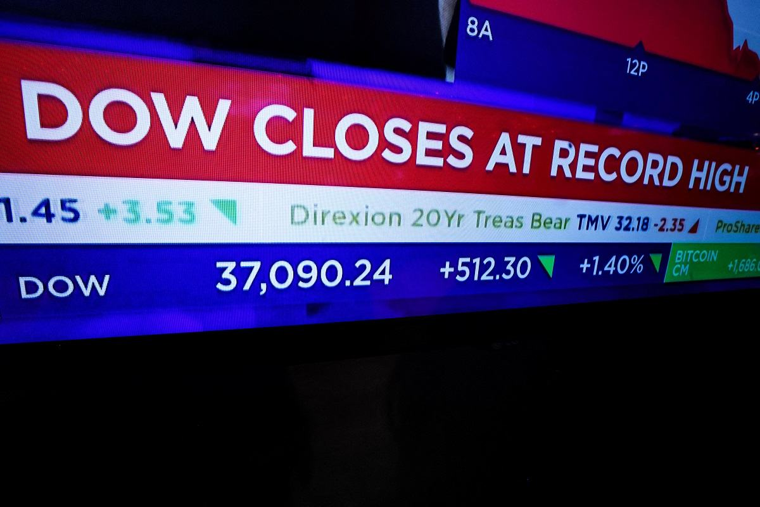
2024 was another good year for investors!
The S&P 500 Has Roared to Over 50 Record Highs in 2024!
Notes:
After a strong year in 2023, Many analysts felt that 2024 was going to be a difficult year for investors.
Heading into the year they forecasted a fair amount of uncertainty, including a very controversial and highly heated presidential election and unrest in Europe and the Middle East.
When 2024 ended, it was another good year for investors. Equity markets made multiple new highs and disciplined long-term investors were rewarded for a second consecutive year.

Slide 5
Strong Year for Investors in 2024
S&P 500 Index 1/1/2024 -- 12/31/2024
Chart Source: Bigcharts.com
Notes:
As you could see by this chart, although in 2024 the markets finished considerably higher than where they started, they clearly did not move in a straight line.
Investors saw markets retreat in April, August, September, and November and even December.
It’s worth noting that those who stayed the course in 2024 were rewarded.
For the second straight year, the S&P 500 finished the year with a gain of more than 20% while the Dow Jones industrial average ended the year up more than 13%.

Slide 6
2024 Equity Market Review
2024 was a good year for investors.
Inflation moved closer to the Fed’s 2% goal.
Interest rates were cut three times in 2024.
The economy was strong in 2024.
Volatility returned in the last few months.
Notes:
Now let’s take a brief look back at some highlights from 2024.
As mentioned, 2024 was a good year for investors.
Inflation continued to move closer to the Fed’s goal of 2% but is still elevated.
In September, the Fed made the first of three straight interest rate cuts to end 2024 and that brought a sigh of relief for investors.
Many of the key indicators that economists watch remained healthy during 2024,and
Volatility returned in a strong way, especially in the last 2 months of 2024 and continues to remain. Because of this, please remember, a well-balanced portfolio should be designed to include proper diversification to address times of volatility.
Overall, 2024 was a good year for investors and 2025 has already started on a positive note!

Slide 7
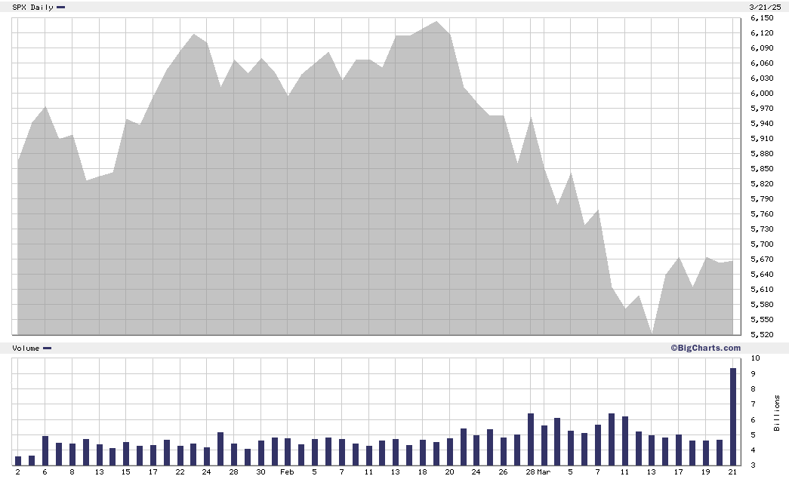
2025 Equity Markets
S&P 500
January 1 – March 24, 2025
Source: bigcharts.com
Notes:
For 2025, volatility has returned to the equity markets in a big way. January and February saw some advancement to all-time highs, but from mid-February to today we have seen some retreat. While the media headlines can make the downward movements sound disastrous, market volatility and pullbacks are a normal part of an investing experience. While market movements downward can cause some stress, so far for 2025, the S&P 500 Index has had a pullback that can be uncomfortable, but is not uncommon to those who follow the investment world.

Slide 8
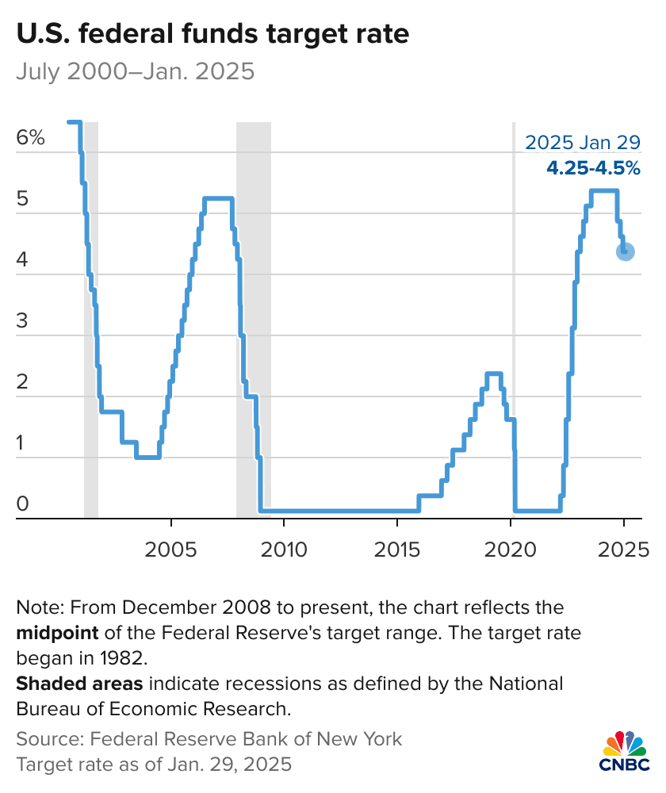
Federal Reserve Rates
Notes:
In 2024, investors saw the last three of eight Fed meetings produce interest rate reductions. However, the Fed’s meeting notes from December 2024, suggested that 2025 would probably start with a pause.
After starting the year with a range of 5.25 to 5.5%, the Fed ended the year with their key rate at 4.25 to 4.5%. In their January and March 2025 meetings they kept the Federal Funds rate at 4.25 to 4.5%
Remember the Fed remains committed to achieving a 2% inflation rate goal, therefore interest rates and their direction in 2025 still needs to be watched.

Slide 9
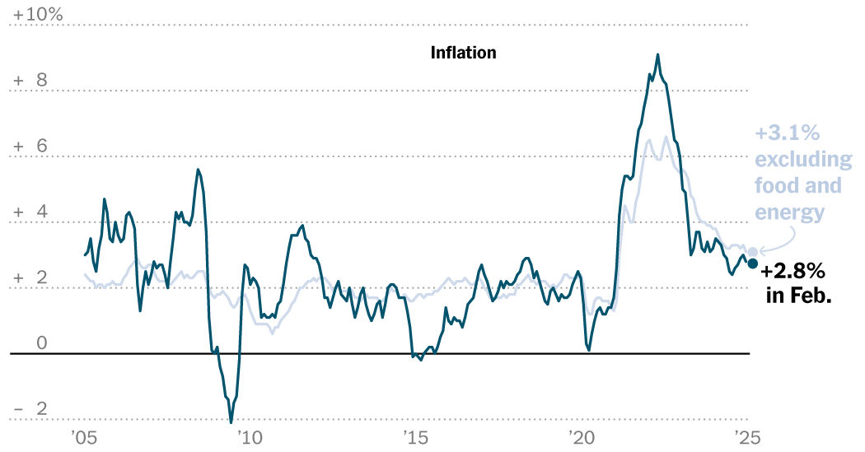
Inflation
Inflation (2005 – February 2025)
January 2024
3.4%
December 2024
2.9%
January 2025
3.0%
February 2025
2.8%
Source: New York Times 3/12/2025
Notes:
The consumer price index is a key inflation gauge. While we’ve seen results from the feds aggressive campaign to lower inflation from its high of over 9% in June 2022, it is still not at their 2% goal.
For January 2024, the inflation rate was 3.4% and December 2024’s rate of 2.9% pleasantly surprised many.
As reported in February, the inflation results for January 2025 showed a very slight uptick to 3% year over year. Then in March, the February results came in at 2.8%.
Although inflation is far better than it has been since it started to spike in 2021, it is currently still increasing prices and acting stubbornly. This may affect the timeline as to if, or when interest rates continue to move downward.

Slide 10

Inflation
Inflation rates are down from 2022 but are still trending at or near 3%.
Notes:
As consumers we feel price increases and that’s why inflation at high numbers is challenging.
Anyone who walks thru the grocery store regularly is constantly reminded that prices of good have risen over the last few years.
As financial professionals, Inflation is something we watch.

Slide 11

Interest Rates and Bonds
Bond Prices Have an Inverse
Relationship with Interest Rates
Bond Prices
Interest Rates
Interest Rates
Bond Prices
Notes:
As you may know, bonds and interest rates move in the opposite direction. When interest rates rise, existing bond prices tend to fall, and conversely, when interest rates decline, existing bond prices tend to rise.

Slide 12

Bond Market & Treasury Yields
Treasury Par Yield Curve Rates |  |  |  | Treasury Par Yield Curve Rates December 29, 2023
January 2, 2024 |  |  |  | December 31, 2024 |  |  |  | March 3, 2025
5-year | 10-year | 20-year | 30-year | 5-year | 10-year | 20-year | 30-year | 5-year | 10-year | 20-year | 30-year
3.93% | 3.95% | 4.25% | 4.08% | 4.38% | 4.58% | 4.86% | 4.78% | 3.97% | 4.16% | 4.49% | 4.45%
Treasury.gov |  |  |  | Treasury.gov
Notes:
Even though the Fed reduced the Federal Funds rate three times during the year, the interest rates on treasury notes and bonds ended 2024 higher than they started. On December 31, 2024, 5-year Treasury notes yielded 4.38%, 10-year notes yielded 4.58%, 20-year bonds yielded 4.86%, and 30-year bonds finished at 4.78%.
As of March 3, 2025, rates were slightly down from the December rates.
We continue to closely monitor interest rate movements. With the current forecast of future Fed interest rate cuts to be paused, there can be some opportunities to find some lower-risk, higher-yielding bonds.

Slide 13

Cost of Safety
Notes:
Safety comes with a cost and even though interest rates have risen many major banks are still averaging low interest and CD rates to savers.
For anyone who is interested in exploring better interest rate options, please contact our office.

Slide 14
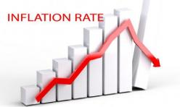
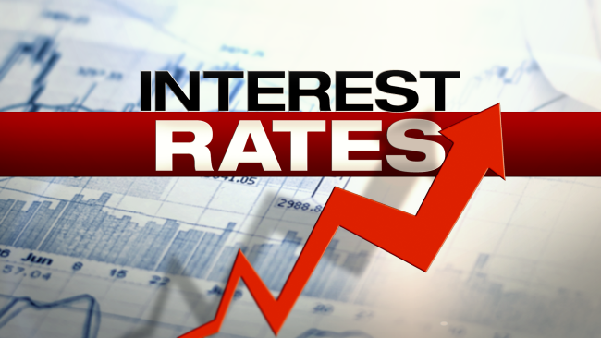

2025 Investor Outlook
Notes:
For 2025, we are excited about the returns 2024 brought and have reasons to be optimistic, but there are still some major issues that we need to watch carefully.
Interest rates and inflation will continue to be two of the top factors that will affect the direction of the economy and equities.
Other issues that could affect the direction of equity markets include the new administration. This new administration talked about making changes to tax laws and possibly using tariffs to balance trade with other countries. Talks of tariffs can bring uncertainty and equity markets do not like uncertainty. Please remember that changes in tax laws can take time, and sometimes they do not go into effect immediately.
We are also still seeing continuing geopolitical unrest in the Middle East and there is still an ongoing Russia-Ukraine war. Tensions with China will also remain a concern. The global economy will also continue to be a concern in 2025. Equities don’t like geopolitical or global economic uncertainty, so we will continue to keep an eye on how they may affect the equity markets
As your financial professionals, we are committed to keeping you apprised of any changes and activities that could directly affect you and your unique situation.

Slide 15

2025 Fed Rates
What is the Federal Reserve?
2025 FOMC Changes
January | 28-29 | No Change
March | 18-19 | No Change
May | 6-7. | ?
June | 17-18 | ?
July | 29-30 | ?
September | 16-17 | ?
October | 28-29 | ?
December | 9-10. | ?
Often referred to as “The Fed,” it is the central bank of the United States.
The Federal Reserve exists to create control over the U.S. monetary system. It was created in 1913 in response to a banking panic, with a goal of ensuring that similar panics would be better controlled in the future.
The Fed’s central purpose is what’s called the dual mandate – to maximize employment and to stabilize prices.
Notes:
So, what has historically happened to equities when the Fed moves rates?
Let’s remember, that the Federal Reserve was created in 1913 as a response to the banking panic of the time. Their central purpose is to uphold what is referred to as a dual mandate. That is to maximize employment and stabilize prices - which essentially means to keep inflation in check.
They are scheduled to meet eight times this year. At their March session they paused moving rates and indicated that economic conditions will determine future moves. For now, investors will have to wait-and-see if they will continue to reduce interest rates during meetings later this year.
The results of the Fed’s meetings and discussions always present the possibility of immediate temporary equity market movements, and if that happens, investors should try not to overreact.

Slide 16
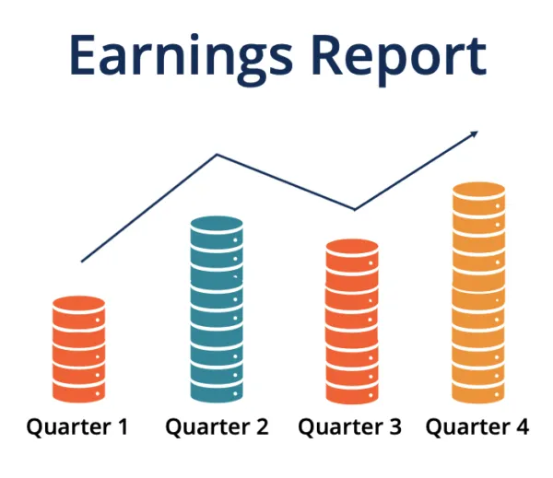

Corporate Earnings
What are earnings per share (EPS)?
A metric investors commonly use to value a stock or company because it indicated the profitability of a company on a per-share basis.
EPS Numbers are most useful when evaluated along with other metrics such as price-to-earnings (P/E) ratio, and the return on equity (ROE).
Net Income – Preferred Dividends
= EPS
Shares Outstanding
Notes:
Equities primarily respond to corporate earnings.
In 2024, corporate earnings reports, for the most part, were healthy and starting in 2025, a majority of companies that have already reported earnings have shown growth. This is good for the economy and one of the reasons why the equity markets have done well.
One of our goals as financial professionals is to keep monitoring these results so we can advise our clients moving forward.

Slide 17

Helping clients make informed financial decisions can lead to better outcomes!
Notes:
One of our primary goals is to help our clients make more informed financial decisions which could lead to better outcomes. So, let’s take a few minute to go over some key 2025 items to look out for.

Slide 18

Equity Market Outlook
Markets DO NOT move in a straight line
and equities are a long-term commitment.
A long-term strategy needs to be
the benchmark for smart investors.
Notes:
2023 and 2024 rewarded long-term investors and 2025 has started on a healthy note. We continue to follow the understanding that investing in equities is a long-term commitment and we are still recommending equities as a long-term investment.
Just because returns have done well, this is not the time to become complacent or make risky decisions. Heading into a new year, we believe that volatility could still be prevalent and that investors should be cautionary when making financial decisions. Again, a long-term strategy and measurement needs to continue to be the benchmark for smart investors.

Slide 19
Potential for a “Correction” in 2025
Before
Many factors, like an external crisis and an “overheated” market, could cause a correction.
Correction
A market correction is a drop of between 10 to 20%.
After
While a correction could potentially lead to a bear market, historically, the market eventually corrects to its longer-term trend, and that is why it’s called a correction.
Notes:
Markets enjoyed strong annual equity returns in 2023 and 2024: both up over 20%, compared with the long-run average of about 10%. Right now, we are experiencing a long-anticipated market pullback. History teaches us that after great returns that we need to be prepared for a pullback. Also, valuations of some leading equities were historically high, which is another indicator that it equities could see this pullback during 2025. Having said that, it is nearly impossible to determine when the tide shifts, so long-term investors need to understand pullbacks are part of the experience. You want to avoid trying to time equity markets.
When the S &P index falls more than 10% from a recent high point it is said to have entered “correction” territory. There have been 24 market corrections since November 1974. They historically happen on average about every 18 months. The term “correction” is used because historically the market drop often "corrects" and returns equity prices to their longer-term trend at some point in time. The S&P 500 did not experience a correction in 2024. Technically, for 2025 we have seen one, with a drop from the high of a fraction more than 10%.
Analysts share that corrections are healthy and even necessary for the equity markets. They help shake out some of the so-called ‘froth” in the stock market, where prices run up too dramatically and get ahead of themselves. Analysts also remind us that a correction isn’t necessarily something to dread. Many strategists are still predicting solid earnings growth for equities in 2025. With that backdrop, stocks could head higher this year, even if there are some bumps in the road. We are only sharing this as a way to alert you that when you see equities drop, do not panic. If you get concerned should this happen, your first move is to call us.

Slide 20

Equity Market Outlook
Inflation is still a factor.
Interest rates might stagnate.
The Economy is still showing signs of strength.
Volatility can cause concerns.
Proactive planning is key to a solid financial strategy.
Notes:
What else should investors still be looking at in 2025?
Inflation is not at the Fed’s desired 2% goal. Because of this, look for possible interest rate stagnation.
The economy and many economic indicators like corporate earnings and unemployment are still showing signs of strength.
The return of equity market volatility can unnerve even the savviest of investors.
Having a solid investment strategy is an integral part of a well-devised, holistic financial plan. Remember, we help clients create a well-crafted plan customized for their unique situation and goals. We consider many variables including your time horizon, tax implications, liquidity needs, risk tolerance, and overall personal objectives.
Most importantly, as always, we are here for you! As stewards of your wealth, we are here to help you pursue your goals.

Slide 21

Proactive tax planning…
…should always be a key focus when reviewing your personal financial situation.
Notes:
Now, let’s talk about proactive tax planning. We feel it is important to remember that proactive tax planning should always be a key focus when reviewing your financial situation.
We believe that a proactive approach to looking at your tax situation can lead to better results than a reactive approach.
Tax laws seem to always be changing. 2025 looks like it could be a year of major change for tax laws. One of our goals is to point out as many tax saving opportunities and strategies as possible for clients. Let’s briefly review some broad tax information and some potential tax reduction ideas based on current laws.
Please remember that not all ideas may be appropriate for your personal situation. This is for informational purposes only and we always recommend you always address any tax strategy with a tax knowledgeable professional.

Slide 22

Proactive Tax Planning
for 2025
Notes:
Let’s look at some helpful proactive tax planning strategies.

Slide 23
2025 Tax Brackets
Tax Rate | Single | Head of Household | Married Filing Jointly or Surviving Spouse | Married Filing Separately
10% | $0- $11,925 | $0- $17,000 | $0- $23,850 | $0- $11,925
12% | $11,926- $48,475 | $17,001- $64,850 | $23,851- $96,950 | $11,926- $48,475
22% | $48,476-$103,350 | $64,851-$103,350 | $96,951-$206,700 | $48,476-$103,350
24% | $103,351-$197,300 | $103,351-$197,300 | $206,701-$394,600 | $103,351-$197,300
32% | $197,301-$250,525 | $197,301-$250,500 | $394,601-$501,050 | $197,301-$250,525
35% | $250,526-$626,350 | $250,501-$626,350 | $501,051-$751,600 | $250,526-$375-800
37% | Over $626,350 | Over $626,350 | Over $751,600 | Over $375,800
Source: irs.gov
Notes:
The IRS has already released 2025 tax brackets.
There are still seven federal income tax brackets which have been slightly adjusted from 2024.

Slide 24
2025 Long-term Capital Gains Tax Rates
Tax Rates | Single | Married Joint Filers
0% | $0 – 48,350 | $0 - $96,700
15% | $48,350 - $533,400 | $96,700 - $600,050
20% | $533,400 and up | $600,050 and up
Source: Tax Foundation. Note: The income figures represent total taxable income, or income after all deductions are taken.
Notes:
Long-term capital gains are still currently scheduled at favorable rates for 2025.

Slide 25
Contribute to Your Retirement Plans
2025 Retirement Contribution Plan Limits
Elective deferrals to 401(k), 403(b), 457(b)(2), 457(c)(1) plans | $23,500
Contributions to defined contribution plans | $70,000
Contributions to SIMPLEs | $16,500
Contributions to traditional IRAs | $7,000
Catch-up Contributions to 401(k), 403(b), 457(b)(2), 457(c)(1) plans | $7,500
Catch-up Contributions to SIMPLEs | $3,500
Catch-up Contributions to IRAs | $1,000
New “SUPER” Catch-up for those aged 60 - 63 | $11,250
Notes:
Planning for retirement is always helpful.
In fact, it’s never too early in the year to start contributing to your retirement plan.
Here are the current retirement contribution plan limits. Some have increased for 2025.
Also, for those aged 60 to 63, there is a new “super” catch-up provision. If you are 60 to 63, this is a great time to check with us as to your eligibility to use this new rule.
If you have any questions about your retirement plan, please give us a call.

Slide 26

Annual Exclusion Gifts
$19,000
2025 maximum amount of gift tax exemption per person.
  Ideas for gifting can include:
    contributing to a working child (or grandchild’s) IRA
    gifting to a 529 plan
Notes:
You might want to examine taking advantage of annual exclusion gifts. For 2025, the maximum amount of gift tax exemption is now $19,000 per person. For example, you can give up to that amount per person to a family member without having to pay a gift tax.
Some ideas for using this annual gifting can include:
contributing to a working child (or grandchild’s) IRA, or
or gifting to a 529 plan, which is a tax-sheltered plan for college expenses.

Slide 27

Proactive Tax Planning Strategies
A “Proactive” approach to your tax planning instead of a “Reactive” approach could produce better results!
Notes:
Here are some proactive tax planning strategies because, as we said earlier, we believe that taking a proactive approach is better than a reactive approach—especially regarding income tax strategies!
Your objective should be to minimize your taxes whenever possible.

Slide 28


Sunsetting Tax Laws from the TCJA In 2025
Tax Law Change Promises
Notes:
The Tax Cuts and Jobs Act (TCJA) bill was signed into law in December of 2017. Most of the changes that were made in this bill are scheduled to expire on December 31, 2025.
The current administration ran with the intention of extending these tax laws and making modifications.
As of today, the sunsetting of these changes is still intact. This is a subject we anticipate discussing with clients and friends later this year as we see what Congress proposes.

Slide 29
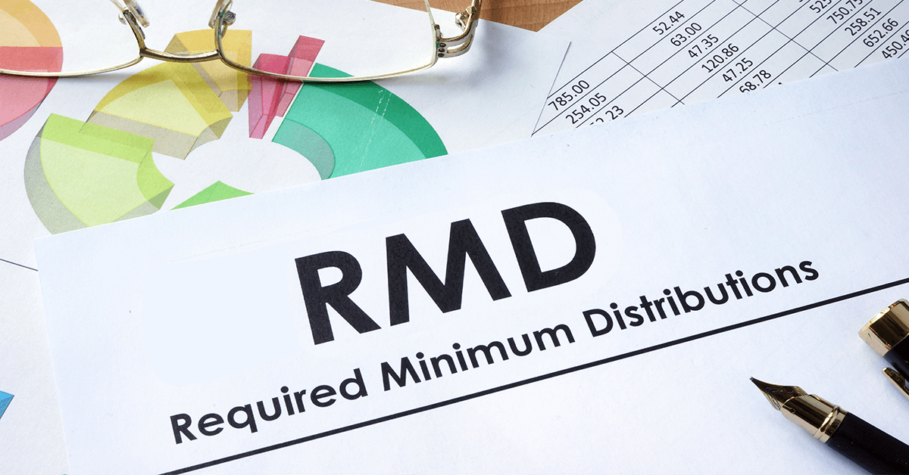
RMDs are at age 73
Required minimum distribution has moved from
72 to 73. Moves to 75 in 2032.
Notes:
The original SECURE Act changed the required minimum distribution age from 70 ½ to 72. Then the SECURE 2.0 Act pushed that age up even further, to age 73.
Distributions are required to begin by April 1st of the year after you reach 73. The legislation also set the RMD age to increase to 75 in the year 2032.

Slide 30


529 Plan Conversions
New 529 Plan Conversions
529 Plan
ROTH
IRA
Notes:
In addition to some catch up contribution allowances , another nice future feature of the SECURE 2.0 Act is the option to convert unused 529 plan funds into a ROTH IRA.
The qualifications for this are complicated, including that the 529 plan must have been in existence for 15 years of longer. After 15 years, any unused 529 plan assets can be rolled over to a ROTH IRA for the beneficiary, subject to the annual ROTH contribution limits and an aggregate lifetime limit of $35,000. This rollover will be treated as a contribution toward that person’s annual ROTH IRA contribution limit.
If you would like to see how this fits into your situation, please schedule time to talk with us.

Slide 31
Family Tax Bracket Management
Should I leave my beneficiary a Traditional or ROTH IRA?
High
Your Marginal Tax Rate is:
_____________
Marginal Tax Rate of IRA Holder
Marginal Tax Rate
Marginal Tax Rate of Beneficiary
Low
Don’t Convert to a ROTH IRA
High
Your Beneficiaries Marginal Tax Rate(s) is/are:
_____________
Marginal Tax Rate of Beneficiary
Marginal Tax Rate
Marginal Tax Rate of IRA Holder
Low
Consider a Partial or Full ROTH Conversion
Notes:
A critical area to review in tax planning for your retirement accounts is what we refer to as overall Family Tax Bracket Management.
If you have retirement assets that are not in a ROTH IRA, when and who takes distributions can make a huge financial difference from a tax standpoint.
Simply put, if you are in a higher tax bracket than your beneficiaries, then it might make sense to let them take distributions in their tax bracket rather than you in yours.
However, if your beneficiaries are in a higher tax bracket, then it might make sense to take distributions in your bracket, convert these accounts to Roth IRAs and leave them an account that still must be taken out in 10 years after your death, but can grow tax- free for up to those ten years.
A key step that we like to start with to help clients look at tax minimizing is to compare your marginal tax rate with your beneficiary's marginal tax rate(s) each year. This is something we try to think about for clients, especially those with large retirement accounts.

Slide 32
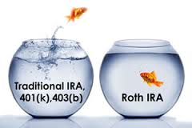
Roth IRA Conversion Benefits
Explore Roth IRA Conversion Benefits
Lowers overall taxable income long-term
Tax-free compounding
No RMDs (currently at age 73)
Tax-free withdrawals for beneficiaries
*Withdrawals from Roth IRA may be tax free if they are considered qualified. Limitations and restrictions may apply. Withdrawals prior to age 59 ½ or prior to the account being opened for 5 years, whichever is later, may result in a 10% IRS penalty tax. Future tax laws can change at any time and may impact the benefits of Roth IRAs. Their tax treatment may change. Traditional IRA account owners have considerations to make before performing a Roth IRA conversion. These primarily include income tax consequences on the converted amount in the year of conversion, withdrawal limitations from a Roth IRA, and income limitations for future contributions to a Roth IRA. In addition, if you are required to take a required minimum distribution (RMD) in the year you convert, you must do so before converting to a Roth IRA.
Notes:
Especially now with the SECURE Act’s 10-year rule, for some people, exploring a ROTH IRA Conversion could be helpful. Some benefits from Roth IRA Conversions include:
They could lower your overall taxable income long-term.
ROTH IRAs enjoy tax-free compounding.
ROTH IRAs have no RMDs (currently at age 73).
ROTH IRAS allow tax-free withdrawals for beneficiaries.
Partial or full Roth IRA conversion are not for everyone. Whether you convert part or all your traditional IRA to a Roth IRA depends on your situation. Before doing so, it is best to prepare a tax projection and calculate the appropriate amount to convert.
Like with many financial decisions, there are several pros and cons to making this change. Please call us or talk with your tax advisor to see if this makes sense for you.

Slide 33
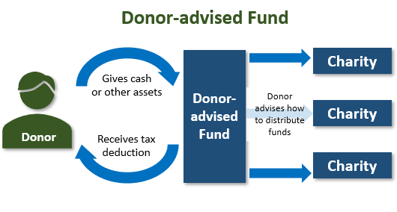
Consider Bunching Charitable Contributions
Using a Donor Advised Fund (DAF)
Donor
Donor
Example is for informational purposes only.
Notes:
For those of us who are close to the standard deduction level, a strategy to consider is “bunching” your charitable donations into a Donor Advised Fund (DAF).
For example, someone who is slightly over the standard deduction each year can “bunch” three years of charitable contributions into a Donor Advised Fund in year one. This could bring that taxpayer a much larger overall tax savings over, in this example, three years. Then from their Donor Advised Fund they can give their favorite charity money each year.
Now is the time to explore if it is helpful for your tax situation to deposit cash, appreciated securities or other assets into a Donor Advised Fund, and then distribute the money to charities over time. For more information on this strategy, call us.

Slide 34
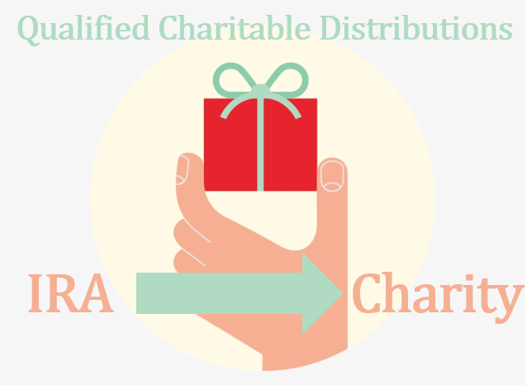
Qualified Charitable Distributions (QCD)
Qualified Charitable Distributions (QCD) are a
strategy for retirement savers.
Allowed at 70½.
Many retirement savers like to use their RMDs or part of them for QCDs.
Notes:
Qualified Charitable Distributions (QCD) can be a tax advantaged gifting strategy for retirement savers. For 2025, the maximum Qualified Charitable Distribution (QCD) is $108,000 per individual. This means that someone aged 70 1/2 or older can donate up to $108,000 directly from their IRA to a qualified charity without having to include the amount in their taxable income.
One idea that experts suggest if you are charitably inclined is to consider using part or all of your Required Minimum Distribution or “RMD” if you are over age 73 for a Qualified Charitable Distribution or “QCD”.
Like many of the other strategies we are discussing today, this is one you should see us about if you are interested in evaluating your situation.

Slide 35

Tax Law Changes
Notes:
The new administration ran with the goal of changing tax laws. Part of their discussion was to continue the favorable rates we have seen. Another part was to make changes.
Our goal today is not to speculate on what and when but to watch, learn, and help our clients when these changes come about.
During the course of this year, please be prepared to hear from us on changes and opportunities as they take place.

Slide 36

Look for our special tax report!
Helpful Information for Filing 2024 Income Taxes and Proactive Tax Planning for 2025
Notes:
Again, we believe that taking a proactive approach to your tax situation could yield better results.
One of our goals is to continually educate our clients. Please read our special tax report, or if you do not have a copy, we encourage you to request one. It offers valuable and useful information for filing your 2024 taxes as well as proactive tax planning tips for 2025.Please connect with our office and we can send this report to you or anyone you feel may benefit from this information.

Slide 37
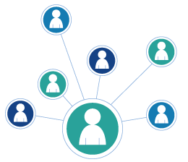
We appreciate you!
The best compliment is a referral!
Add someone to our mailing list
Invite them to attend a presentation
Notes:
We are very grateful for our clients and appreciate the opportunity to partner with you in your financial journey. We look forward to serving you in 2024.
This year, one of our goals is to help more people just like you!
The best compliment is a referral. Some of our best clients were referred to us by existing clients.
If you know someone you think may benefit from our services, we would appreciate their contact information so we can add them to our distribution list to receive our newsletters and so we can invite them to attend our presentations.
Again, thank you for your business. One of our primary goals is to keep clients informed and we appreciate you watching our update.
Please call us if you have any questions.

Slide 38
Insert registered branch office address and phone number, as well as broker-dealer identification/disclosure
The views expressed are not necessarily the opinion of Insert Broker-dealer name. Information is based on sources believed to be reliable, however, their accuracy or completeness cannot be guaranteed.
Investing involves risk including the potential loss of principal. No investment strategy can guarantee a profit or protect against loss in periods of declining values. Past performance is no guarantee of future results. Diversification and strategic asset allocation do not ensure a profit or protect against a loss. The process of rebalancing may carry tax consequences.
This information is not intended to be a substitute for specific individualized tax, legal, or investment planning advice. You should discuss any tax, legal or investment planning matters with the appropriate professional.
All indexes are unmanaged and cannot be invested into directly. Unmanaged index returns do not reflect fees, expenses, or sales charges. Index performance is not indicative of the performance of any investment. Economic forecasts set forth may not develop as predicted and there can be no guarantee that strategies promoted will be successful. International investing involves special risks such as currency fluctuation and political instability and may not be suitable for all investors.
The S&P 500 is an unmanaged index of 500 widely held stocks that is generally considered representative of the U.S. Stock market. The Dow Jones Industrial Average (DJIA) commonly known as “The Dow”, is an index representing 30 stocks of companies maintained and reviewed by the editors of the Wall Street Journal. Index performance does not include transaction costs or other fees, which will affect actual investment performance. Individual investor’s results will vary.
Contents provided by: The Academy of Preferred Financial Advisors, Inc. © 2025. All rights reserved.

