Slide 1

Quarter 3 2026
Economic Review
Presented By:
Your Name
Company
Notes:
Hello, clients and friends. This is ___________________ from __________________, and it’s my pleasure to present our third quarter economic review.
We believe an informed client is our best client. As you watch this, please keep in mind that it is a review of the third quarter, which includes the months of July, August, and September of 2026.

Slide 2

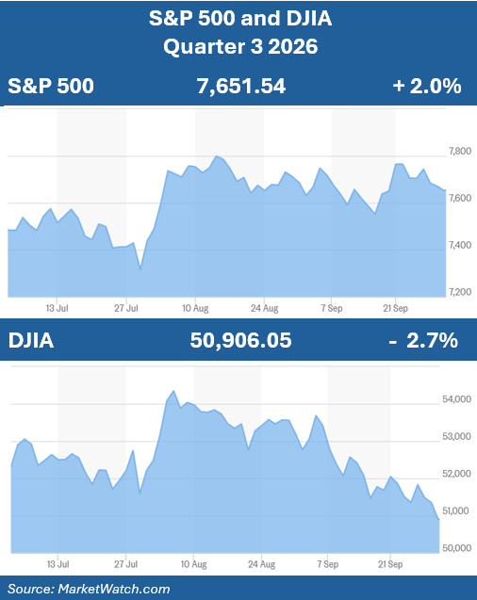
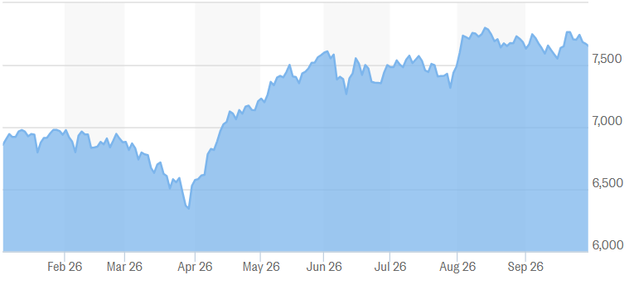
Equity Markets
3rd Quarter
January 1 – September 30
S&P 500 +12.0%
Chart Source: Marketwatch.com
Notes:
The third quarter of 2026 reinforced an important lesson for investors: even healthy markets can experience periods of heightened volatility. During the quarter, equities once again reached record levels that were fueled by strong corporate earnings, continued economic growth, and investor optimism surrounding artificial intelligence and technological innovation. However, markets also reacted to renewed inflation concerns, rising interest rates, elevated Treasury yields, and continued instability in the Middle East, which prompted increased market fluctuations as the quarter progressed.
Following strong second-quarter rebounds, the major indexes delivered mixed results during the third quarter.
The S&P 500 closed September 30 with a gain of approximately 2.0% for the quarter, which left it up over 12% for the year.
(Sources: Associated Press; Investopedia, September 30, 2026)

Slide 3
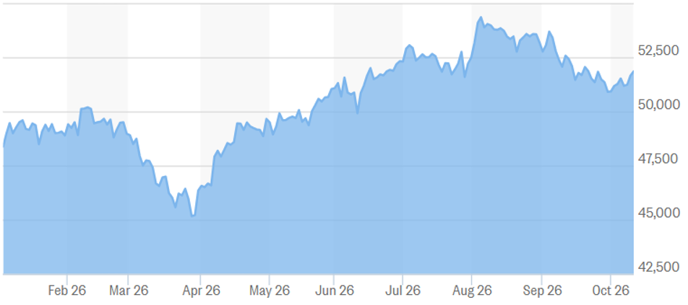
Equity Markets
3rd Quarter
January 1 – September 30
DJIA +5.9%
Chart Source: Marketwatch.com
Notes:
The other major index, the Dow Jones Industrial Average, showed a decline of 2.7% for the third quarter, but for the year, it ended September up approximately 5.9%.
(Sources: Associated Press; Investopedia, September 30, 2026)

Slide 4
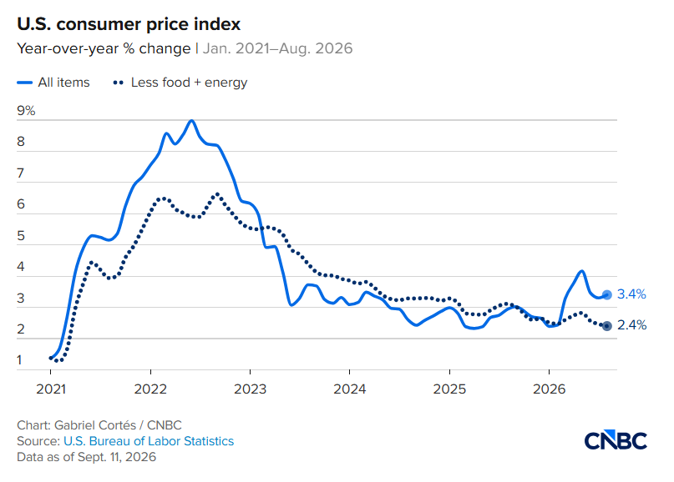
Inflation
Core CPI
January | 2.4%
February | 2.4%
March | 3.3%
April | 2.8%
May | 2.9%
June | 2.6%
July | 2.5%
August | 2.4%
Notes:
Inflation remains a key concern for investors, as rising prices continue to affect household budgets and the economic outlook.
According to the Bureau of Labor Statistics, the Consumer Price Index rose 3.4% over the 12 months ending in August. Core CPI, which excludes food and energy, increased 2.4% over the same period.
Energy prices were a significant driver of inflation. The energy index climbed 16.3% over the past year, led by a 27.4% increase in gasoline prices. In August alone, gasoline prices rose 3.9%, accounting for more than one-third of the monthly increase in consumer prices.
The Federal Reserve remains focused on bringing inflation back to its 2% target, but reaching that goal could take time. We will continue to monitor inflation trends closely and assess what they may mean for interest rates, financial markets, and your financial plan.
(Source: Bureau of Labor Statistics, September 11, 2026)

Slide 5
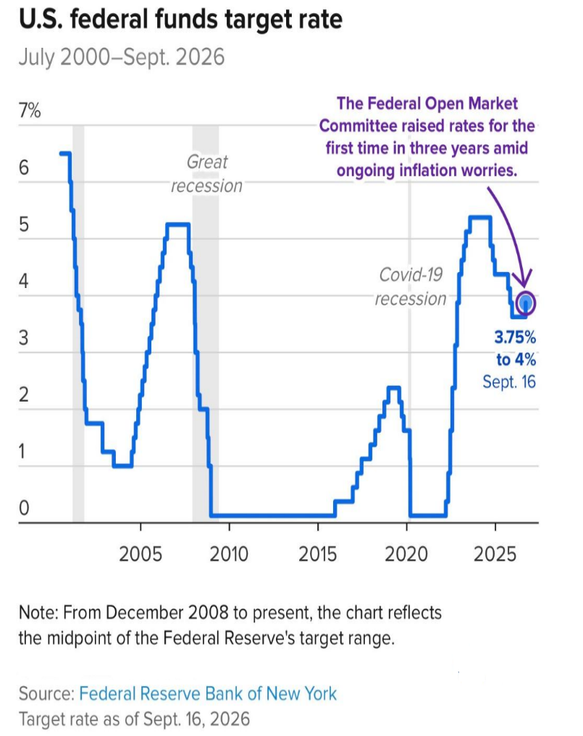
Interest Rates
2026 FOMC Meeting Dates & Interest Rate Adjustments
January | 27-28 | No Change
March | 17-18 | No Change
April | 28-29 | No Change
June | 16-17 | No Change
July | 28-29 | No Change
September | 15-16 | 3.75% – 4.0%
October | 27-28 | ?
December | 8-9 | ?
Notes:
During the first five meetings of 2026, the Federal Open Market Committee, or FOMC, held its benchmark federal funds rate steady at a target range of 3.50%–3.75%.
However, at its September meeting, the committee voted unanimously to raise the target range by 25 basis points—or one-quarter of a percentage point — to a range of 3.75% – 4.00%. This marked the first rate increase since July 2023 and reflected continued concern about inflation remaining above the Federal Reserve’s long-term 2% target.
Interest rates influence borrowing costs, savings yields, and investment decisions, making them an important consideration in your financial plan. We will continue to monitor Federal Reserve policy and keep you informed about what these developments could mean for you.

Slide 6

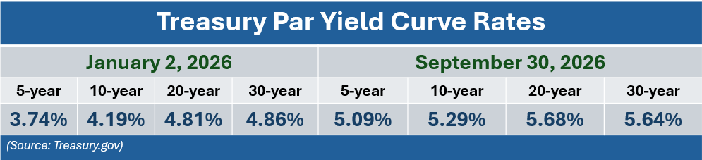
Bond Market & Treasury Yields
Source: Treasury.gov
Notes:
U.S. Treasury yields rose during the third quarter of 2026 as persistent inflation, higher energy prices, and resilient economic activity shaped expectations for interest rates. The Federal Reserve’s September rate increase pushed shorter-term yields higher as investors weighed the possibility of another increase before year-end.
On September 30, the 10-year Treasury yield stood at 5.29%, the 5-year yield at 5.09%, and the 30-year yield at 5.64%.
Looking ahead, inflation and Federal Reserve policy will remain key drivers of bond performance. Falling interest rates generally support existing bond prices, while rising rates generally put downward pressure on them.
We will continue to monitor these developments as part of your overall investment strategy. Remember, diversification can help manage risk, but it does not ensure a profit or protect against loss.
(Source: U.S. Department of the Treasury)

Slide 7
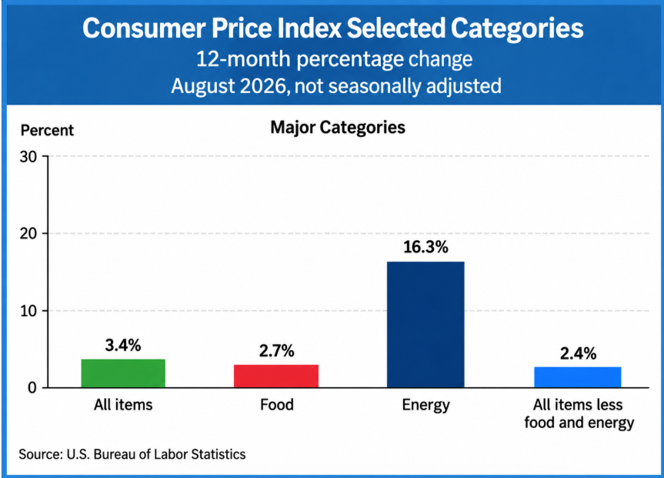
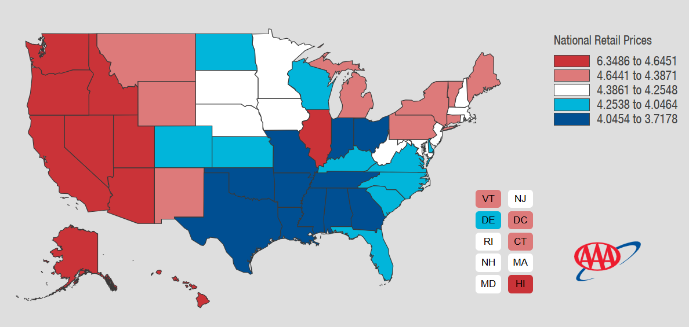
Inflation - Energy
As of 10/8/26
Notes:
Energy prices continued to strain household budgets during the third quarter of 2026. According to AAA, regular gasoline averaged $4.33 per gallon nationally in September, surpassing the previous September record of $3.83 set in 2023. Prices eased toward quarter-end but remained unusually high for the season.
Developments in the Middle East remain a key influence on global oil supplies, energy prices, and investor sentiment. We will continue to monitor their potential effects on inflation and financial markets.
(Source: AAA.com)

Slide 8
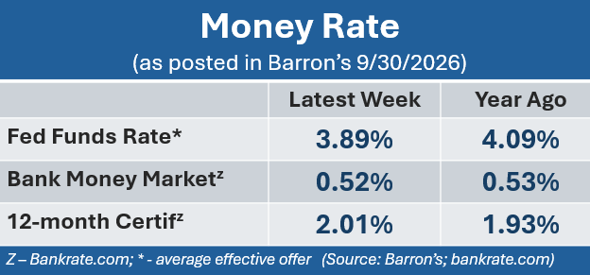
Cost of Safety
Notes:
Safety still comes at a cost, and sadly, many major banks are still only offering low interest rates to savers.
According to Barron’s, the average bank money market rate on September 30, was 0.52%, and the average 12-month CD rate was 2.01%.
For anyone who is interested in exploring sources of better interest rates, please contact our office.

Slide 9
Key Takeaways
Volatility remains. Equities continued to be resilient.
Strong corporate earnings and AI continue to support equity markets.
The Fed raised its target rate to 3.75 – 4.00%.
Inflation numbers remain elevated.
Treasury yields increased.
Notes:
Looking ahead, we remain cautiously optimistic. Strong earnings expectations for the upcoming quarter gives investors a reason for confidence, although persistent inflation, higher interest rates, and geopolitical uncertainty could lead to further market volatility.
Key takeaways from the third quarter are:
• U.S. equities reached record highs before volatility increased in September.
• Strong corporate earnings and continued enthusiasm for AI and technology supported market gains.
• The Federal Reserve raised its target rate to 3.75%–4.00%, reflecting continued concern about inflation.
• Higher energy and gasoline prices added to inflation and strained household budgets.
• Rising Treasury yields and oil prices put pressure on bond prices, borrowing costs, and parts of the stock market.

Slide 10
Key Takeaways
We will continue to monitor key economic indicators.
Focusing on your long-term goals and following a well-
guided plan can help you stay grounded and confident
during these times of uncertainty.
We are here for you!
Notes:
As always, we will continue to monitor key items that could continue to fuel volatility, including oil prices, the path of inflation and interest rates, and geopolitical uncertainty.
And finally, as a reminder, focusing on your long-term goals and staying the course of a disciplined, diversified, and long-term investment strategy remains especially important during periods of heightened uncertainty.
We are here for you. Please reach out with any questions or concerns—your financial well-being is always our priority.

Slide 11
Insert registered branch office address and phone number, as well as broker-dealer identification/disclosure
The views expressed are not necessarily the opinion of Insert Broker-dealer name. Information is based on sources believed to be reliable, however, their accuracy or completeness cannot be guaranteed.
Investing involves risk including the potential loss of principal. No investment strategy can guarantee a profit or protect against loss in periods of declining values. Past performance is no guarantee of future results. Diversification and strategic asset allocation do not ensure a profit or protect against a loss. The process of rebalancing may carry tax consequences.
This information is not intended to be a substitute for specific individualized tax, legal, or investment planning advice. You should discuss any tax, legal or investment planning matters with the appropriate professional.
All indexes are unmanaged and cannot be invested into directly. Unmanaged index returns do not reflect fees, expenses, or sales charges. Index performance is not indicative of the performance of any investment. Economic forecasts set forth may not develop as predicted and there can be no guarantee that strategies promoted will be successful. International investing involves special risks such as currency fluctuation and political instability and may not be suitable for all investors.
The S&P 500 is an unmanaged index of 500 widely held stocks that is generally considered representative of the U.S. Stock market. The Dow Jones Industrial Average (DJIA) commonly known as “The Dow”, is an index representing 30 stocks of companies maintained and reviewed by the editors of the Wall Street Journal. Index performance does not include transaction costs or other fees, which will affect actual investment performance. Individual investor’s results will vary.
Contents provided by: The Academy of Preferred Financial Advisors, Inc. © 2026. All rights reserved.

Slide 12

We appreciate you!
Please feel comfortable sharing this update
with others!
Thank you!
Notes:
Once again, thank you for your trust in us. One of our main objectives is to keep our clients informed, and we appreciate you taking the time to watch this update.
Thank you for watching this update and please feel comfortable sharing it with anyone else you think can benefit from it.

